Slide 1
Cost Transfers
As explained by your friendly neighborhood OSP Team

Slide 2
Cost Transfers (aka Expenditure Transfers) are the process of transferring expenses from one project to another.
Cost transfers are occasionally needed if an expense has initially posted to one project, but actually belongs to another. These transfers are typically scrutinized very thoroughly by auditors and can result in material findings if not done correctly. Therefore it is very important to ensure they are processed and documented properly. But OSP is here to help!!
The What
The Why

Slide 3
The When: when cost transfers are acceptable or unacceptable Per Federal Uniform Guidance, expenses “…may not be shifted to other sponsored agreements in order to meet deficiencies caused by overruns or other fund considerations, to avoid restrictions imposed by or by terms of the sponsored agreement, or for other reasons of convenience.”
Acceptable
Unacceptable
The administrator misunderstood the PD/PI’s instructions on how to allocate the cost.
The PI/PD has multiple funding sources for the same project and he/she provided the wrong account number to charge.
To move a cost overrun to a non-sponsored account (e.g. to a Campus Program "86xxx" project)
To transfer costs to cover a deficit on another award / sponsored project.
To transfer costs to spend the balance of an award / sponsored project.

Slide 4
The How
Forms (because we all love them)
Requestor completes:
OSP Review (because that’s what we do)
Transfer is Processed (Boom shaka-laka!!)
Once the SPA approves both forms, they will either return them to the requestor to submit to Auxiliary Accounting, or the SPA may simply submit it themselves as a courtesy (cc’ing the requestor)
Additional Cost Justification Form (located at https://www.csusm.edu/corp/sponsoredprojects/osp_pol_forms.html)
Expenditure Transfer Form (located at https://www.csusm.edu/corp/businesssrvcesandfinance/policies_proc_forms/index.html)
Requestor submits both forms to the assigned Sponsored Project Analyst (SPA) for review
Requestor DOES NOT submit the Expenditure Transfer Form without OSP review and approval
Auxiliary Accounting then processes the form while we all bask in the glory of having followed the correct process
PI signs and approves the forms

Slide 5
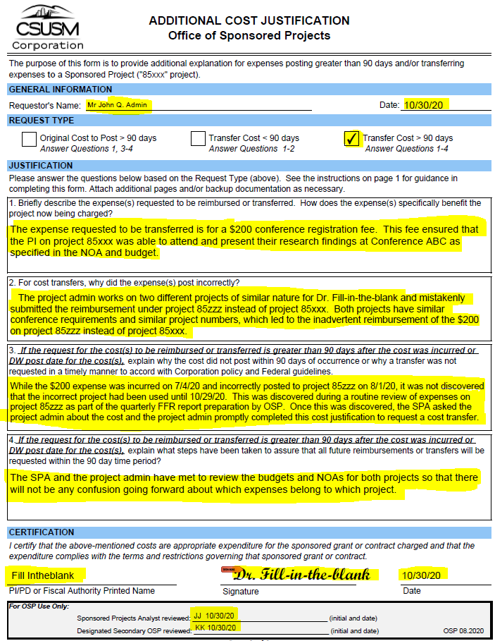
Additional Cost Justification Form
Required for all cost transfers
Explains the background of the transfer to document allowability and ensure audit compliance
Required for all expenses over 90 days old
Explains why the cost did not post within the required 90 days of being incurred, to ensure timeliness standards are adhered to.
Alignment of OSP and PI approvals
Documents the signature approval of the cost transfer and its subsequent explanation by the PI and OSP

Slide 6
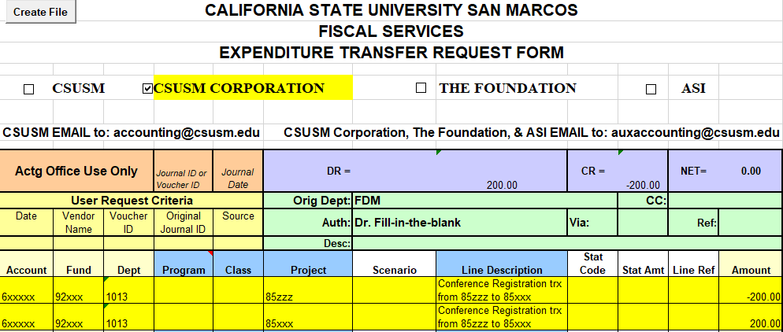
Expenditure Transfer Form
Required for all cost transfers
Provides the chartfield string, amount, and line description of the expense being transferred so that Auxiliary Accounting can correctly process the transfer in our system.
Back-up Documentation
Include an export from Data Warehouse showing the transaction details of the incorrect expense that is being requested to be transferred.

