Slide 1
Marketing
CSUSM Corporation

Slide 2
Information Gathering
What information are we looking for?
New Grants
Research Topics
Awards, Recognition, Accolades
Discoveries
Where will it be shared?
CSUSM Corporation social media
CSUSM Corporation Website
Email
jtemnick@csusm.edu

Slide 3
Gift Cards
CSUSM Corporation

Slide 4
Process Updates
Storing electronic gift cards
Revised Exemption process
Added a chart to the procedures detailing the approvers
Reminders
Employee and Student recipients

Slide 5
Form Information
Details are filled out in Microsoft Forms
Important things to remember about the form
Purpose and Mission
IRB
Chartfield
Approvers (Supervisor v. Fiscal Authority)
Signatures/Approvals are completed in Adobe Sign
Once filled out in Microsoft Forms – Requesters will get an email prompting them to attach documents and begin the routing process
Anyone can attach document
Requesters can check the status of their request in Adobe Sign

Slide 6
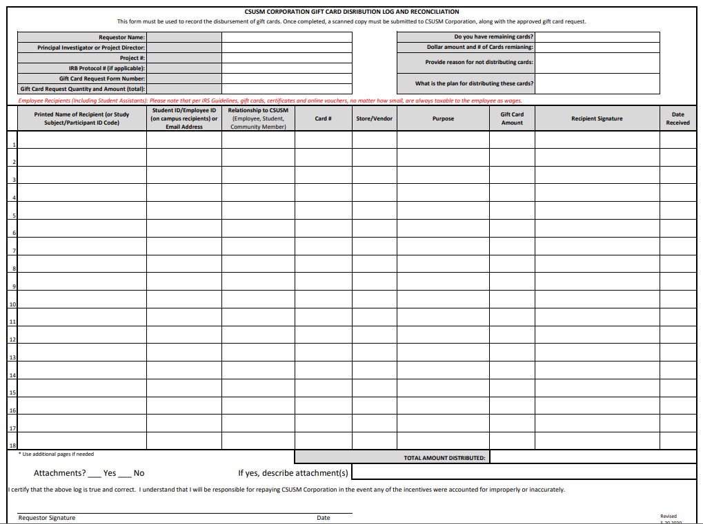
Distribution Log

