Slide 1
EOP History
The landscape of the 1960’s provided the ground work for the founding of the Educational Opportunity Program and explains why the program is so important yesterday, today and for the future.

Slide 2
Rosa Parks
An icon of the civil rights struggle in the years after the Montgomery boycott, a symbol of resistance against injustice.
Known as the “First Lady” of the Civil Rights Movement.

Slide 3
Greensboro Four
While not the first sit-ins of the civil Rights Movement, the Greensboro sit-ins were an instrumental action, leading to increased national sentiment at a crucial period in US history.
The primary event took place at the Woolworth store in Greensboro, NC and was led by four freshman from North Carolina A&T University.
The site of the store is now the international Civil Rights Center and Museum.

Slide 4
An outgrowth of the Civil Rights Movement, the Student Rights movement began when students who had participated in the Civil Rights marches brought that same activism right back to the college campuses.

Slide 5
Students along with adults wanted to gain back the land that was lost.
They wanted the restoration of historic land and wanted the right to use the land as they pleased for agriculture.

Slide 6
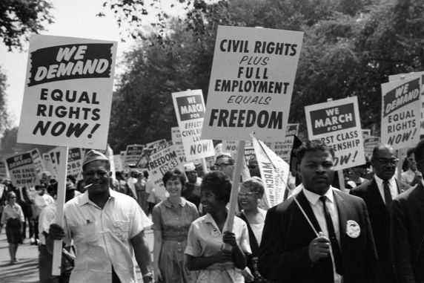
Too often we forget that America has not always enjoyed its position as a human rights watchdog.
Only a few generations ago, Americans were legally segregated with women and African-Americans barred from the voting booth.

Slide 7
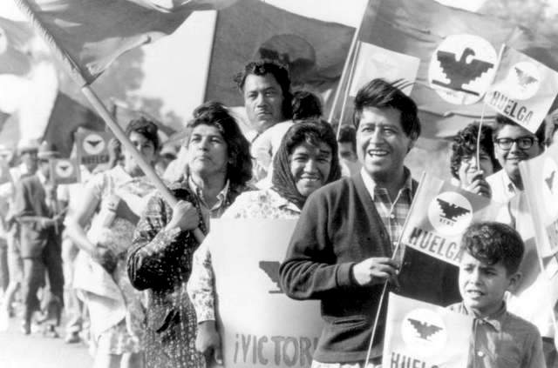
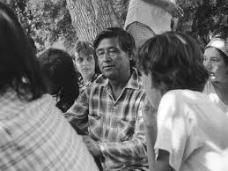
In the 1960s and 1970s a generation of Mexican Americans, frustrated by persistent discrimination and poverty, find a new way forward, through social action and the building of a new “Chicano” identity.
The movement is ignited when farm workers in the fields of California, led by Cesar Chavez and Dolores Huerta.

Slide 8
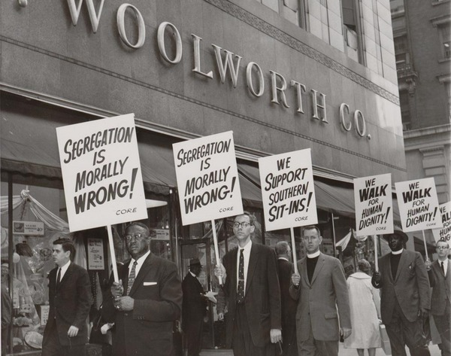
The Greensboro sit-ins included activity outside the lunch counter. Everyday people marched outside the stores.
In this photograph from April 14, 1960, the picketers were mostly ministers from a church committee that organized a protest of Woolworth policies in conjunction with the Congress of Racial Equality.

Slide 9
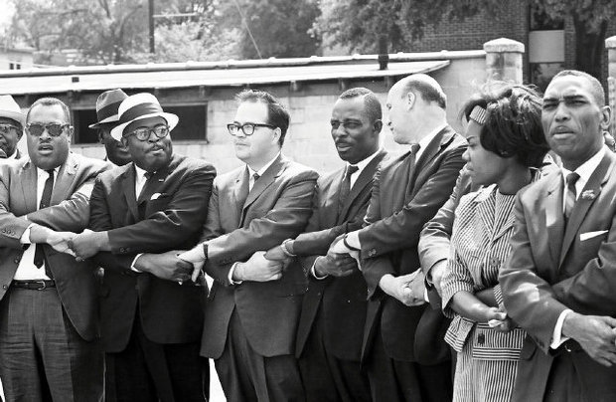
Marchers hand-in-hand Americans demand racial equality on a civil rights demonstration.

Slide 10
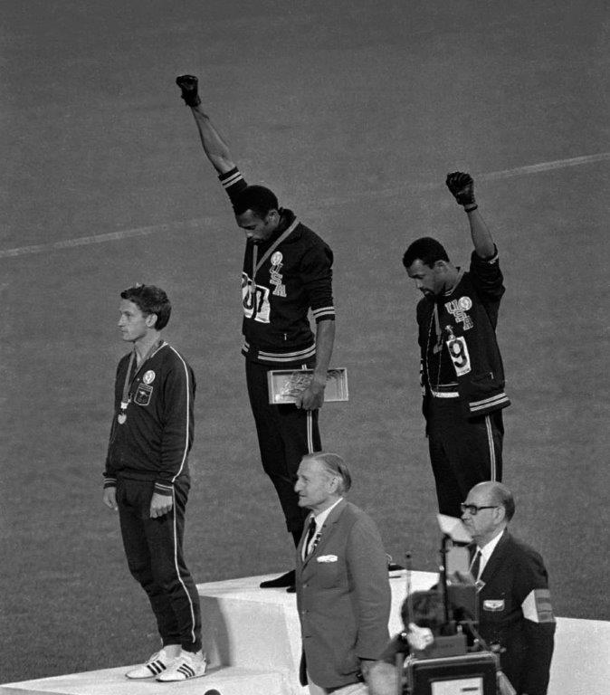
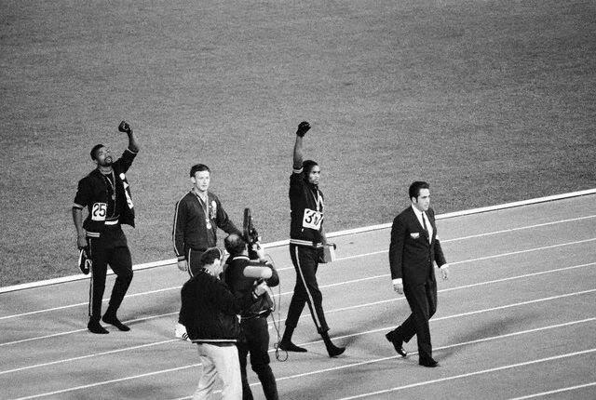
The 1968 Olympics Black Power Salute was a political demonstration organized by African-American athletes John Carlos and Tommie Smith during the 1968 Olympic medal ceremony.
They each raised a black-gloved fist as they turned to face their flags and hear the national anthem.
These athletes said that this wasn't a Black power salute, it was a human rights salute.

Slide 11
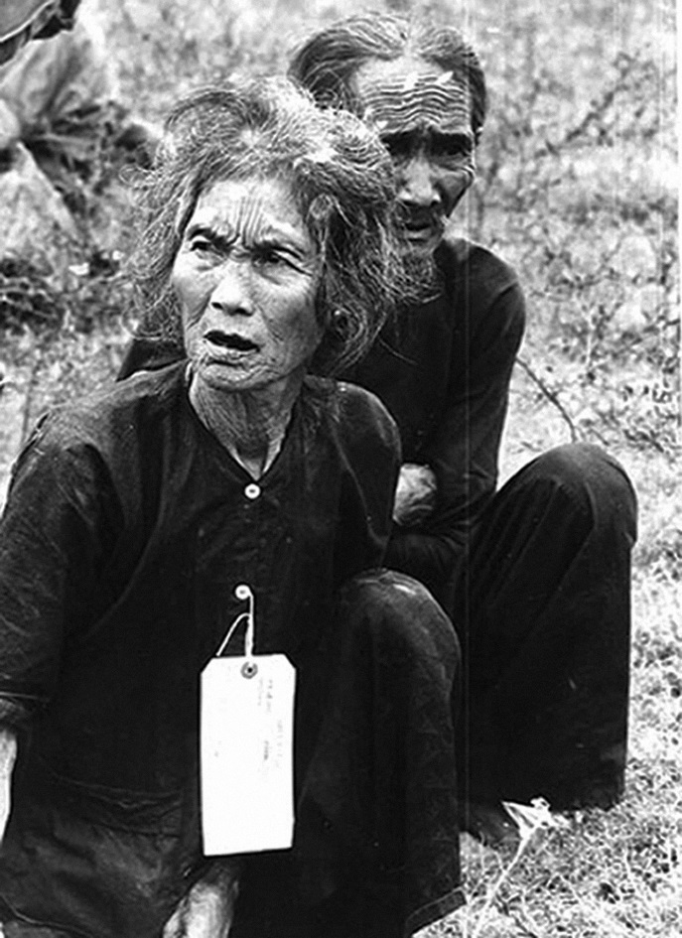
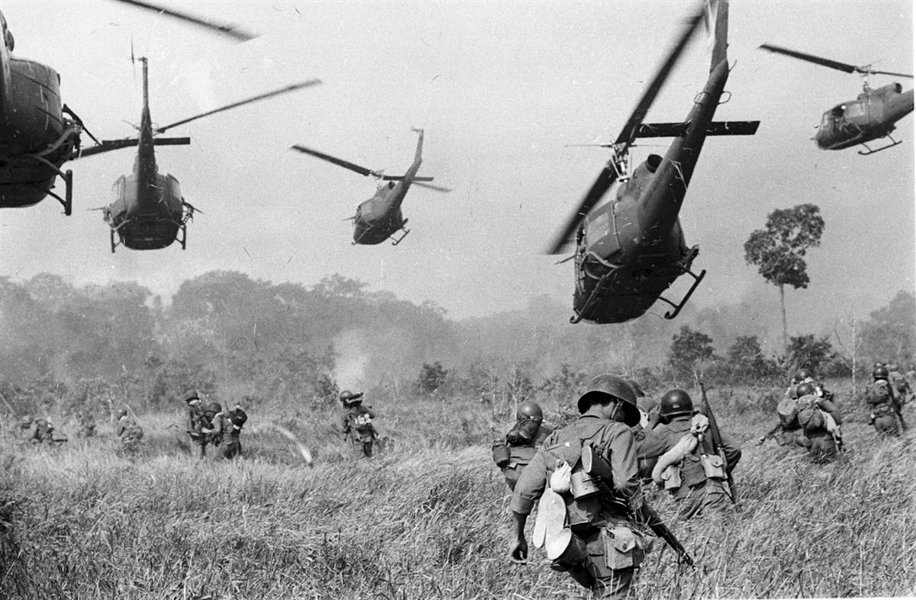
Vietnam War
1963-1972

Slide 12
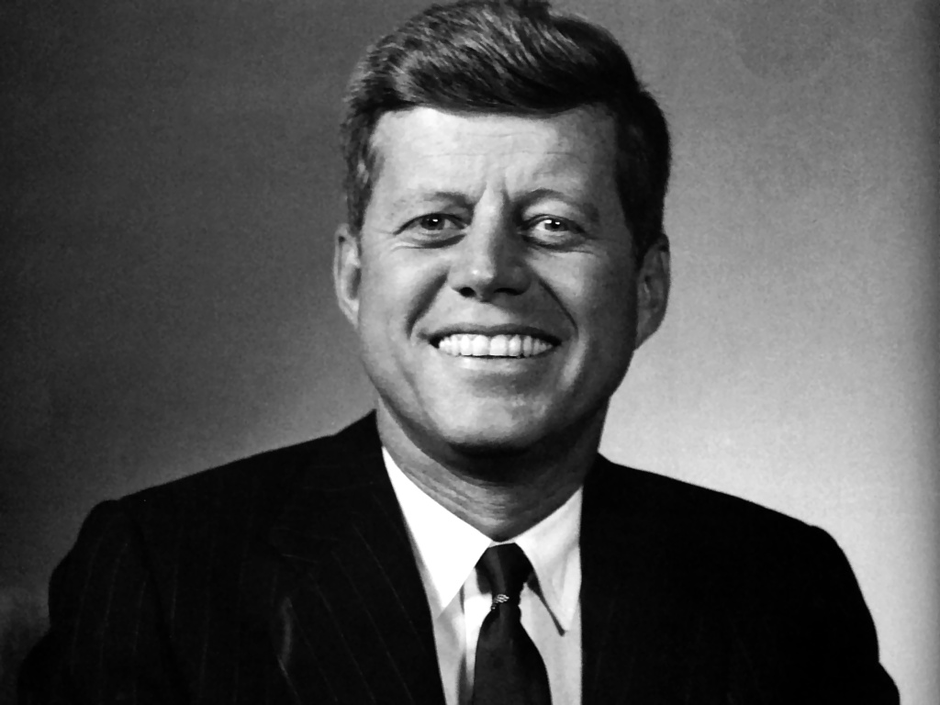
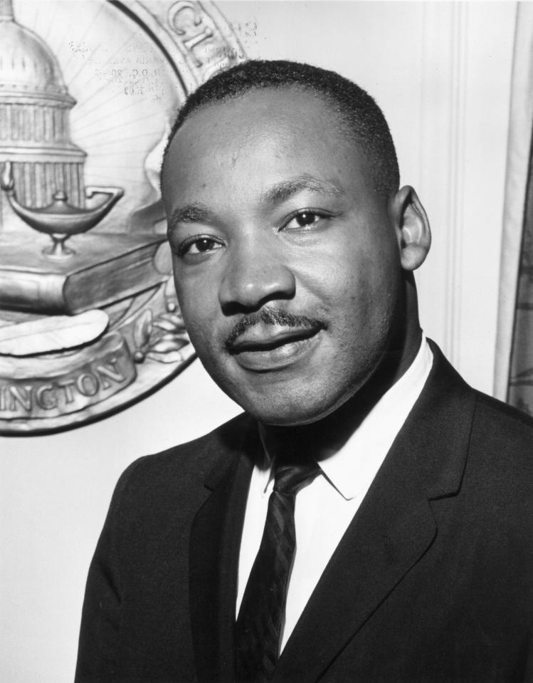
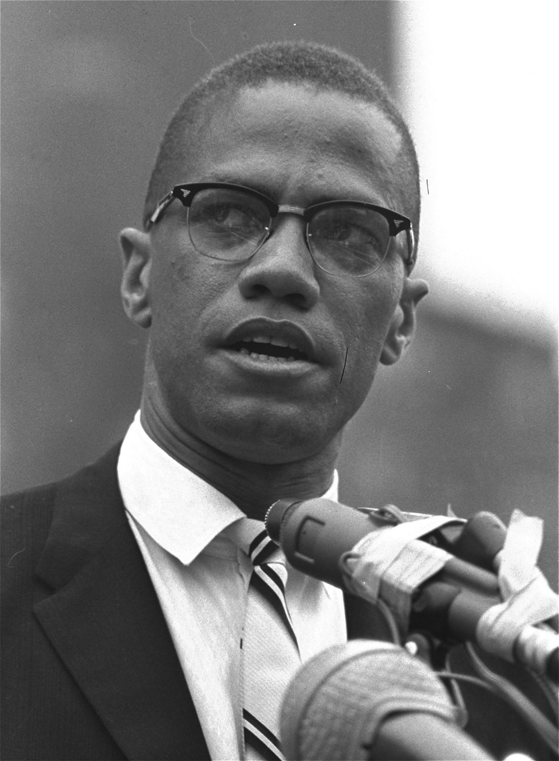
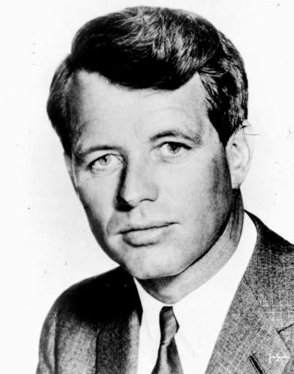
More Major Events:
Death of Martin Luther King, Malcolm X, John F. Kennedy and Robert F. Kennedy
Apollo Eight flight around the moon

Slide 13
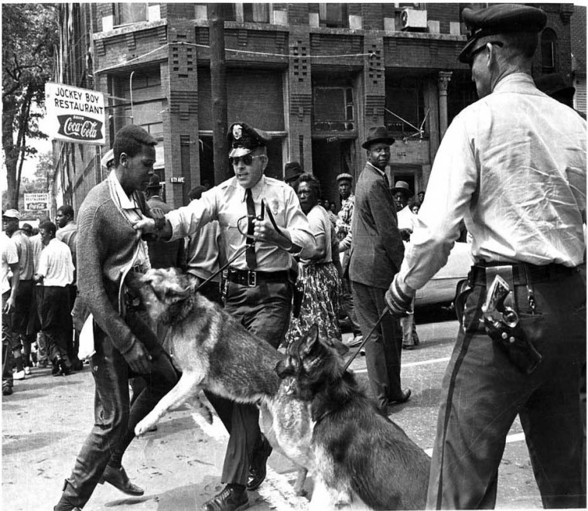
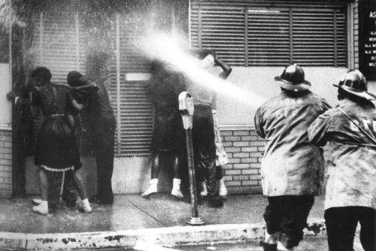
Birmingham Campaign 1963: Protesters were met with fire hoses.
Firefighters turn their hoses full force on civil rights demonstrators July 15, 1963 in Birmingham.
Parker High School student Walter Gadsden being attacked by police dogs in Birmingham, Alabama on May 3, 1963

Slide 14
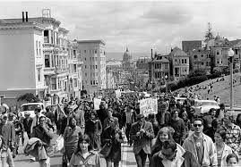
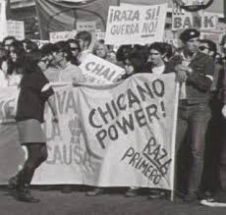
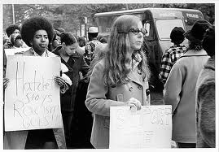
EOP: It began with students…
The Civil Rights movement of the 1960’s inspired many college students to play an active role in changing the educational system.
Poverty, discrimination, and other socio-economic barriers began to be linked to the lack of higher education opportunities for many minority and economically disadvantaged students.

Slide 15
History of EOP
Fall 1967
Cal State L.A.
Black/African American and Mexican American/Chicano students questioned access to higher education and access to quality jobs.
Minority Student Association formed
Black Student Association (BSA) and United Mexican American Student Association (UMASA) formed on Cal State L.A. campus
BSA & UMASA discover 2% rule
2% of entering students are allowed to enter the university without meeting all or even any of the universities requirements.
2% rule a loophole for athletic recruitments not academic admissions.

Slide 16
History of EOP
Spring 1968
San Francisco State University student strike & protest
Five-month strike, the longest student led strike in history.
Strike Demands
Special admissions program for underrepresented students of color.
400 slots for special admits
Create six to seven faculty positions for the special admit students.
Demand for Ethnic Studies curriculum
Most demands met, university actually hired about four or five new faculty.
April 1969
Harmer Bill (SB 1072) provided institutionalized funding source for EOP

Slide 17
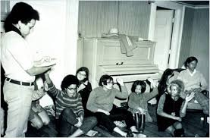
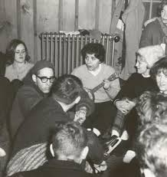
Early criteria for EOP (SB 1072)
Historic economic and/or Educational disadvantage
Underrepresented populations
African American
Mexican American
Native American
First generation in college

Slide 18
Today the criteria is:
History of Financial Disadvantage
First generation in college
Educational/Environmental Disadvantage
Low performing high school
Unprepared for college
From an inner city neighborhood
Low test scores

Slide 19
EOP Impact in the last 40+ years?
For 45 years EOP has been providing educational access and opportunity to more than 250,000 economically and educationally disadvantaged students throughout California, the majority of whom are first generation college students.
Over 200,000 EOP students have graduated from the CSU system.

Slide 20
EOP CSUSM Mission
“The mission of EOP is to provide access, retention support services, and lifelong skill development for historically underrepresented, financially disadvantaged and first generation students that will lead to their bachelor’s degree.”

