Slide 2
Mission of Civility Campaign
The mission of the Civility Campaign is to engage CSUSM students, faculty, and staff in learning opportunities to create a community that navigates social justice issues and multiple perspectives through self-reflection, care, respect, and empathy while acknowledging the culture and humanity of others.

Slide 3
Definition of Civility at CSUSM
Civility is conducting oneself with self-reflection, care, respect, and empathy while acknowledging the culture and humanity of others.

Slide 4
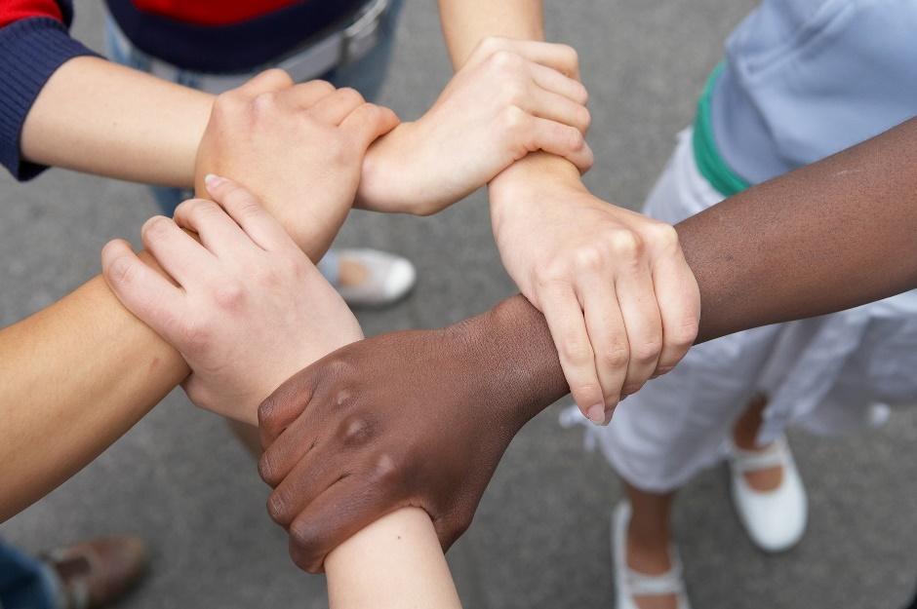
Community Agreements
Express your experience in a clear, respectful, and honest way.
Aim to build trust with the people you are engaging.
Listen to understand, not to defend or argue your own opinion.
Ask questions and seek clarification when needed.
Notes:
Make notes more explicit to explain concepts or revisit own.

Slide 5
Community Agreements
Have an open mind and invite the opportunity to learn, even if you do not agree.
Use “I” statements and speak from your own experience.
Lean into discomfort; discomfort can mean that your mind is working intensely to learn and understand.
Brave space – vulnerability is a sign of strength and a desire to grow as a person!
Notes:
Make notes more explicit to explain concepts or revisit own.

Slide 6
Civil discourse is not…
Everyone agreeing or having the same opinion
Avoiding difficult conversations with diverse perspectives
Notes:
As we engage in discussion and cover different training topics, we realize we all have different experiences and options.
While some view civil discourse as shutting down dialogue and disagreement, this slide is intended to address the “myths” about civility and civil discourse.
Staff may want to provide examples of incivility here, such as:
Interrupting others
Raising your voice at someone
Texting in training and not listening
Putting up a wall or “checking out” when disagreement occurs ; completely shutting down because of the disagreement/opinion
Dominating the discussion without listening to others

Slide 7
Civil discourse is…
Trying both to understand and be understood
Trying to uncover multiple perspectives rather than becoming entrenched in either/or thinking
An integral aspect of the learning process
Notes:
Civil discourse includes both speaking up and sharing one’s opinion, AND listening to others’ perspectives
Civil discourse helps students learn from one another and think about topics from a different perspective
Much like the students you will work with, your training experience is much more rich with a variety of experiences/points of view. You will be working with a diverse group of students in ______. Wouldn’t it be great to practice understanding and listening to points of view different from your own?

