Slide 1
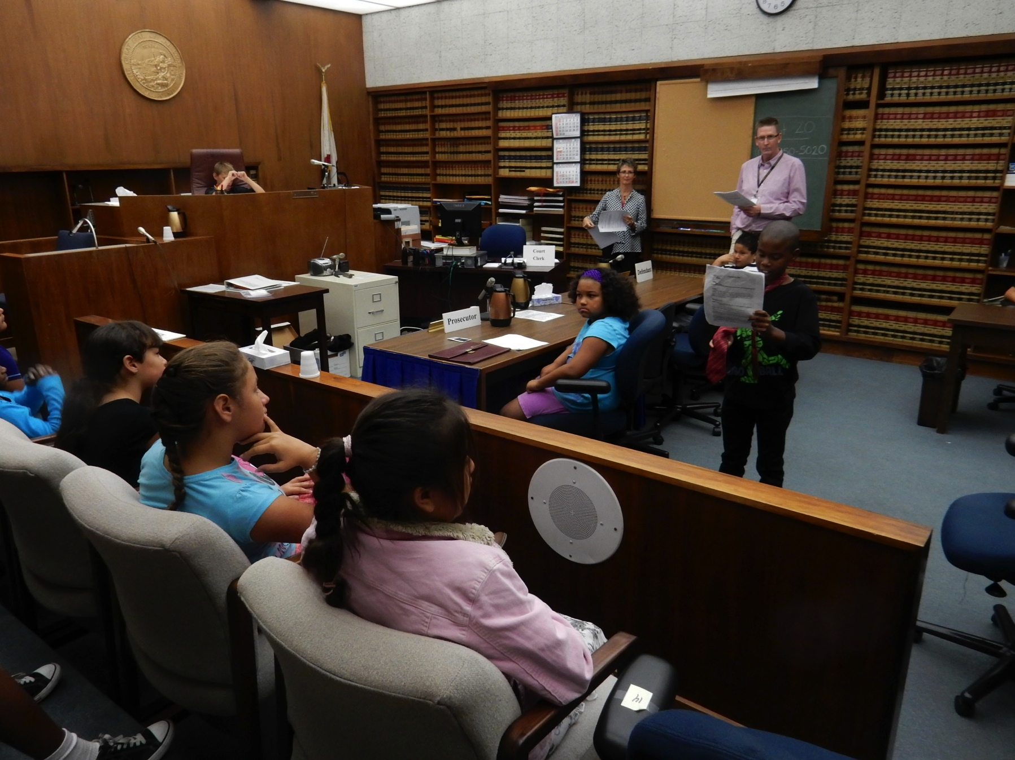
Courtroom Diagram
Notes:
Many courtrooms look like the above. The Judge’s chambers are the offices for him/herself and the court clerk and they are not shown in this picture. You see the judge up above (reviewing his work). The jury members are on the left (not seen). The prosecuting attorney is in the blue shirt, looking at the jury, and the defense attorney is standing and speaking to the jury. There is not a witness on the “stand” at this time. The court clerk is usually at her desk, helping with the details of the trial (over to the right side of the judge) and the court reporter, who types everything that is said during the trial would be in that area as well. The bailiff is not seen in this picture, but is over to the right side (you can see part of his desk).

Slide 2
Quiz Show Vocabulary Introduction
Notes:
We will learn some of the vocabulary of the court today. It will be important to know who plays what part in the legal process.

Slide 3
An attorney is called a lawyer and a counselor.
Notes:
An attorney helps people, whether they are accused of a crime or accusing someone else. The prosecuting attorney helps the Plaintiff – the one complaining and bringing forth the lawsuit. The defense attorney, represents the defendant – the person defending themselves in a trial.

Slide 4
The defendant is the person accused of a crime.
Notes:
The defendant is the one who is defending him or herself with the help of an attorney.

Slide 5
In a trial, what is the person called who has made the complaint?
The Plaintiff
Notes:
The attorney who represents the Plaintiff is the Plaintiff’s Attorney or Prosecuting Attorney. The one complaining is the plaintiff (easy way to remember).

Slide 6
When an objection is overruled, the judge has decided…
That a rule has not been broken
Notes:
Attorney’s can “object”, or question whether something can be said or used in a trial, or if the way the other attorney is questioning someone is not within the rules. If the judge says, Overruled – it means that the rule has not been broken and the objection itself was “overruled”. The attorney moves on.

Slide 7
When the judge agrees that a rule has been broken during the trial, he or she says the objection is….
Sustained
Notes:
When the judge says, Sustained, following an objection by one of the attorneys it means that the judge agrees that a rule has been broken by the attorney who is doing the questioning. The question must be dropped or changed.

Slide 8
The Rule of Law means
Decisions in a trial must be made by using the law as a guide. The rules must be followed the same way for everyone. The judge and jury must be impartial.
Notes:
This is the basis for the judicial branch of government…judges cannot make decisions based on personal opinions and all interpretations must be based on Constitutional law. The jury is also responsible for looking at all of the facts and details in a case and following the Jury Directions given by a judge. The directions explain the law for this case.

Slide 9
What is due process?
The time you are “due” in court as a citizen
The processing of your court case
Legal rights that must be followed for all persons
The process of being told your rights
All of the above
Notes:
Follow up: Due process is part of the Rule of Law. Legal rights must be followed for everyone.

Slide 10
Burden of proof means:
The prosecution has the burden of proving the guilt of the defendant.
The defendant must prove his/her innocence.
The defense attorney must prove the defendant is not guilty
The judge must have proof.
It is a burden to prove innocence.

Slide 11
Impartiality means:
The defendant broke part of the law.
A juror (person serving on the jury) may be partially sure when making a decision.
The defendant is partially guilty of the crime.
The witnesses have some information about the case.
The judge and jury must follow the rule of law, and may not make decisions based on personal feelings.

Slide 12
Match the title to the role in court:
Judge
Assists the judge
Court Reporter
Citizens who decide the case
Jury
Referee and guide
Bailiff
Types every word in trial
Court Clerk
Police Officer in court

