Slide 1
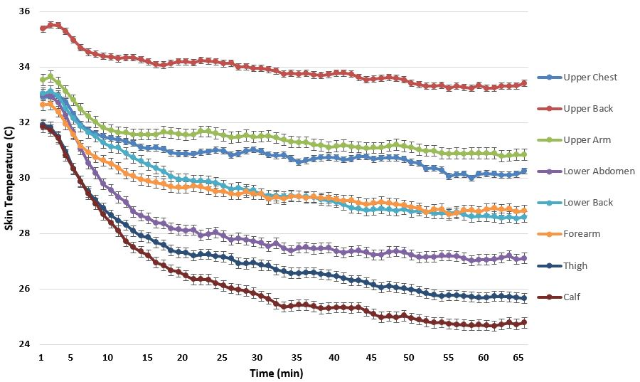
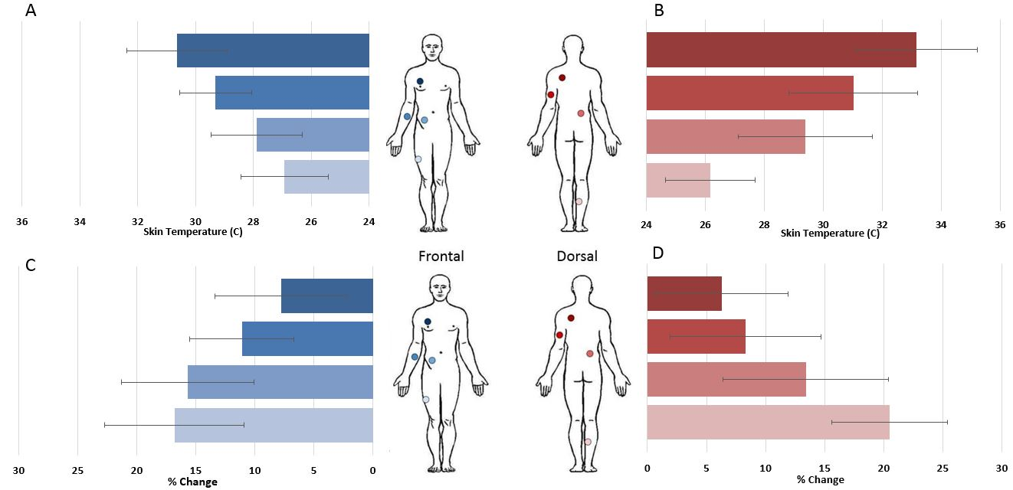
Characterization of Regional Skin Temperatures in Recreational Surfers Wearing A Wetsuit
Luis J. Corona¹, Jean C. Aguilar¹, Vladymir Kuryshko¹, Grant Simmons², Jeff A. Nessler¹, Sean C. Newcomer¹
¹Department of Kinesiology, California State University San Marcos, CA.
²Department of Medical Pharmacology and Physiology, University of Missouri School of Medicine, Columbia, MO.
Abstract
Results
Characteristic Results
Background: The dynamic nature of surfing exposes the body to variable rates of convective heat loss through both water and air. Currently, there is a paucity of research regarding the thermoregulatory responses to prolonged partial submersion in seawater while surfing. Purpose: The purpose of this study was to investigate skin temperatures across surfers’ bodies while wearing a wetsuit during recreational surfing. Methods: Forty-seven male recreational surfers were recruited and agreed to participate in this study (Age: 30.6±9.3 years, Height: 1.78±0.07 m, Weight: 77.4±7.6 kg, Years surfed: 14.1±10.1 years). Participants were instrumented with eight wireless iButton thermal sensors [chest, back, lower abdomen, lower back, arm, forearm, thigh and calf], a Polar RCX5 heart rate monitor, and a custom 2mm full wetsuit. Skin temperature and heart rate measurements were sampled at 1-minute intervals. Environmental conditions were obtained for each surf session using information from the National Oceanic and Atmospheric Administration. Following instrumentation, participants were instructed to engage in recreational surfing activities as normal, with the duration of each session determined by the individual. Results: Significant differences (p<0.001) in mean skin temperature were found across the body (chest: 30.7±1.6°C, back: 33.6±1.5°C, lower abdomen: 27.9±1.6°C, lower back: 32.7±2.2°C, arm: 31.3±2.1°C, forearm: 29.4±1.2°C, thigh: 27.0±1.6°C, and calf: 26.1±1.6°C) while wearing a wetsuit during recreational surfing. In addition, within session changes in skin temperature were significant for several regions of the body (p<0.001), and the magnitude of these changes varied significantly between regions (chest: 7.8±5.6%, back: 6.3±5.6%, lower abdomen: 15.7±5.6%, lower back: 13.4±7.0%, arm: 8.3±6.4%, forearm: 11.1±4.4%, thigh: 16.8±5.9%, calf: 20.5±4.9%). Conclusion: These data are the first to demonstrate that significant differences exist in skin temperature across the body while wearing a wetsuit during an average recreational surfing session. These findings may have implications for wetsuit design.
Water temperature (C°) | Air temperature (C°) | Wind speed (kts) | Wind direction (°) | Wave size (ft.) | Wave direction (°)
16.0 ± 0.8 | 18.7 ± 2.6 | 4.4 ± 2.8 | 197.6 ± 78.2 | 3.0 ± 0.7 | 249.3 ± 36.9
 | Mean | ±SD | Range
Age, years | 30.6 | 9.3 | 18-57
Height, m | 1.78 | 0.1 | 1.5-1.9
Weight, kg | 77.4 | 7.6 | 61-90
Surf Experience, years | 14.1 | 10.1 | 1-40
Heart rate, bpm | 136.3 | 13.7 | 106-166
Session duration, min | 81 | 31 | 40-149
Table 1. Summary of environmental conditions during recreational surfing sessions. Data expressed in mean ± SD.
36
34
32
30
28
26
24
Chest
Back
Arm
Lower Abdomen
Lower Back
Forearm
Thigh
Calf
Table 2. Summary of subject characteristics expressed in mean ± SD and Range..
Discussion
Skin Temperature (C°)
There are regional differences in mean skin temperatures throughout an average 65-minute recreational surf session while wearing a wetsuit (Figure 1).
Significant differences (p<0.001) in mean skin temperature were found across the body while wearing a wetsuit during recreational surfing (Figure 2).
Within session changes in skin temperature were significant for several regions of the body (p<0.001), and the magnitude of these changes varied significantly between regions (Figure 2).
These data demonstrate differences in skin temperatures of recreational surfers wearing a wetsuit, which may have significant implications for wetsuit design within the surf industry.
Background
Despite the increase in popularity of surfing as a recreational sport (Loveless & Minahan, 2010), there is a paucity of research on the physiological aspects of surfing; more specifically, the thermoregulatory responses to prolonged partial submersion in seawater.
The dynamic nature of surfing (Meir et al., 1991; Farley et al., 2012) likely causes the upper and lower body to lose heat at different rates, in part because of the difference in thermal conductivity between water and air.
Although evidence shows that wetsuits assist with thermoregulation (Wakabayashi et al., 2008; Naebe et al., 2014; Riera et al., 2014), regional skin temperatures differ across the body in thermoneutral environments and adjust during exercise as a thermoregulatory response (Fernandes et al., 2016).
1 5 10 15 20 25 30 35 40 45 50 55 60 65
Time (min)
Figure 1. Mean regional skin temperatures throughout an average surfing session. Data represented in mean ± SD.
References
Purpose
Chest
Forearm
The purpose of this study was to investigate skin temperatures across surfers’ bodies while wearing a wetsuit during recreational surfing. Due to the more frequent immersion of the lower body in water during a typical surfing epoch, it was hypothesized that the torso and upper extremities of surfers wearing a wetsuit would maintain higher skin temperatures when compared to lower extremities.
Back
Arm
Fernandes, A.A., Amorim, P.R.S, Brito, C.J., Sillero-Quintana, M., and Marins, J.C.B. (2016). Regional skin temperature response to moderate aerobic exercise measured by infrared technology. Asian J. Sports Med. 7(1): 1-8.
Loveless, D. J. and Minahan, C. (2010) Peak aerobic power and paddling efficiency in recreational and competitive junior male surfers. European Journal of Sport Science, 10(6): 407-415.
Meir, R. A., Lowdon, B. J., and Dave, A. J. (1991). Heart rates and estimated energy expenditure during recreational surfing. The Australian Journal of Science and Medicine in Sport 23(3): 70-74.
Naebe, M., Robins, N., Wang, X., and Collins. P. (2013). Assessment of performance properties of wetsuits. Journal of Sports Engineering and Technology.
Wakabayashi, H., Kaneda, K., Sato, D., Tochihara, Y., Nomura, T. (2008). Effect of non-uniform skin temperature on thermoregulatory response during water immersion. European Journal of Applied Physiology. 104(2): 175-181.
.
Lower Abdomen
Thigh
Lower Back
Calf
Methods
Subjects:
Forty-seven male recreational surfers, between the ages of 18 and 57, were randomly recruited from Southern Californian beaches.
Inclusion participation criteria included having at least 1-year of recreational surfing experience.
Informed consent and surfing demographic questionnaire forms were fill out by subjects.
Protocol:
Participants were instrumented with eight wireless iButton thermal sensors [chest, back, lower abdomen, lower back, arm, forearm, thigh and calf] (Figure 2), a Polar RCX5 heart rate monitor, and a custom 2mm full wetsuit.
Skin temperature and heart rate measurements were sampled at 1-minute intervals.
Following instrumentation, participants were instructed to engage in recreational surfing activities as normal, with the duration of each session determined by the individual.
Environmental conditions were obtained for each surf session using information from the National Oceanic and Atmospheric Administration.
Data Analysis:
All values reported are means ± standard deviations.
Mean skin temperatures and percent change in skin temperatures were analyzed using a repeated measure analysis of variance (RMANOVA) via MATLAB software.
Statistical Package for the Social Sciences (SPSS) was used to perform all statistical tests at α = 0.05.
36 34 32 30 28 26 24
24 26 28 30 32 34 36
Skin Temperature (C°)
Skin Temperature (C°)
Chest
Forearm
Back
Arm
Lower Abdomen
Thigh
Lower Back
Calf
Acknowledgements
30 25 20 15 10 5 0
0 5 10 15 20 25 30
We would like to thank the surf research interns: Cody Cuchna, Heather Furr, Thomas Hastings, Ning Jia, Gavin Palma and Moses Wosk, and the California State University: San Marcos undergraduate KINE 326 Exercise Physiology class participants for their help with data collection. We would also like to thank Hurley for donating wetsuits for this study.
Percent Change (%)
Percent Change (%)
Figure 2. Mean skin temperatures (A and B) and percent changes (C and D) across frontal and dorsal regional parts of the body during recreational surfing. Data expressed in mean ± SD.

