Slide 1
Fragments, Run-Ons, and Comma Splices
Powered by the Writing Center

Slide 2
What is a sentence?
a group of words expressing a complete thought
consists of:
a subject (tells whom or what the sentence is about)
a predicate (tells what the subject does or did)
Examples:
My classmates feel tired today.
subject predicate
Working full-time while going to school is difficult.
subject predicate

Slide 3
What is a fragment? #1
a group of words that does not express a complete thought because it is usually missing a subject or a predicate
Examples:
The prompt available in Cougar Courses. (missing verb)
Cared for his younger siblings. (missing subject)

Slide 4
What is a fragment? #2
a stand alone subordinate clause
begins with subordinate adverbs (whenever, because, since, until, although, even if, etc.)
Examples:
Because I said so
Although you’re wrong
Since you’ve already made your mind up
Even though I don’t agree
Whenever you’re ready…
As soon as we finish the test.

Slide 5
What is a fragment? #3
Prepositional phrases:
By a stroke of luck…
In addition to being a dinosaur wrangler...
Participial phrases:
Women working in the computer science field...
Repeatedly working until midnight, (John became ill).

Slide 6
Fixing sentence fragments 1
Pull/ attach the fragment into a nearby sentence.
Examples:
On that morning I sat in my usual spot. On the old wooden chair in the corner of my grandmother’s kitchen.
On that morning I sat in my usual spot, on the old wooden chair in the corner of my grandmother’s kitchen.
Normally the bride-price consists of cattle and sheep. Because money has little value to these isolated people.
Normally the bride-price consists of cattle and sheep because money has little value to these isolated people.

Slide 7
Fixing sentence fragments 2
Turn the fragment into a sentence.
Examples:
The pilots ejected from the burning plane, landing in the water not far from the ship. And immediately popped their flares and life vests. They
Population increases and uncontrolled development are taking a deadly toll on the environment. So that in many parts of the world, fragile ecosystems are collapsing. In

Slide 8
What is a run-on?
Fusing two sentences into one without any conjunction and punctuation mark.
Gestures are a means of communication for everyone they are essential for the hearing-impaired.
Connecting two or more independent sentences by a comma without a coordinating conjunction (and, but, or, nor, for, so, yet).
Gestures are a means of communication for everyone, they are essential for the hearing-impaired.
Comma splice

Slide 9
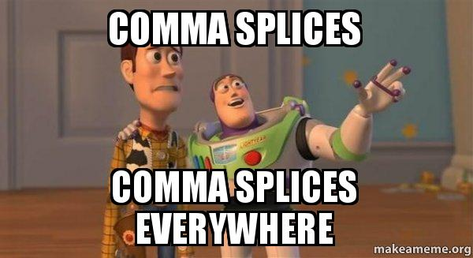
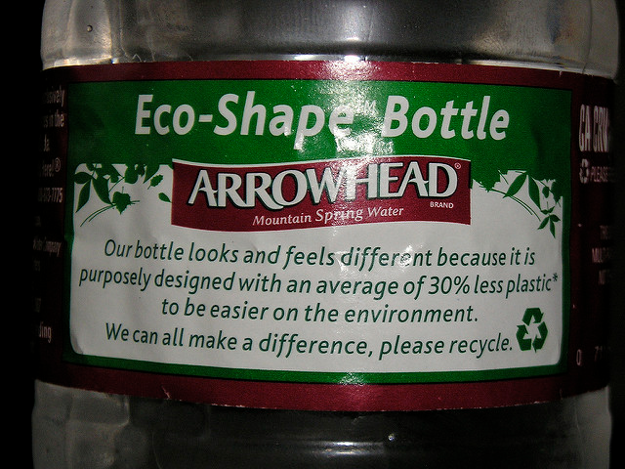
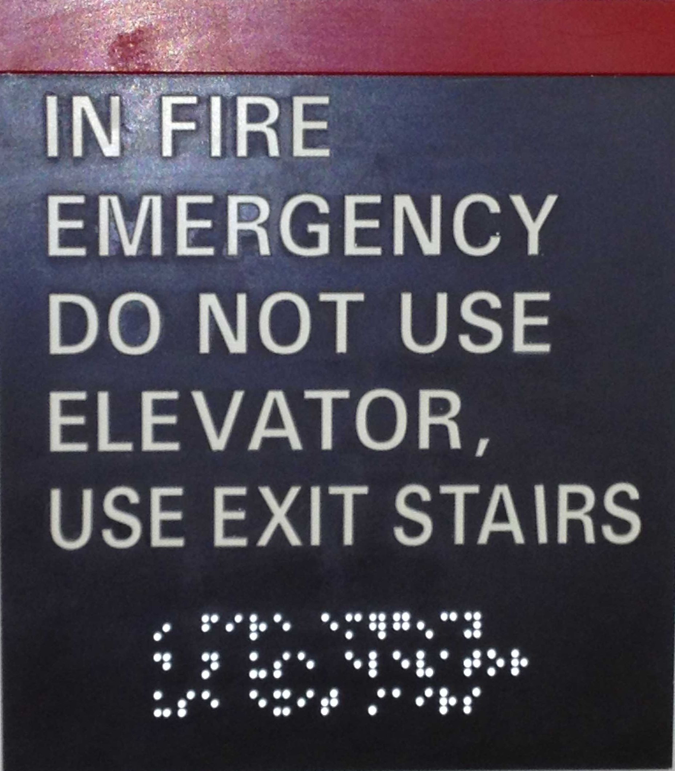
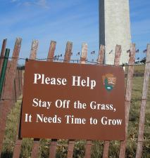
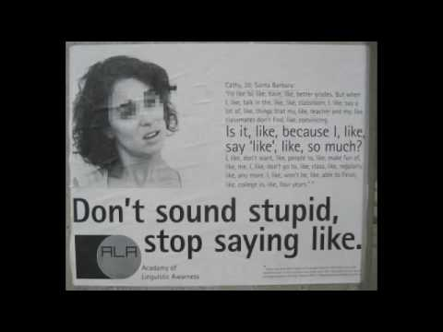
Comma splices Out in the World

Slide 10
4 fixes for run-on sentences
Use a comma+ a coordinating conjunction (and, but, or, nor, for, so, yet).
Gestures are a means of communication for everyone, but they are essential for the hearing-impaired.

Slide 11
4 fixes for run-on sentences
Use a semicolon (+ transitional expression)
Gestures are a means of communication for everyone; (however,) they are essential for the hearing-impaired.

Slide 12
4 fixes for run-on sentences
Make the clauses into separate sentences.
Gestures are a means of communication for everyone. they are essential for the hearing-impaired. They

Slide 13
4 fixes for run-on sentences
Restructure the sentence.
Gestures are a means of communication for everyone they are essential for the hearing-impaired.
Although gestures are a means of communication for everyone, they are essential for the hearing-impaired.

