Slide 1
Santa’s Elves: Subordinate Clauses (Dependent & Independent Clauses)
Presented by the Writing Center

Slide 2
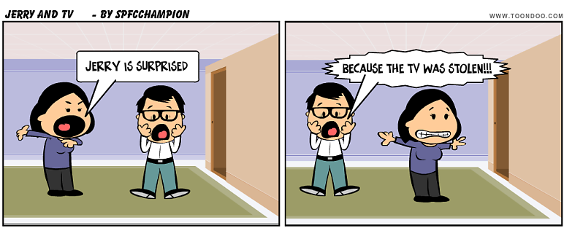
Dependent vs Independent Clauses
Independent Clause
Dependent Clause
Notes:
How are these sentences different?

Slide 3
Independent Clauses
Clauses that can stand on their own:
Examples:
I am a student at CSUSM.
Pancakes are my favorite food.
Target is the Disneyland of stores.
Notes:
http://www.blogthingsimages.com/whatkindofpancakesareyouquiz/buttermilk.jpg

Slide 4
Dependent Clauses
Clauses that cannot stand alone:
Examples:
If I had won the lottery…
When I become supreme ruler of the world...
...because I hate cats
Notes:
http://farm8.staticflickr.com/7195/13955810685_7571976435_o.jpg

Slide 5
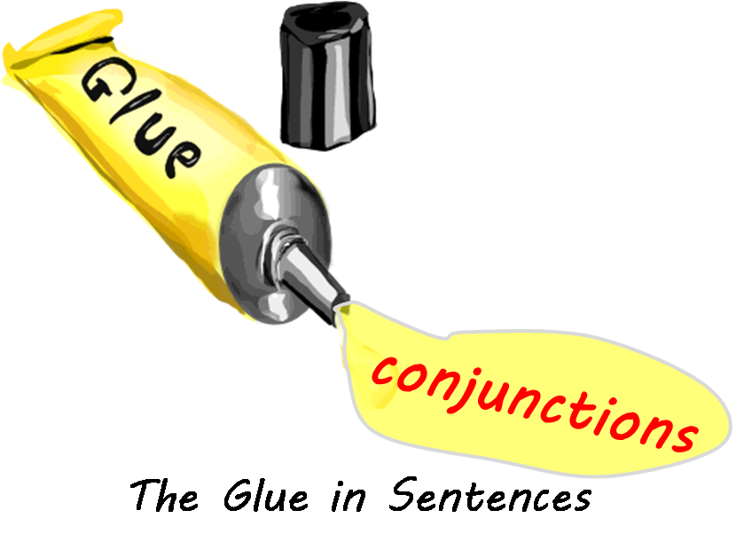
Notes:
http://schoolsquestiontime.org/wp-content/uploads/2012/08/what-is-a-conjunction-glue.png

Slide 6
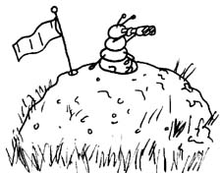
Coordinating Conjunctions
Information paraphrased/adapted from https://owl.english.purdue.edu/engagement/2/1/37/
When a coordinating conjunction connects 2 independent clauses, use a comma before the conjunction:
Example:
I like to hunt ants, but all the anthills in my neighborhood have mysteriously disappeared.
For
And
Nor
But
Or
Yet
So

Slide 7
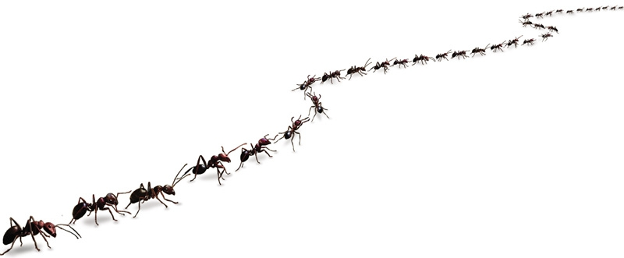
Correlative Conjunctions
Either …or (alternative)
Not only…but also (additive)
Either the ants all ran away or I am not as good at hunting ants as I used to be.
Not only is she taking physics but she is also taking biology.
No comma before “or” & “but”!!!

Slide 8
Sentence Connectors
Connect 2+ independent clauses (separate sentences or clauses in the same sentence, separated by a semicolon)
also, consequently, finally, furthermore, hopefully, however, indeed, etc.
Examples:
In oral traditions, cultures passes many myths down to later generations. In addition, many cultures told historical stories, known as legends.
We can read myths simply as stories; on the other hand, we can see them as reflections of cultural values and ideas.
Notes:
If the connector is at the beginning or in the middle of an independent clause, we separate it with commas. We don’t use commas to separate connectors at the end of an independent clause (“however” and “though” are exceptions).

Slide 9
Types of Subordinate Clauses
Time
Cause/Effect
Contrast
Condition
Location
There were people in Australia before Europeans arrived.
Scientists develop vaccines so that people develop immunity to disease.
Although chimpanzees are fruit eaters, they eat meat.
If monkeys hear a call, they look up.
Wherever you go, I will be there for you.

Slide 10
Notes:
http://2.bp.blogspot.com/-pyQCTQKDuRE/U2j95ANA6rI/AAAAAAAAAeo/ZwkSvqlsQmw/s1600/Subordinating-Conjunctions.png

Slide 11
Subordinating Conjunctions
Information paraphrased/adapted from https://owl.english.purdue.edu/engagement/2/1/37/
If you begin your sentence with a subordinate conjunction, use a comma after the subordinate clause:
Ex: Because I hunted so many ants, the remaining ants moved to a different location.
If the subordinate conjunction is not at the beginning of the sentence, a comma is not necessary.
Ex: The remaining ants moved to a different location
because I hunted so many of their brothers.
Subordinate Clause
Subordinate Clause

Slide 12
Credits
Special thanks to all the people who made and released these awesome resources for free:
Presentation template by SlidesCarnival

