Slide 1
PI Expenditure Detail Report
As explained by your friendly neighborhood OSP Team

Slide 2
A report summarizing FY20 expenses (7/1/20 – 6/30/21) by month and account, with transactional expense detail.
For PIs to have visibility and transparency into the expenses on their project.
Ensure only correct and expected expenses have hit their projects.
Report will be sent quarterly, following the schedule below.
The What
The Why
The When
Report Sent By: | Expenses Included Through:
01/31/2021 | 12/30/2020
4/30/2021 | 3/31/2021
7/31/2021 | 6/30/2021
10/31/2021 | 9/30/2021

Slide 3
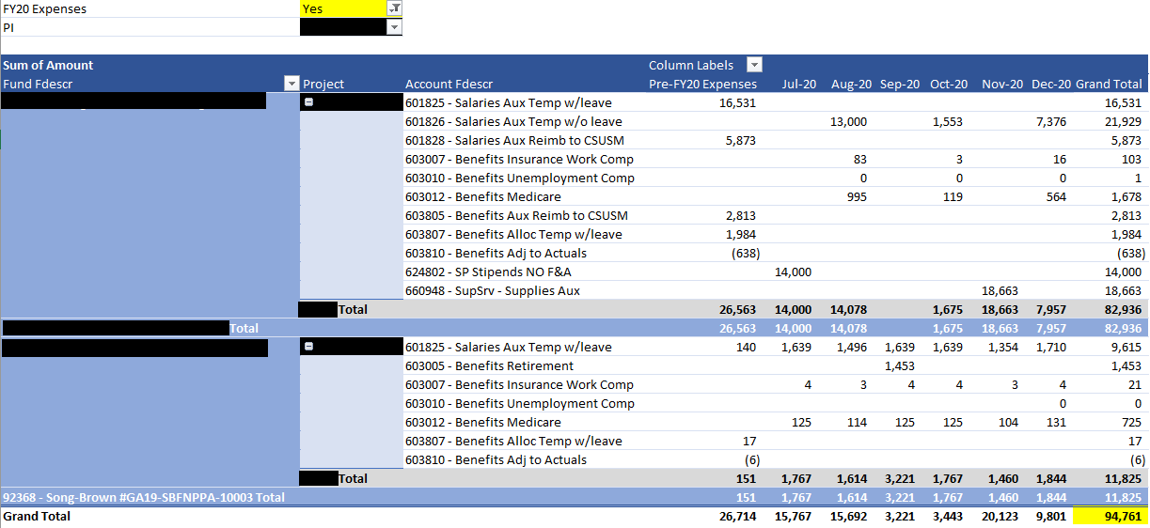
The How (to use)
Pivot Tab
Summary of total project expenses, with current fiscal year expenses (FY20) displayed by month.
Pre-filtered to ONLY display projects with FY20 expenses The Grand Total on the “Pivot” tab may not initially match the total expenses on the “Details” tab due to this.
If desired, the PI can change the filter to "No" to display ALL the PI's projects. The Grand Total on the “Pivot” tab will then match the total expenses on the “Details” tab.

Slide 4
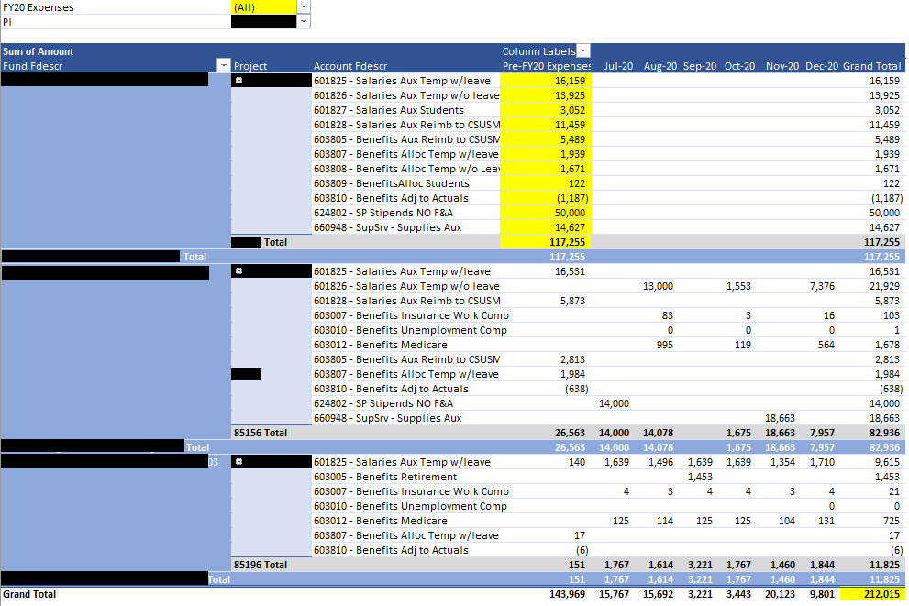
If desired, the PI can change the filter to "No" to display ALL the PI's projects.
All old/closed projects will then show up….
…and the Grand Total on the “Pivot” tab will then match the total expenses on the “Details” tab.

Slide 5
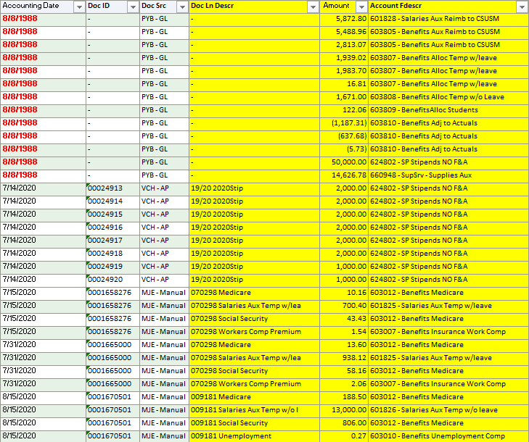
Details Tab
Details of ALL project expenses posted to ALL the PI's projects.
Expenses posted pre-FY20 (before 7/1/20) are SUMMARIZED VY ACCOUNT WITH A DEFAULT DATE LISTED AS 8/8/1988 (Data Warehouse system limitation)
If details are needed for any of these legacy expenses, please request from your assigned Sponsored Projects Analyst (SPA).

Slide 6
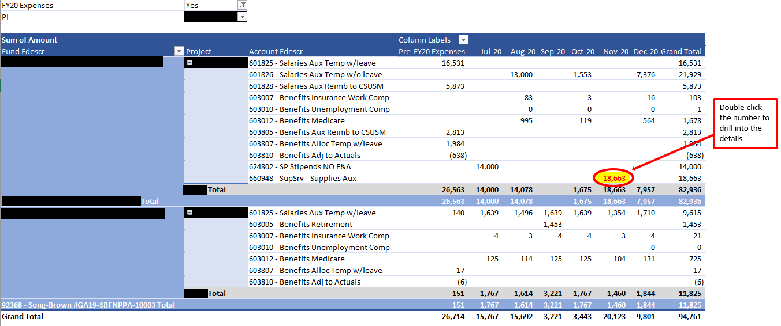
Review Monthly Amounts by Project by Month
If expenses in a particular month or category don’t sound familiar, drill into the details by double-clicking that particular number in the Pivot Table.
Expense Details
All the details that comprise the particular amount will then appear on a new tab. If the expense(s) do not look familiar or appear mis-coded, reach out to your assigned SPA.

