Slide 1
Mixed-Methods Investigation of Second-Year Success for Black Undergraduates
25th National Conference on Students in Transition
Adam Petersen, Student Success Analyst
Office of Undergraduate Studies, CSU San Marcos

Slide 2
The Plan for the Next Hour
Situating the study
Quantitative phase
Qualitative phase
Implications
Discussion
Key findings will be labeled with KEY so you know what to take with you today

Slide 3
Background

Slide 4
Background
18.7% gap in 2008

Slide 5
Background
Out of every 100 Black students who started in Fall 2010 in the California State University system:¹
25 left before the second year
10 more left before the third year
17 more left before the fifth year
44 of them have graduated by the end of the sixth year
At many regional universities, 1 in 5 Black students who make it to the second year do not return for a third year²

Slide 6
Literature Review
There is empirical support for Tinto’s theory, particularly for the influence of social integration (Terenzini & Pascarella, 1980; Braxton, Sullivan, & Johnson, 1997)
Less support for the influence of academic integration (Braxton, Sullivan, & Johnson, 1997)
Criticism of integration as a concept:
  Poorly and/or inconsistently operationalized (Bean, 1980, 1983; Braxton & Lien, 2000)
  Integration requires separation, which can be harmful for traditionally underserved students (Hurtado & Carter, 1997; Tierney, 1992, 2000)
  Social integration is particularly challenging and possibly even dangerous for minority students in environments they perceive as hostile (Harper et al., 2011; Rendón et al., 2000)

Slide 7
Literature Review
Disproportionate negative effects of campus racial climate (Cabrera et al., 1999; Fischer, 2007; Hurtado & Carter, 1997)
Disproportionate positive effects of sense of belonging (Hausmann et al., 1997; Hoffman et al., 2002; Strayhorn, 2008)
Positive interactions with faculty contribute to success (Guiffrida, 2005; Lundberg & Schreiner, 2004; Nettles et al., 1986)
Interpersonal validation, especially from faculty, is very powerful (Barnett, 2010; Rendón, 1994; Terenzini et al., 1994)

Slide 8
Literature Review
Second-year students are:
Second-year students can also be:
Increasingly more active and less passive in their education (Baxter Magolda, 1992; Schaller, 2005, 2007)
More likely to be retained if they report frequent and positive interactions with faculty (Graunke & Woosley, 2005; Schreiner, 2010; Young et al., 2015)
Less satisfied in general (Juillerat, 2000)
Academically disengaged, especially in the classroom (Gardner, 2000; Kuh & Hu, 2001, Schreiner, 2010)
Deeply concerned about major choice (Gardner, 2000; Graunke & Woosley, 2005; Tobolowsky, 2008)

Slide 9
Literature Review
Key questions from the literature:
How does Tinto’s theory apply to the second year?
  What is “academic integration” in year two?
  What is “social integration” in year two?
How much influence do each of these factors have in second-year retention?
  Sense of belonging
  Interactions with faculty
  Interactions with peers
  Academic engagement
  Confidence in major choice

Slide 10
Methods
Research Questions
Methodology
Split into two separate research questions:
What factors influence second-year student retention?
How do African Americans describe their second years in college?
Explanatory sequential mixed methods: QUAN -> qual
Quantitative study of all second-year students at institution
Qualitative study of Black second-year students at institution

Slide 11
Data Collection & Analysis
Quantitative Data Collection (Second Year Student Survey)
Fall 2017
Initial Quantitative Analysis
Early Spring 2018
Qualitative Data Collection (Second Year Student Success Study)
Late Spring 2018
Final Quantitative Analysis
Fall 2018
Qualitative Analysis
Summer 2018

Slide 12
California State University San Marcos (CSUSM)
Third youngest campus in the CSU system (1989)
14,000 undergraduates
Northern San Diego county
HSI and AANAPISI
“Low selectivity” category in CSRDE
Most recent 4Y grad rate: 15%
Most recent 6Y grad rate: 53%

Slide 13
Quantitative Phase
The Second Year Student Survey (SYSS)
428 responses (25%)
Measured constructs:
  Goal and Institutional Commitments
  Satisfaction (NSSE and YFCY)
  Faculty interaction (YFCY and Pascarella & Terenzini, 1980)
  Academic and Social Self-Concept (YFCY)
  Engaged Learning (Schreiner & Louis, 2011)
  Major confidence (Nauta, 2007)
  Peer group interactions (Pascarella & Terenzini, 1980)
  Perceptions of campus racial climate (Cabrera et al., 1999)
  Interpersonal validation (DLE)
  Sense of Belonging (YFCY)

Slide 14
Quantitative Phase
We know these constructs are all correlated with one another
We cannot determine causality but we can test hypotheses of directionality
We do that by building directional models and testing them against our data
Structural Equation Modeling (SEM)
  Measurement model (factor analysis): what are the latent or unobserved variables in the model?
  Path model (path analysis): what are the relationships between observed and latent/unobserved variables in the model?

Slide 15
Quantitative Phase
Comparison of Total Population and Survey Sample
Category | All Second-Year Students |  | Survey Respondents
Total | 1710 | 100.00% | 428 | 100.00%
Sex
Female | 1130 | 66.08% | 335 | 78.27%
Male | 580 | 33.92% | 93 | 21.73%
Race/Ethnicity
Black / African American | 67 | 3.92% | 20 | 4.67%
Latino/a | 753 | 44.04% | 175 | 40.89%
White | 511 | 29.88% | 133 | 31.07%
Underrepresented Minority (URM) | 845 | 49.42% | 201 | 46.96%
Not Underrepresented Minority | 865 | 50.58% | 227 | 53.04%
First-Generation Status
First in Family to Attend College | 528 | 30.88% | 117 | 27.34%
Not First in Family to Attend College | 1182 | 69.12% | 311 | 72.66%
Class Standing
Freshman (<30 units as of Fall 2017) | 1015 | 59.36% | 197 | 46.03%
Sophomore (30-59 units) | 664 | 38.83% | 214 | 50.00%
Junior (60-89 units) | 29 | 1.70% | 15 | 3.50%
Senior (90+ units) | 2 | 0.12% | 2 | 0.47%
Average GPA
Fall 2016 (First Term) | 3.247 |  | 3.384
Spring 2017 (Second Term) | 3.037 |  | 3.209
Cumulative GPA as of Fall 2017 | 3.106 |  | 3.306

Slide 16
Quantitative Phase
Factor | Reliability (α) | Name | Original associated construct
1 | .921 | Majorconf | Major Confidence
2 | .887 | Validation | Interpersonal Validation
3 | .909 | Peerfriend | Peer Group Interactions
4 | .818 | Instinteract | Satisfaction
5 | .925 | Facoutofclass | Faculty Interactions
6 | .834 | Meanlearning | Engaged Learning
7 | .818 | Selfconfidence | Academic & Social Self-Confidence
8 | .867 | Senseofbelonging | Sense of Belonging
9 | .823 | Classengage | Engaged Learning
10 | .765 | Genraceclimate | Perception of racial climate
11 | .803 | Faccare | Faculty Interactions
12 | .664 | Acadself | Academic & Social Self-Confidence
13 | .764 | Classpart | Engaged Learning
14 | .813 | Satisfaction | Satisfaction
15 | .484 | Peerisolation | Peer Group Interactions

Slide 17
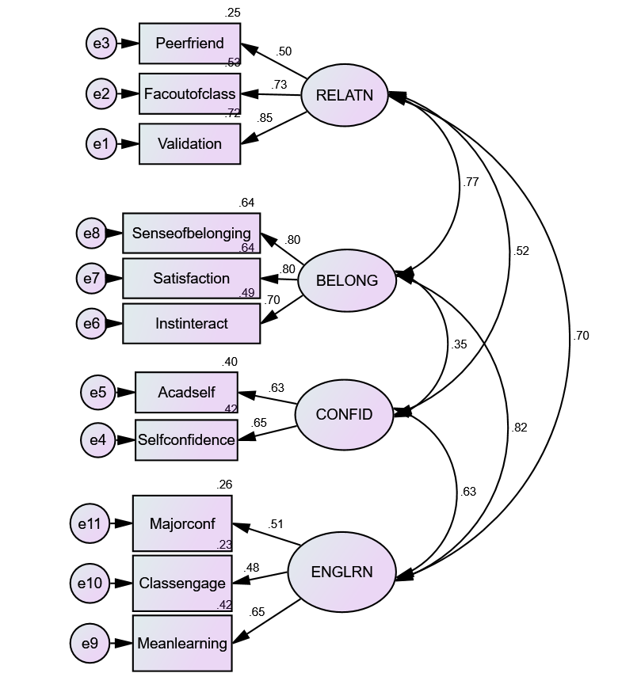
Quantitative Phase
Four latent variables:
Relationships (RELATN)
  Peerfriend
  Facoutofclass
  Validation
Belonging (BELONG)
  Senseofbelonging
  Satisfaction
  Instinteract
Self-Confidence (CONFID)
  Acadself
  Selfconfidence
Academic Engagement (ENGLRN)
  Majorconf
  Classengage
  Meanlearning

Slide 18
Quantitative Phase
Not included in these latent variables:
Faccare
Classpart
Genraceclimate
These factors were separate and had low correlation with anything else (and particularly with Retention)
…at least for the full sample.

Slide 19
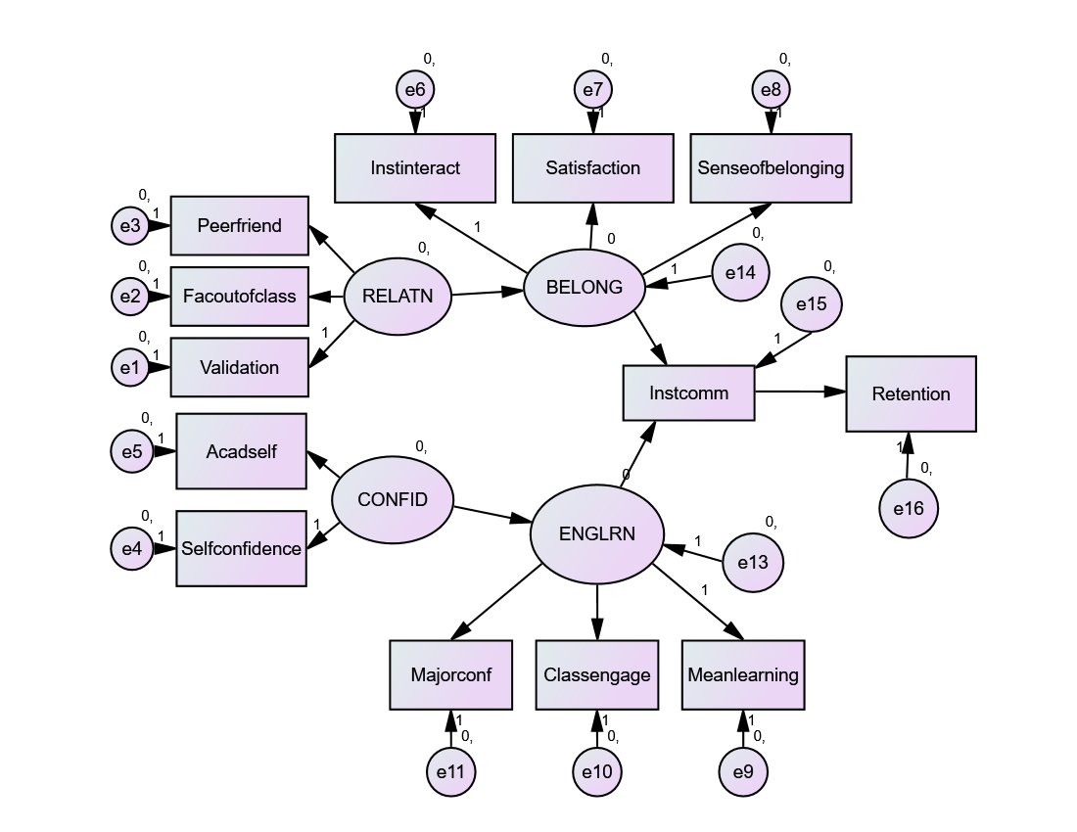
Quantitative Phase
The path model should be built on theory
How does Tinto’s theory apply to the second year?
Social integration = Sense of belonging
Academic integration = Academic engagement
Both have a combined effect on commitment which leads to retention

Slide 20
Quantitative Phase
KEY: Goal Commitment is not correlated with retention, only Institutional Commitment
KEY: Grades are not strongly correlated with retention
Commitment | Correlation | p
Goal | .088 | .07
Institutional | .468 | <.001
GPA | Corr w/ IC | Corr w/ Ret
Fall | .1* | .167**
Spring | .019 | .02
Total | .045 | .074

Slide 21
Quantitative Phase
The simplified model, adapted from Tinto, scored low on various fit indices:
x²=439.68, df=62, p<.000
RMSEA=0.119
CFI=0.778; SRMR=0.171

Slide 22
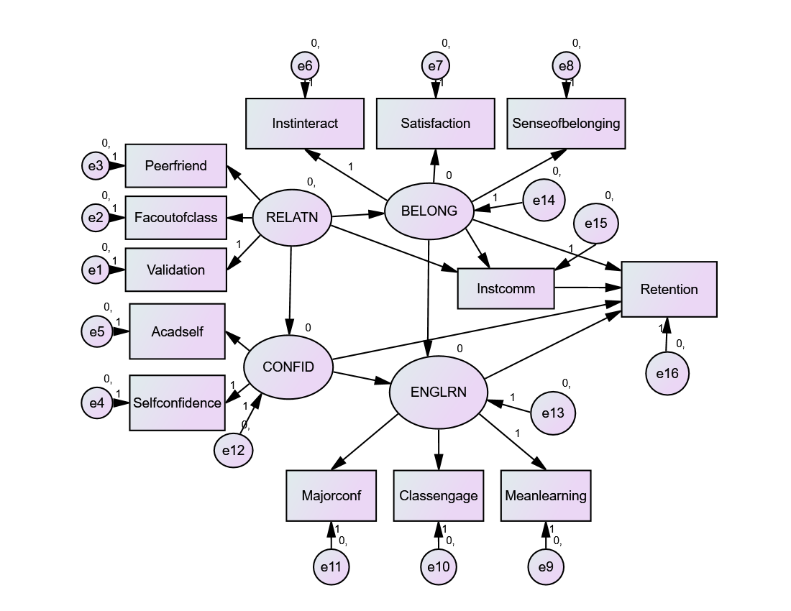
Quantitative Phase

Slide 23
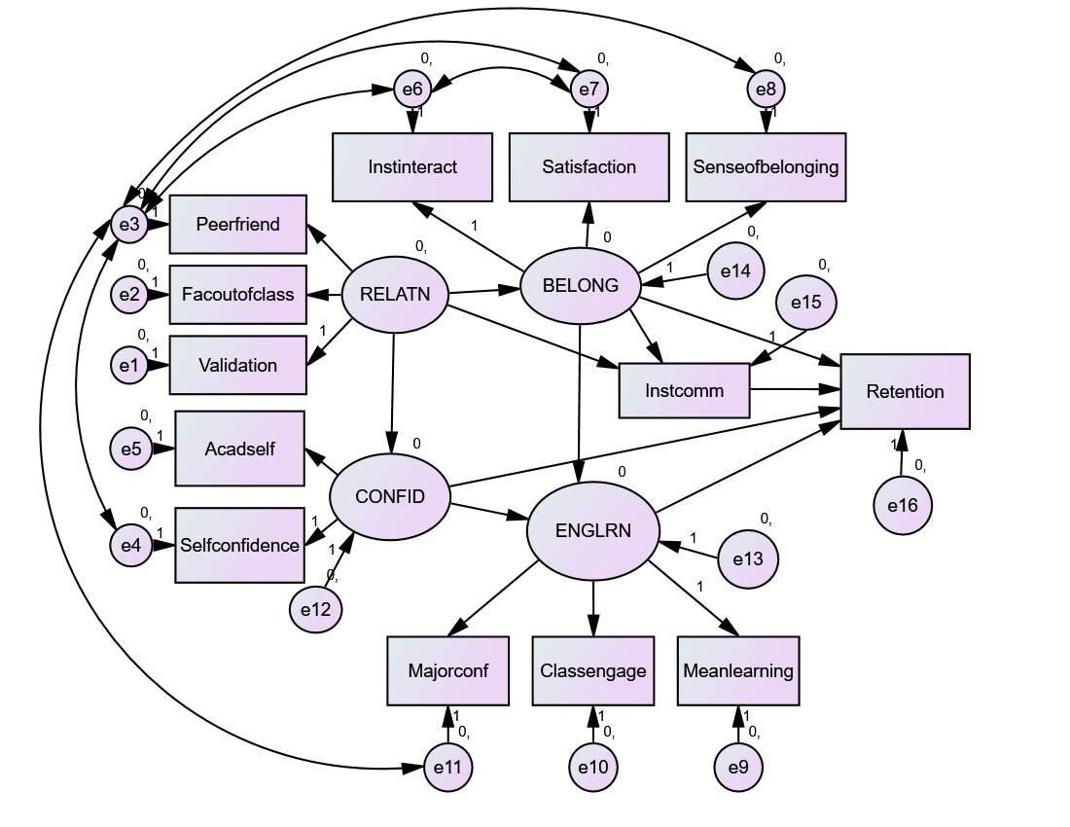
Quantitative Phase

Slide 24

Quantitative Phase
x²=82.856, df=51, p=.003; RMSEA=0.038; CFI=0.981; SRMR=0.0356

Slide 25
Quantitative Phase
To read standardized regression weights:
When RELATN increases by 1 standard deviation, BELONG increases by 0.755 standard deviations
Standardized Regression Weights
RELATN | → | BELONG | 0.755
RELATN | → | CONFID | 0.483
RELATN | → | IC | -0.455
BELONG | → | ENGLRN | 0.670
BELONG | → | IC | 0.840
BELONG | → | Retention | -0.283
CONFID | → | ENGLRN | 0.390
CONFID | → | Retention | -0.248
ENGLRN | → | Retention | 0.522
IC | → | Retention | 0.355

Slide 26
Quantitative Phase
RELATN | →→ | IC | 0.180
 | 1 direct, 1 indirect
RELATN | →→→→ | Retention | 0.093
 | 4 indirect
BELONG | → | IC | 0.840
 | 1 direct
BELONG | →→→ | Retention | 0.365
 | 1 direct, 2 indirect
CONFID | →→ | Retention | -0.045
 | 1 direct, 1 indirect
ENGLRN | → | Retention | 0.522
 | 1 direct
Standardized Total Effect gives us the sum of all standardized coefficients, the total effect of all the pathways from an independent variable to a dependent variable

Slide 27
Quantitative Phase
RELATN | →→ | IC | 0.180
 | 1 direct, 1 indirect
RELATN | →→→→ | Retention | 0.093
 | 4 indirect
BELONG | → | IC | 0.840
 | 1 direct
BELONG | →→→ | Retention | 0.365
 | 1 direct, 2 indirect
CONFID | →→ | Retention | -0.045
 | 1 direct, 1 indirect
ENGLRN | → | Retention | 0.522
 | 1 direct
Example: BELONG has three paths to Retention:
BELONG → Retention
BELONG → IC → Retention
BELONG → ENGLRN → Retention
BELONG’s direct path to Retention is negative but its two indirect paths are positive

Slide 28
Quantitative Phase
RELATN has a strong positive effect on BELONG
  Peer and faculty relationships but especially validation are strongly correlated with sense of belonging
RELATN has a moderate negative effect on IC
  Peer relationships and validation are negatively correlated with IC

Slide 29
Quantitative Phase
BELONG has the strongest direct effect on IC
  Sense of Belonging has the single strongest correlation with IC of any observed variable
BELONG has a small negative direct effect on Retention but a strong positive direct effect on ENGLRN, which has a strong positive direct effect on Retention

Slide 30
Quantitative Phase
CONFID is moderately influenced by RELATN and has a moderate influence on ENGLRN
CONFID has a small negative direct effect on Retention
  Academic Self-Concept has no correlation with IC but a negative correlation with Retention

Slide 31
Quantitative Phase
ENGLRN has no effect on IC
ENGLRN has the strongest direct effect on Retention

Slide 32
Quantitative Phase
KEY: The two most important pathways are:
  BELONG → IC → Retention
  BELONG → ENGLRN → Retention
KEY: Feelings of connection and belonging are a necessary condition for retention in the second year. Belongingness contributes to commitment to the institution and academic engagement, both of which contribute to retention.
KEY: Academic engagement requires both belonging and self-confidence, both of which are influenced by positive relationships.

Slide 33
Quantitative Phase
r² values (squared multiple correlations) can tell us how much variance can be explained by the model
KEY: Even this model can only explain 33% of the variance in Institutional Commitment and 20% of the variance in Retention
Variable | Error Variance | Explained Variance
IC | 0.664 | 0.336
Retention | 0.793 | 0.207
KEY: There is no silver bullet. There is no magic switch. Even a fully-connected, confident, engaged, and supported student might leave your institution for a hundred different reasons. But do it anyway. Connect, validate, engage, and support your students. These things do not operate in isolation.

Slide 34
Qualitative Phase
Construct | Difference for AA | Research Subquestion
Goal Commitment | ↑ | How do Black second-years describe their commitments and connections to their goals and to the University?
Institutional Commitment | ↓↓
Sense of Belonging | ↓↓
Engaged Learning | ↓↓↓ | How do Black second-years describe their engagement with academics?
Major Confidence | ↓↓
Validation | - | How do Black second-years describe their relationships and interactions with faculty, staff, and other students?
Perception of Racial Climate | ↓↓↓ *
Faculty Relationships | -
Peer Relationships | -
Academic Self-Concept | - | How do Black second-years describe themselves?
Social Self-Concept | ↑↑↑ **
*p<.05 **p<.01

Slide 35
Qualitative Phase
The Second Year Student Success Study
  Two research assistants (undergraduate students employed by the Black Student Center)
  One-on-one interviews
  14 interview sign ups but 3 no-shows and 2 with technical difficulties
  9 interviews recorded out of 67 Black second-year students: 13% of the population interviewed
  6 men and 3 women

Slide 36
Qualitative Phase
Six major categories:
Involvement
Community
Academic Engagement
Outreach
Self-Confidence
Separation

Slide 37
Qualitative Phase
Six major categories:
Involvement
Community
Academic Engagement
Outreach
Self-Confidence
Separation
Answers to SoB questions tended to be in the form of “involvement”
Do you feel like you are a part of the campus community at CSUSM? Why or why not?
Yeah, I do feel like it because um, I just, I just involve myself in a lot of things. Like for BSU and I was in the sorority too. So I feel like I'm really connected, like I go onto campus and I'll say hi, like I always see somebody that I know. So I feel like pretty involved and connected with it.

Slide 38
Qualitative Phase
Six major categories:
Involvement
Community
Academic Engagement
Outreach
Self-Confidence
Separation
KEY: If belonging and “connections” are a result of “involvement” then these students see it as their responsibility
I was involved a lot in high school, and after my first year of doing nothing, I felt disconnected from the campus, I knew I had to do something.
Involvement has tangible benefits and requires initiative, energy, and time

Slide 39
Qualitative Phase
Six major categories:
Involvement
Community
Academic Engagement
Outreach
Self-Confidence
Separation
Students see direct value in belonging
And, um, it's like even when I do want to have like my days when I just want to be by myself they're always there checking on me, or like always encouraging me like when I'm struggling in classes, even though we're not even in the same major or same classes it's like I have someone I can like lean on when things get tough.

Slide 40
Qualitative Phase
Six major categories:
Involvement
Community
Academic Engagement
Outreach
Self-Confidence
Separation
KEY: Students clearly articulated their participation in multiple communities and the value of this participation
It's definitely worth it 'cause it's ... 'cause I don't, um ... My upper di- ... some of my upper division classes. So, you definitely both communities. So, you need your major community for people to help you. And then also if you’re stressed, 'cause the community is not seeing you go through your major.

Slide 41
Qualitative Phase
Six major categories:
Involvement
Community
Academic Engagement
Outreach
Self-Confidence
Separation
Most descriptions of the full “campus community” mentioned a lack of community
Uh, just there is a lot going on for activities and stuff that I do know of, but then when it comes to everything else, like there're clubs and stuff, I'm in part of some, but I don't feel as though everything's kinda unified, you know? …I feel like everything's kinda doing their own thing rather than knowing what truly is everything going on or so.

Slide 42
Qualitative Phase
Six major categories:
Involvement
Community
Academic Engagement
Outreach
Self-Confidence
Separation
Answers to questions of engagement in academics tended to begin with faculty, particularly with instructors
Interest does seem to play a role in the classroom but was brought up more in questions about major

Slide 43
Qualitative Phase
Six major categories:
Involvement
Community
Academic Engagement
Outreach
Self-Confidence
Separation
Most said their courses were harder (both in terms of difficulty and work load) but connection to faculty and peers can help
[talking about when she’s engaged in class] Honestly when I know people I have in the classroom. Like I've always been a little bit more participating when I'm comfortable with people I'm around. And it's like I don't know, but it's like there's a little, kind of a barrier there kind of protecting me.

Slide 44
Qualitative Phase
Six major categories:
Involvement
Community
Academic Engagement
Outreach
Self-Confidence
Separation
Students emphasized and clearly articulated the value of individual connection to faculty and staff
I feel like it's made me believe in myself even more, because somebody else is believing in me, and they see the potential in me that I may not see in myself all the time.
I feel that if someone takes an interest in me, I respond better. And I feel like I want to live up to it, impress them, make, make sure that I'm okay, so that they know I'm okay.

Slide 45
Qualitative Phase
Six major categories:
Involvement
Community
Academic Engagement
Outreach
Self-Confidence
Separation
KEY: Students place significant value on faculty outreach (over student-initiated contact)
He saw that I was, 'cause he takes attendance and he saw that I was missing a couple classes and that I missed a quiz and he actually reached out to me. He emailed me. He was like, "Is everything okay at home? Like if you ever needed any help, just let me know. Come to office hours. Talk to me." Blah, blah, blah. And I was like, oh, like that was really cool. 'Cause I'd never had a professor do that before. So I thought that was really cool of him. And that was really nice.

Slide 46
Qualitative Phase
Six major categories:
Involvement
Community
Academic Engagement
Outreach
Self-Confidence
Separation
Self-confidence was mentioned many times throughout the interviews; touched on every one of the other constructs
Students clearly articulated how their self-confidence affected and was affected by peers, faculty, and academics

Slide 47
Qualitative Phase
Six major categories:
Involvement
Community
Academic Engagement
Outreach
Self-Confidence
Separation
KEY: Students are able to clearly articulate the lack of critical mass of Black people (students and staff/faculty) and the effects that has on them
[When asked about racial climate] Um, that was like a very, very important like, for example, like you walk in class on the first day of school and usually I'm like the only Black person. So it's kind of like you stand out more and like people, like, look at you differently I feel like. Like, I just feel like I have higher expectations than people that are in my class.

Slide 48
Qualitative Phase
Six major categories:
Involvement
Community
Academic Engagement
Outreach
Self-Confidence
Separation
Students tended to emphasize student hostility while giving the University a pass
Student: Yeah, I feel like the faculty is okay when it comes to race. It's just the students sometimes that have a problem, and I'm like…
Interviewer: What do you mean, help me, give me an example, I don’t--
Student: There's, I would say in order to be employed at Cal State San Marcos, you would have to accept diversity, but in order to be a student at Cal State San Marcos, you don't necessarily have to have that same requirement.

Slide 49
Summary of Key Findings
Key Quantitative Findings
Institutional Commitment predicts 2Y Retention, not Goal Commitment
Grades are not strongly correlated with retention
Feelings of connection and belonging are a necessary condition for retention in the second year. Belongingness contributes to commitment to the institution and academic engagement, both of which contribute to retention.
Academic engagement requires both belonging and self-confidence, both of which are influenced by positive relationships.
Even this model can only explain 33% of the variance in Institutional Commitment and 20% of the variance in Retention
Connect, validate, engage, and support your students. These things do not operate in isolation.
Key Qualitative Findings
If belonging and “connections” are a result of “involvement” then these students see it as their responsibility
Students clearly articulated their participation in multiple communities and the value of this participation
Students place significant value on faculty outreach (over student-initiated contact)
Students are able to clearly articulate the lack of critical mass of Black people (students and staff/faculty) and the effects that has on them

Slide 50
Implications
To improve second-year retention, focus on programming that creates / facilitates / strengthens personal connections
  With faculty
  With other students
Think about how your institution can encourage or support outreach from faculty (tenure-track and adjunct)
Grades do not independently predict risk of dropout after the first year. Do not assume that your predictive models behave the same year-over-year.
Use Sense of Belonging survey data to look for positive deviance in academic departments. Success data will naturally vary across disciplines but SoB might be able to tell you who’s doing good work inside a department. Then find out how to support and/or replicate that work.
Invest in understanding your students. Don’t just collect survey data, use it. Plan for systematic and continual qualitative data collection.

Slide 51
What are we doing at CSUSM?
Data Fellows Program: cohort-based professional development in data literacy with a goal of improving campus data culture
https://www.csusm.edu/ipa/datafellows/index.html
Business Professional Development in the College of Business Administration: connecting second-year business students to faculty, alumni, and community members to develop skills to succeed in modern business settings
https://www.csusm.edu/coba/signature-programs/bpd/index.html
Community of Inquiry, Practice, and Action (CIPA) on Second Year Students: faculty learning community focused on professional learning through the Fall semester and program development in the Spring semester
https://www.csusm.edu/asc/faculty/cipa.html

Slide 52
Questions?
Contact: apetersen@csusm.edu
All slides and materials online: https://www.csusm.edu/ougs/students/secondyear.html
Please remember to submit your evaluation on Guidebook: https://guidebook.com/g/sit2018/

