Slide 1
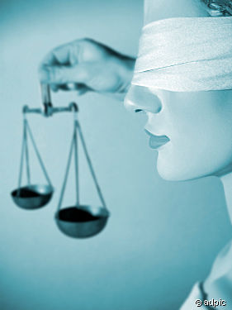
The Importance of
Impartial Courts
Notes:
This PowerPoint has been specially designed for teens and young adults by the Sacramento Superior Court. The Court would like to acknowledge the contributions of the Communications and Community Outreach Division, and special recognition to Judicial Administration Fellow Michael Carlin for adapting the original presentation for a youth audience.
This presentation is about our government, more specifically about our courts and their independence.
Before talking about the courts, however, I would like to talk with you briefly about our government in general, the basis for our form of government, and the importance of preserving the principles upon which our form of government was founded.

Slide 2
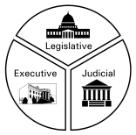
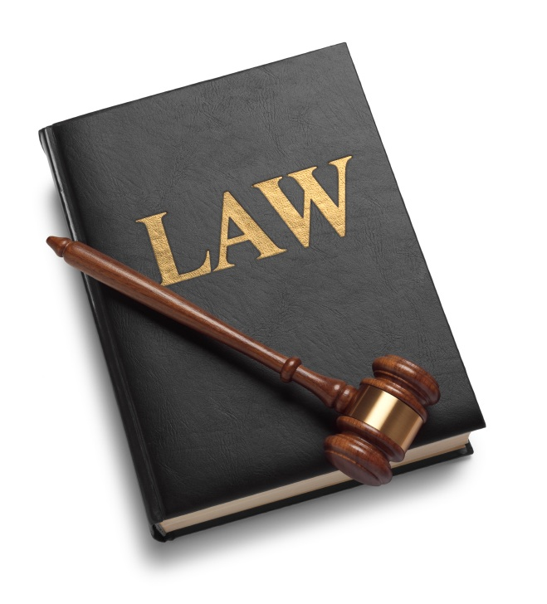


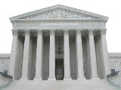
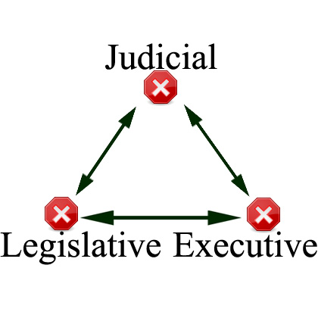
Four Ideals that Support Our Government
1. The Rule of Law
2. The Separation of Powers
3. Checks & Balances
4. Impartial Courts & Judges
Notes:
In order to understand our government, we have to understand these 4 ideals upon which our government was founded.
[click to advance text]
Impartial may be a new word to many of you, it basically means fair and not pre judging. It is very important to the rule of law.
I will discuss briefly the first three Ideals and then spend the remainder of this presentation on #4 Impartiality of our courts and judges.

Slide 3
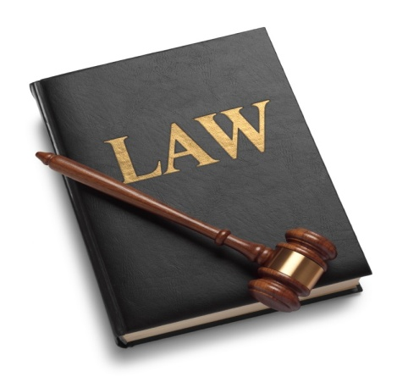
Ideal #1
The Rule of Law
The law is to be followed by everyone and
  gives everyone the same rights
Notes:
One of the most important principles behind the courts and government is the rule of law.
The rule of law is the concept by which the equality of all citizens can be protected because under the rule of law
[Review text on slide and elaborate]
I’ll need 2 volunteers to demonstrate an example of this ideal.

Slide 4

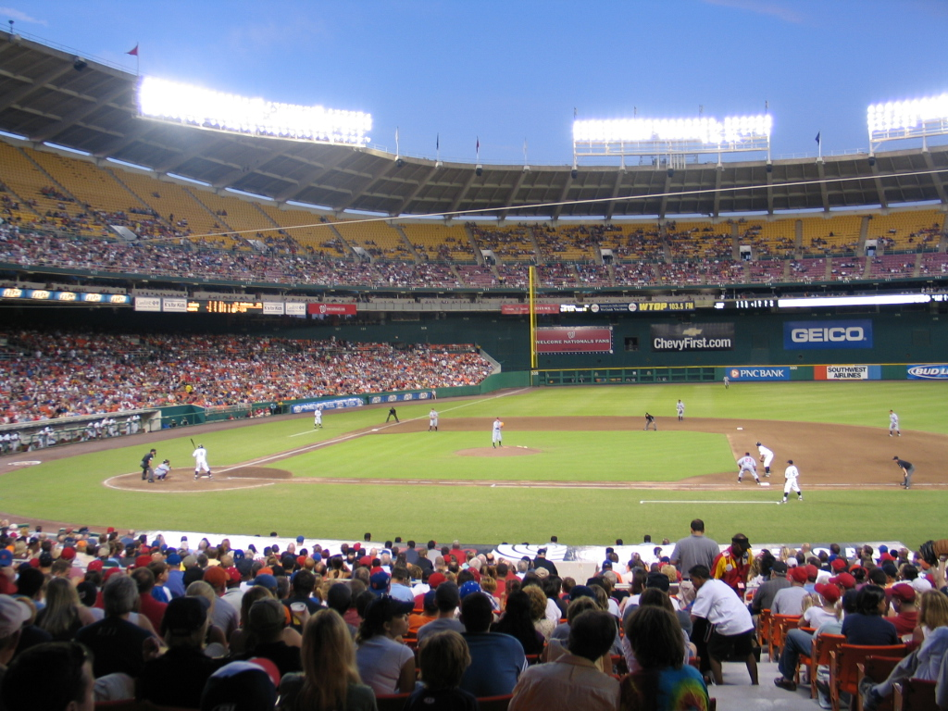

What if umpires could make up
their own rules during a game?
Notes:
Now imagine we’re in a baseball park. You (2) are the umpire, and you (1) are up to bat and hit a home run straight out of that ballpark, through center field.
[Click to play sound of batter hitting home run]

Slide 5
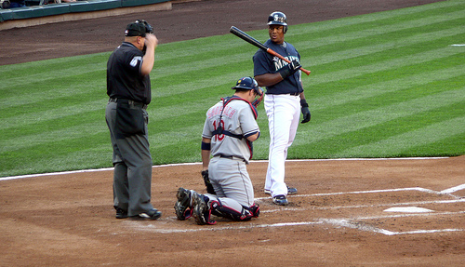
What if umpires could make up
their own rules during a game?
Umpire: Foul Ball!

Slide 6
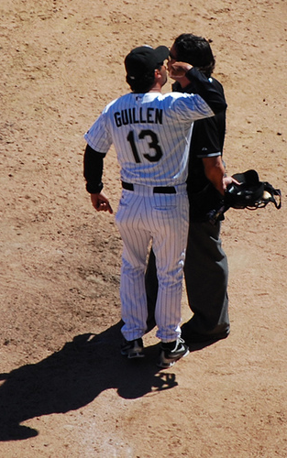
Batter: What! I clearly hit it through center field and out of the park, that means that it’s a home run! How can you say it’s a foul?

Slide 7
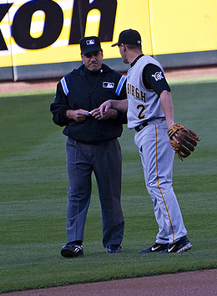
Umpire: Too bad, that’s my definition of a foul.

Slide 8
Batter: Show me where you got your definition.

Slide 9
Umpire: Look, those are just my rules. I’m the umpire, deal with it.
Notes:
Presenter: Now, how do we know that our umpire here is mistaken? Well, because there are rules that define what a homerun is.
But what if there were no rules. If there were no rules then neither the umpire nor the batter would be right, the game would just break down into chaos.
Just as this game can not be played fairly without established rules that everyone must follow, government can not be fair without established rules that everyone must follow.

Slide 10
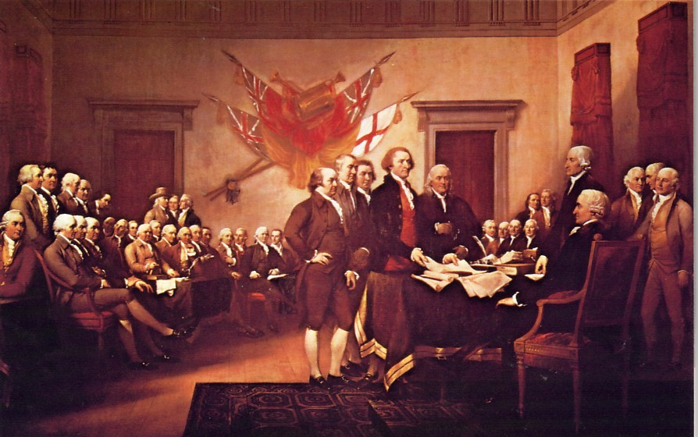
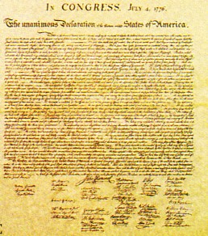
DECLARATION OF INDEPENDENCE
(July 4, 1776)
List of ways that King George III
was acting unfairly
Like a bad umpire, King George ordered judges to decide
cases based on his wishes, not the rule of law
Notes:
[click to point arrow to the Declaration of Independence]
“When, in the course of human events, it becomes necessary for one people to dissolve the political bands which have connected them with another … and to assume a separate and equal station... a decent respect to the opinions of mankind requires that they should declare the causes which impel them to the separation.“ With these words the 13 American colonies began their Declaration of Independence from England.
The signers of the Declaration of Independence (including Thomas Jefferson, Benjamin Franklin, and John Adams) set forth in the Declaration the causes which compelled them to separate from England. Among the most important causes leading the signers to declare the independence of the 13 colonies were that King George had “obstructed the administration of justice” and “been deaf to the voice of justice” in the colonies:
By Appointing judges that always ruled in his favor
By Reducing pay when judges didn’t rule in his favor
By taking away the right for a trial by jury
Of all grievances detailed in the Declaration of Independence, none was more galling than the lack of independence imposed by King George on Colonial judges: “He has made Judges dependent on his Will alone, for the tenure of their offices, and the amount and payment of their salaries.”
Ladies and Gentlemen think about it, the foundations of this country, our government, our way of life was, among other things, constructed upon the revolutionary notion that to be truly free, our citizens required and demanded that we institute an impartial and independent judiciary.

Slide 11
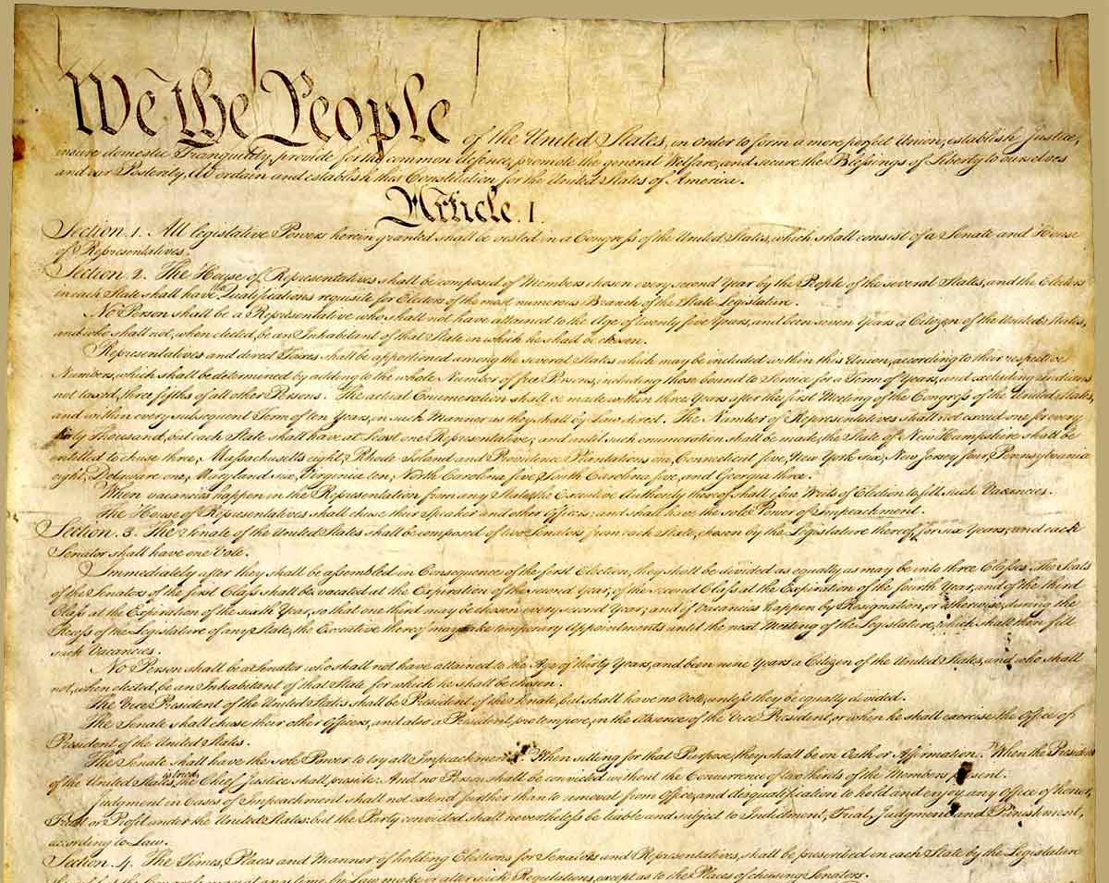
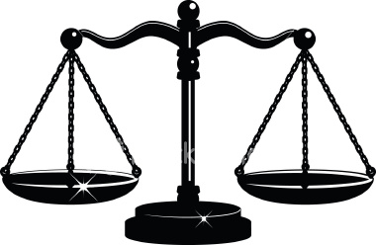
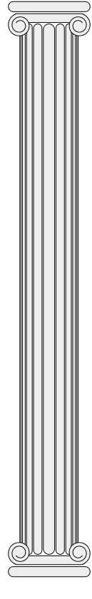
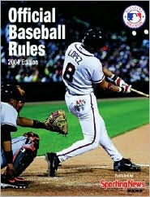
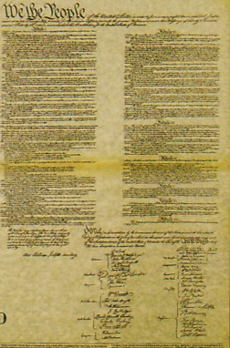
CONSTITUTION
(Sept. 17, 1787)
Just as all sports have rules,
our government has the constitution,
this is the set of rules that the government must follow. The constitution strengthened the rule of law by:
Allowing the courts to protect rights
  -Speedy jury trial, and other rights
Removing governmental and popular influences from the court
  The constitution also separated the powers of government
Notes:
11 years later, and after the Revolutionary War, Jefferson, Adams, Franklin, John Madison, Alexander Hamilton, and other founders of the American form of government gathered in Philadelphia to draft the US Constitution.
In order to avoid the injustices they had suffered under colonial rule the founders wanted to strengthen the rule of law and limit the powers of government
[click to advance and review text]
To accomplish these purposes, the founders drafted a constitution that rested on important principles of constitutional democracy.
To institutionalize the dreams of our Declaration of Independence, our forbearers raised the concept of an independent judicial system to Constitutional status, enshrining it forever in Article III and even highlighting it in the Preamble itself. As if that were not sufficient, the right to a trial by jury was emphasized in our Bill of Rights in the Sixth & Seventh Amendment (Criminal & Civil trials)

Slide 12
Ideal # 2 The Separation of Powers
Into Three Branches of Government
Legislative
Executive
Judicial
Create the law
Carry out the law
Interpret and
apply the law
Notes:
From the development of the rule of law in the 18th century came three distinct legal powers of the government. [Click to advance boxes]
the power to make the law (legislative);
the power to execute or carry out the law (executive);
and the power to interpret and apply the law in resolving disputes (judicial).
Can anyone name a legislator or executive?
Under the English colonial governments in the American colonies in the 18th century, the judicial power was very weak compared to the legislative and executive powers, and the colonial judges tended to uphold the will of the English King and colonial governors by whom they were appointed rather than the rights of the colonists.

Slide 13
Impartial Courts & Judges
Impartiality is a judge’s ability to decide cases:
Only considering the law;
  (As an umpire would only consider the rules)
Not considering personal gain, prejudices, preferences, or beliefs;
  (As an umpire would not call in favor of their favorite team)
Without outside powers telling judges how to make decisions or run their courtrooms;
(As fans and team managers can’t tell umpires how to make calls).
Notes:
Today, I am focusing on the third branch of government, the judicial branch.
[click to review text]
Judicial independence is a fourth important principle on which the US Constitution is based. Judicial independence is the freedom of the judiciary from undue or improper influence or pressure, whether from other branches of government, politics, public opinion, litigants, or other sources.
Judicial independence generally consists of two kinds: (1) “decisional” independence referring to the independence of individual judges in deciding issues before them, and; (2) “institutional” independence referring to the independence of the court or judicial branch in governing and managing its own affairs.

Slide 14
The Separation of Powers (cont.)
The government’s powers are split between the three branches
Each branch of government is equal in power
No branch can exercise a power granted to one of the other branches
Notes:
Separation of powers limits the power of all branches of government so that no 1 branch becomes too powerful (like a king)
[Advance]
The powers of the government are spread among the different branches,
[Advance]
Each branch of government is co-equal
[Advance]
No branch can exercise the authority granted to another branch – this provides a safeguard against one branch controlling the others or having too much power.

Slide 15
Ideal #3
Checks and Balances
If one branch doesn’t agree with another branch’s decision, it can take action against that decision.
Notes:
A third important principle of government is that of checks and balances.
[do not read notes if audience is restless]
This term refers to a Constitutional scheme of government that seeks to further limit governmental power by providing means by which each branch of government can check, or partially obstruct, the exercise of power by the others. In this way, the Constitution further limits the powers of government by providing each branch with a means of checking the power of other branches.
The Legislative Branch has the power to make the law, but the Judicial Branch has the power to strike down laws that conflict with the Constitution. The Judicial Branch has the final say over what the constitution means, over how it should be interpreted.
The Executive Branch has the power to charge an individual with a crime, but the Judicial Branch determines whether someone will be detained based on those charges, whether someone is guilty, and if so, what the sentence will be. The Legislative Branch can also pass laws creating limitations on the sentencing choices exercised by the Judicial Branch.
The Judicial Branch has the power to interpret the law but the Legislative Branch has the power of the purse, including authority over the courts’ budgets.
Of course there are other checks and balances. For instance, while the Judicial Branch may declare a law unconstitutional, the Legislative Branch, along with the people, have the power to change the Constitution itself. It is a delicate balance that has served us well for over 200 years.
[introduce clip:] The following clip will illustrate this balance

Slide 16
What if umpires knew the rules but broke
them for personal reasons?
Notes:
[Read title then notes]
I will need my 2 volunteers again for this demonstration.
Like our first example you (1) are up to bat and hit a home run straight out of that ballpark, through center field.
[Click to play sound of batter hitting home run]

Slide 17
What if umpires could make up
their own rules during a game?
Umpire: Foul Ball!

Slide 18
Batter: Not again, are you blind? That was totally a home run, and this time I have the official rules to prove it.

Slide 19
Umpire: The rules, hah! That doesn’t matter because it’s my call.

Slide 20
Batter: But you have to follow the rules, you can’t just make calls for other reasons.

Slide 21
Umpire: Well I have some pretty good reasons, in fact I have about 2,000 dollars that the visiting team gave me before the game.

Slide 22
Batter: How is that fair? You got paid by the other team to make that dumb call? No matter how I play, you’ll never let me score a run.
Notes:
[Try to engage students with some of these questions]
Why do you think this umpire made a decision that’s obviously biased?
What influenced him or could have influenced him?
What happens if umpires don’t make decisions according to the rules?
Why couldn’t we have a game if umpires or referees took gifts from the other teams?
Umpires are not allowed to make decisions based on whether their favorite team was playing, what fans want, or gains they might make if one side wins. Judges must remain impartial, free from the influence of pressures like these… [click to advance to the next slide]

Slide 23
Ideal #3
Checks and Balances
If one branch doesn’t agree with another branches decision, it can take action against that decision.
Notes:
A third important principle of government is that of checks and balances.
[do not read notes if audience is restless]
This term refers to a Constitutional scheme of government that seeks to further limit governmental power by providing means by which each branch of government can check, or partially obstruct, the exercise of power by the others. In this way, the Constitution further limits the powers of government by providing each branch with a means of checking the power of other branches.
The Legislative Branch has the power to make the law, but the Judicial Branch has the power to strike down laws that conflict with the Constitution. The Judicial Branch has the final say over what the constitution means, over how it should be interpreted.
The Executive Branch has the power to charge an individual with a crime, but the Judicial Branch determines whether someone will be detained based on those charges, whether someone is guilty, and if so, what the sentence will be. The Legislative Branch can also pass laws creating limitations on the sentencing choices exercised by the Judicial Branch.
The Judicial Branch has the power to interpret the law but the Legislative Branch has the power of the purse, including authority over the courts’ budgets.
Of course there are other checks and balances. For instance, while the Judicial Branch may declare a law unconstitutional, the Legislative Branch, along with the people, have the power to change the Constitution itself. It is a delicate balance that has served us well for over 200 years.
[introduce clip:] The following clip will illustrate this balance

Slide 24
Ideal #4 Impartial Courts & Judges
Impartiality is a judge’s ability to decide cases:
Only considering the law;
  (As an umpire would only consider the rules)
Not considering personal gain, prejudices, preferences, or beliefs;
  (As an umpire would not call in favor of their favorite team)
Without outside powers telling judges how to make decisions or run their courtrooms;
  (As fans and team managers can’t tell umpires how to make calls).
Notes:
Today, I am focusing on the third branch of government, the judicial branch.
[click to review text]
Judicial independence is a fourth important principle on which the US Constitution is based. Judicial independence is the freedom of the judiciary from undue or improper influence or pressure, whether from other branches of government, politics, public opinion, litigants, or other sources.
Judicial independence generally consists of two kinds: (1) “decisional” independence referring to the independence of individual judges in deciding issues before them, and; (2) “institutional” independence referring to the independence of the court or judicial branch in governing and managing its own affairs.

Slide 25

Why does it matter
to me if judges
are impartial?
Notes:
The court can potentially make a great impact on your life and in society, imagine that you are one of these individuals.
[click to play movie, then click after movie ends to advance the slide]

Slide 26
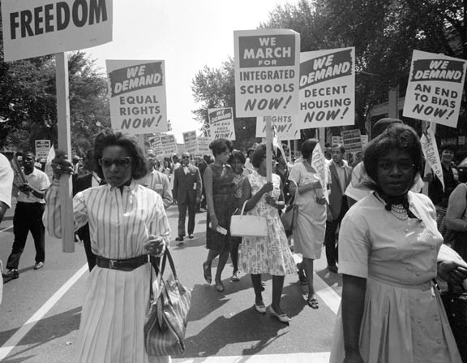
Courts Have the Power to Protect All Persons Equally
Impartial judges administer the laws to all persons
They are not influenced by public opinion.
Examples -
  Racial prejudice
  Religious discrimination
Notes:
Judicial Impartiality allows courts to fairly operate even when the other branches of government, influential groups of people, political parties, and other forces disagree with the law and constitution. As the video showed, no matter how other people view you, judges must view all people as equal according to the law.
[click to advance text]

Slide 27
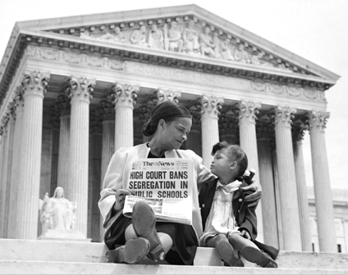
Brown v. Board of Education (1954)
According to the law, until 1954 white and black children had to attend separate schools
At that time most people were in favor of segregated schools
The US Supreme Court decided that separate schools were unequal by nature and therefore unconstitutional
Notes:
[click to advance and review BODY text]
Segregated schools broke the constitutional guarantee of equal protection of all citizens under the law.
Because the Judiciary did not rely on the desires of voters in their decision, the law was overturned and now all of you are free to socialize with your friends, no matter what color their skin is.

Slide 28
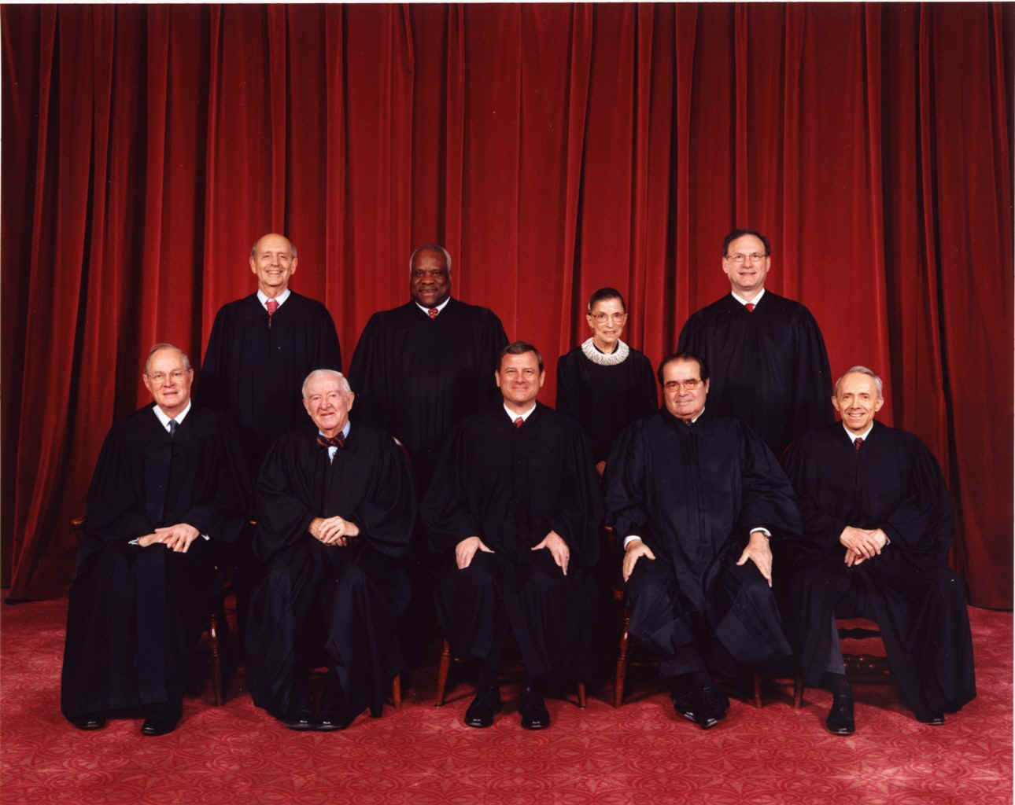
Judges are unlike other government officials
They have unique duties and rules to follow
Notes:
As mentioned before, Judicial independence does not mean judges can do whatever they want

Slide 29
Role of Judges:
Do not write the laws or express their personal preferences
  (Just as umpires don’t write the rule books)
Apply the laws, even if the public does not like the laws
  If a law is not good, it’s the legislature’s job to fix it
Notes:
[If audience is restless only read through the slide and the bold note below]
These principles (the rule of law, separation of powers, checks and balances, judicial independence) became embedded in the various state constitutions as well as in the US Constitution. Thus, the basic roles of the courts, whether federal or state, are the same. [Click to Advance text]
The court interprets the laws but does not write them. The only laws that the courts make are the rules for the operation of the court.
Courts do not write the laws, or decide cases in accord with their personal preferences. Courts perform the judicial function only when presented with a real dispute between litigants. Courts do not try to correct problems on their own initiative and do not decide hypothetical disputes.
Many members of the public have a misperception about these points. Judges actually are called upon to make decisions that go against their personal views if that is what the law requires. This concept is counterintuitive since many court opponents argue that judges are simply deciding cases based upon their own personal views. While judges, like all folks, are not perfect, the overwhelming majority take this charge very seriously. The courage to make the right decision based upon the law and the Constitutions, even in the presence of partisan interest and public clamor, is, perhaps, the most respected shared value among judicial colleagues. [Advance]

Slide 30
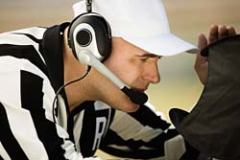
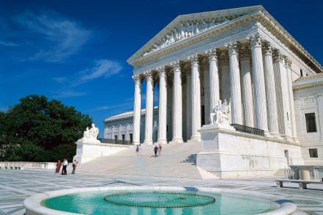
What To Do If You Disagree With a Judge’s Decision or Behavior?
You have the right to appeal your case to a higher court if you are unhappy with the ruling.
  (This can be compared to instant replay in a baseball game)
Judges can be disciplined if they do not do their jobs in the proper way.
Notes:
Judge’s are subject to disciple for wrongdoing, just as students are.
[Advance]
If dissatisfied, a litigant in a civil case or a defendant in a criminal case can have the case reviewed by a higher court.
This is like instant replay, the reviewer must see clear and convincing reason to reverse the prior judgement.
[Advance]
Judges are subject to discipline for misconduct through a process guided by the Commission on Judicial Performance.

Slide 31

  Why is the Rule of Law So Important?
Notes:
I hope you all understand why the Rule of Law and an impartial judiciary are important, without it our court could look like this…
[click to play movie, then ask questions on the following slide to engage students]

Slide 32
  Why is the Rule of Law So Important?
How would you feel if a judge gave a ruling without listening to you?
Has anyone ever made a decision about you without listening to your side?
  How did you feel and what did you want to do about it?
Notes:
32
[Try to engage the students in dialogue by asking these questions]
The rule of law and impartial judges are important foundations of our government. Without the protections of jury trials under the rule of law, and an impartial judges, government officials could have the authority to decide in this way. Society would break down into chaos
I want to leave you with this message… [click to advance to next slide]

Slide 33
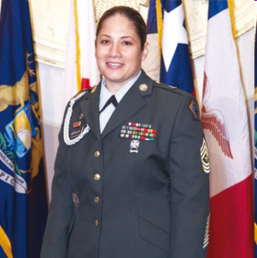
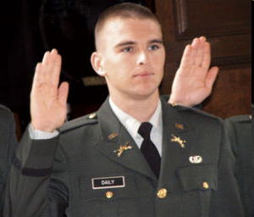


Legal Equality
An impartial court allows all individuals equal and fair treatment under the law
Notes:
Ladies and Gentlemen,
All of you know that the United States is involved in a wars overseas. Although there is tremendous disagreement over the merits of the wars themselves, I think we can all agree that we have hundreds of thousands of brave American men and women who have sacrificed a year or more of their lives and who every day risk being killed or severely injured in service to their country.
The very least that we can do here in America is to ensure that when these soldiers come home, and we hope that every single one does come home safely, that they will return to a country that still has an impartial and independent judiciary protecting the freedoms of all Americans; that, while they were gone, we fought to prevent private interests groups from taking over, from co-opting, from destroying our justice system; that, when they return, they will have a country and government here worth saving.

Slide 34
What if you hit a home run, and
it counts as a home run?

Slide 35
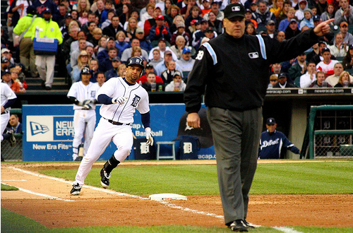
What if umpires could make up
their own rules during a game?
Umpire: Homerun!

Slide 36
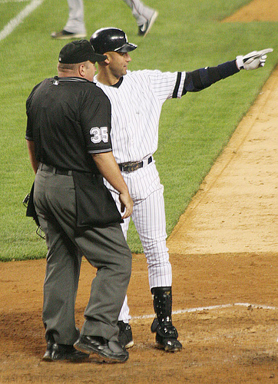
Batter: How cool, that’s actually fair.

Slide 37
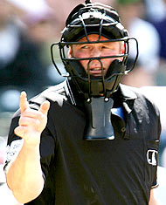
Umpire: Well duh. Look I’m not trying to be cool, I’m following the rules and being impartial.
Notes:
Now this game actually works with established rules and impartial judges, er I mean umpires.

Slide 38
Video credits:
Fairplay.org
Justiceatstake.org
Youthforhumanrights.org
Adapted with permission
from the works of
Superior Court of California
County of Sacramento
Communications & Community Outreach
2009

