Slide 1
Who was Fred Korematsu?
Wartime and the Bill of Rights
Journey to Topaz
Literacy and the Law
Notes:
Who was Fred Korematsu…..anyone know? We are going to find out! But first, let’s watch this short video…..

Slide 2
Film of Pearl Harbor Bombing
Notes:
Show a portion of the video clip of the 1941 bombing of Pearl Harbor, very close to the California coast….ask students to Pair/Share: How they would feel as an American – what emotions come to mind? (Anger, fear, etc.) Comments – emotions? If you lived in Hawaii, on the west coast, or any part of the United States. Threatened? If you were a Japanese American, how would you feel? Share out with entire group some of the comments.

Slide 3
Notes:
Over 2400 Americans were killed in the attack on Pearl Harbor. The U.S. joined WWII. There was great fear in the United States. The government feared that people who were of Japanese ancestry, even though American citizens, would help Japan with another attack on the US.

Slide 4
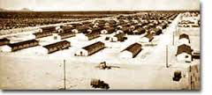
Notes:
Two months later, President Franklin Roosevelt gave the military Executive Order 9066 to force 120,000 Japanese Americans out of their homes and into internment/prison camps. Just like Yuki’s family, Issei, Japanese who were not born here, and Nissei, Americans of Japanese ancestry who were born here were forced to leave their homes and go to prison camps. There were no charges, or trials, and no evidence that Japanese Americans had done anything wrong. . Racism was rampant, primary source, (“Ouster of all Japs….”)
Photo of the internment camp. Before the interment camp was ready, many lived in horse stalls.
Background note: Japanese Americans had already been subject to discrimination ~ many had become very economically successful in agriculture, they “looked different” than the Caucasians, and were looked upon as a threat and competition in business.

Slide 5
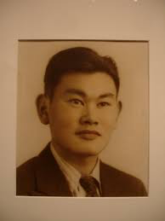
Fred Korematsu
Refused to go to the camps
Notes:
Fred Korematsu was 22 years old, and wanted to continue living as a regular American citizen. He refused to go to the internment camp. He was arrested on a street corner in San Leandro, California and taken to jail. He was found guilty of disobeying the law, and sent to Topaz, Utah, to live in one of the 10 internment camps. He continued to fight his conviction by taking his case to court, claiming that the interment of Japanese was agains the Constitution, Unconstitutional. In this unit we will be working with the Korematsu case. How is the U.S. government is set up ~ just how is war declared? How can U.S. citizens be put in internment camps? The story goes back to over 250 years ago!

Slide 6
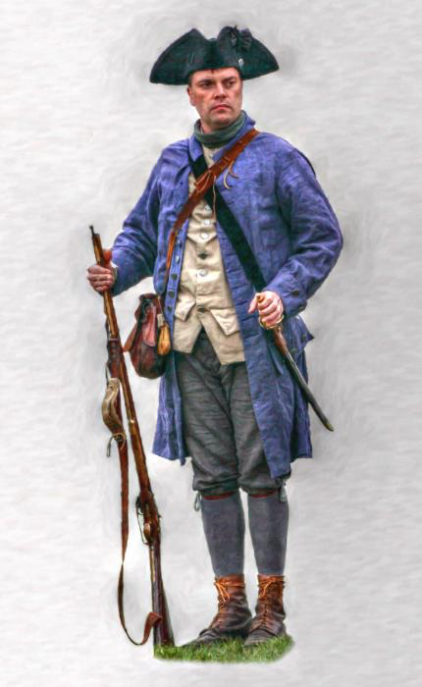
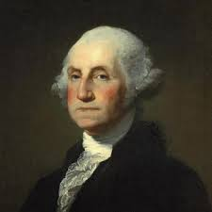
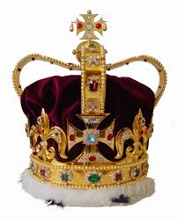
Let’s go back to the beginning….
Patriots
Notes:
The story review (provided with this lesson) can be read to the students – or presented through storytelling – using a crown for King George, a colonists hat for colonists (Party City), and a wig for the founders. as you tell specific parts of the story makes it fun – (I used a long roll of cotton from the drugstore, rolled up the ends and glued it with rubber cement to make an inexpensive wig to represent the “writers” of the Constitution). I also used a sign (written on a paper plate) “No taxation without representation” and students “chimed in” when that part came up a few times. The story reviews the creation of the Constitution and the Bill of Rights. The purpose of this review is to bring the Constitution, and the Bill of Rights into this unit so that students can argue about the internment in a later lesson, based on the 5th amendment of the Bill of Rights

Slide 7
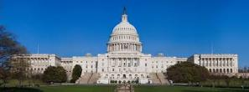
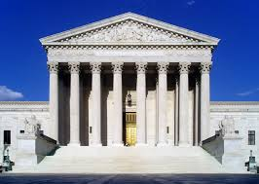
3 Branches of Government
Legislative | Executive | Judicial
Makes the laws | Enforces the laws | Evaluates the laws
Congress: Senate House of Representatives | President Vice President Cabinet | Federal Courts State Courts
Notes:
The U.S. Constitution set up our government. Let’s review the 3 branches of government. We will relate this to the Korematsu case in this unit. What are the three branches? You can click the power point and the three will come up after students have the opportunity to name the three. Ask them if they know the role or job of each branch of government? You can review the branches and roles after the next click! The people remembered King George, and they did not want too much power to go to the government. The three branches are to keep a balance, and a check on one another.

Slide 8
Federal and California Court Systems Compared
United States
California
Courts of Last Resort
U.S. Supreme Court | California State Supreme Court
Appellate Courts
U.S. Court of Appeal | State Courts of Appeal
Trial Courts
U.S. District Courts | Superior Courts of California
Notes:
There are State Courts and there are Federal Courts. Please note the line down the middle separating two court systems. Why would we have two court systems?
Note: We have a federal court system dealing with cases that having to do with the US Constitution, and we have a state court system that handles cases under the rules of the California Constitution (see next two slides)

Slide 9
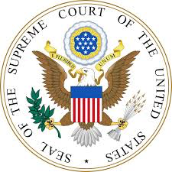
Federal court cases include:
Cases about federal law
Cases about the U.S. Constitution
Disagreements between citizens of different states
Notes:
Example of a federal court case: Someone takes drugs across the border to another state or country. The first amendment is violated (this is in our US Constitution).

Slide 10
State court cases include:
Cases about a state law or rule
Cases about the state constitution
Disagreements between citizens of the state
Cases about family issues
Notes:
Example of a state court case – divorce, argument about money (civil case), murder case (criminal), traffic violations. You may want to consider having your students play a game through icivics.com which gives them practice and understanding of which court case Icivics: Court Quest gives students the chance to see which cases should go to which court. This game can be played in a lab individually, or as a whole group with the teacher projecting the game on the screen in the classroom.
Closure: To which court did Fred Korematsu take his case? Pair/Share:
We will address this in our next lesson, and find out more about the details about the case.

Slide 11
Fifth Amendment
In part, the fifth amendment says the government cannot restrict someone’s “life, liberty, or property” unless it follows “due process of law.” An exception is made in cases involving militia, or in time of war or public danger.
Notes:
Discuss this section of the fifth amendment, as it is the section that applies to the Korematsu Case. Students complete a handout where they analyze the words from this primary document, and put them in their own words. Due process of law is critical! Remind students that they may use their vocabulary sheet. The handout also provides an area for a graphic, or small drawing to remind them of the meaning.

Slide 12
The Korematsu Case
Which court, federal or state?
Which amendment from the Bill of Rights of the Constitution is in question in this case? Explain.
What was Executive Order 9066? Opinion of use.
How do “constitutional war powers of Congress and the president” apply in this case?
What is “espionage” and “sabotage”? Apply to this case.
Notes:
Pass out handout from the Korematsu Institute – this references Executive Order 9066, espionage and sabotage, the 5th amendment and constitutional war powers of the president. The case went to the Federal Court, because Fred Korematsu did not follow an Executive Order given by the President – the Executive Branch of the Federal Government. Students are given time to investigate these questions and collect information. A handout can be used from part of the materials offered from the The Fred T. Korematsu Institute for Civil Rights and Education (available online), pages 34-38 are helpful for this research (download from Korematsu Institute (free). However, other research can be done online at some of the resource websites listed. Much whole group and small group conversation should take place following the reading as students complete notes for this handout for the first four questions.

Slide 13
Continue the Investigation
In what ways could the executive order be in violation of the Fifth Amendment? Explain.
In what ways does the Fifth Amendment support the executive order? Explain.
Notes:
1) Discuss the meaning of “constitutional war powers of Congress and the president” – and ask students to discuss in groups which happened in this case. Share out.
Ask students to pair share, “In your opinion, given what the 5th amendment states, in what ways does the executive order violate this amendment? Share out (In part, the fifth amendment says the government cannot restrict someone’s “life, liberty, or property” unless it follows “due process of law.” )
Pair share again: In what ways does the fifth amendment support the order? Share out (” An exception is made in cases involving militia, or in time of war or public danger.)
Students have the handout in front of them with the section of the 5th amendment in which we are dealing.

Slide 14
So… what is the argument in this case?
What would Korematsu’s lawyers argue based on the Fifth Amendment?
What would the government lawyers argue based on the Fifth Amendment?
Notes:
In order to understand the history of each side, students used “scratch” paper, drew a line down the middle and brainstormed the reasoning that had occurred on both sides.
Some examples of arguments in support of the legality and need for Executive Order 9066: 5th Amendment: Exception in “time of war”, “military necessity”, “public danger”, claim of espionage and sabotage, government claimed there had been acts of espionage …some even argued public danger to the Japanese due to the fear and hysteria. Other facts not dealing with the amendment: Public pressure, General DeWitt’s insistence
Some examples of arguments against the need for Executive Order 9066: 5th amendment: the right of “life, liberty, and property”, due process not observed. Others found arguments in the 4th amendment, illegal search and seizure, right to a trial by jury. Korematsu was never questioned regarding his loyalty to the US. Claim that this is an over reaction and has to do with racial prejudice. Korematsu was an American citizen, born on American soil.

Slide 15
Let’s Write an Argument
Paragraph 1: Hook, thesis statement, background information, list of all arguments to be presented, transition sentence.
Paragraph 2: States first argument in more detail. Recognize the counter claim, and be sure to give evidence (especially as related to the law), transition to next paragraph.
Paragraph 3 and 4: follow the above…the third argument, which is the strongest
Notes:
Give students the Graphic Organizer for the case, Korematsu v U.S. Government. Have them work on one section at a time, depending on the experience and writing abilities of your class. You may want to pull a small group and have them develop an argument together.

Slide 16
Argument
Paragraph 5: Build Momentum and Energy
Topic Sentence, reminder of thesis!
Help reader to see why he/she should care
Push to make the reader want to take action to support your thesis
Close with an inspirational message
Notes:
Reminder of

Slide 17
Argument
Paragraph 5: Topic, convince reader why he/she should care…Push reader to action for support of thesis!
Others will be swayed by your argument when you have a closing inspirational message!
Note: Use effective linking words: for instance, in order to, in addition, specifically, this is important because, this shows that, this proves that, this has shown me that, this made me realize, in contrast, especially, another, for example, also, more, but, and, because
Notes:
Note to teacher: Argumentative writing is difficult, and will most likely take lots of time, some small group instruction, and accommodations for several students. ( See teacher’s edition for samples on arguments for both sides)

Slide 18
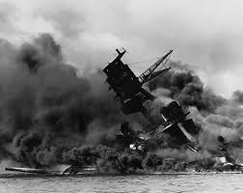
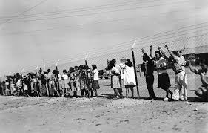
Historical Arguments
Remember! This is 1944, before the case was actually heard before the United States Supreme Court….
Notes:
Students are assigned which side to write the argument, or if time allows, you may have them write the arguments in two separate briefs, following the CCSS for argumentative writing. A discussion took place where all students acknowledge the error in judgment made at this time in history. When writing on the side of the government in the case Korematsu v the US, students must research the facts, the part of the 5th amendment that allowed for the executive order, and the history of the time. It is understood that this argument does not reflect the true opinion of the author – but is for the purposes of showing the history of the case and the ability to “play” the government in the upcoming mock trial.

Slide 19
What Happened in the Fred Korematsu Case?

Slide 20
U.S. Landmark Decision Korematsu v U.S. Government
Internment of the Japanese:
Not caused by racism
Was justified by the Army’s claims of espionage, sabotage and Japanese American’s being prone to disloyalty
Military necessity
Notes:
As most students know, in 1944, the court found in favor of the U.S. Government and against Korematsu and the internment of the Japanese.

Slide 21
Justice Robert Jackson
One of 3 who disagreed:
LACK OF EVIDENCE!!!
“….the court for all time has validated the principle of racial discrimination…”
Notes:
Point out that Justice Robert Jackson dissented (was opposed or against the court’s findings) along with two others, and discuss his quote about racial discrimination.

Slide 22
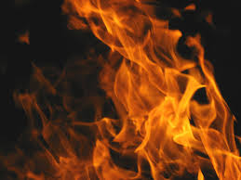
Re-opening of Korematsu’s Supreme Court Case in 1980!
1980: President Jimmy Carter:
These camps occurred because of “…race, prejudice, war hysteria, and a failure of political leadership.”
Government misconduct!
Notes:
In 1980 Jimmy Carter appointed a commission who reviewed the facts and circumstances and concluded the following: (above slide)
The FBI had sent reports created at that time that denied that Japanese Americans had committed any wrong doing. The reports were never presented to the US Supreme Court – and in one case set afire! This was government misconduct.

Slide 23
Back to Court! Conviction Overturned
“…being an American citizen was not enough…you have to look like one, otherwise they say you can’t tell a difference between a loyal and a disloyal American…this decision was wrong…
…I would like to see the government admit that they were wrong and do something about it so this will never happen again to any American citizen of any race, creed, or color…” Fred Korematsu
Notes:
When there is misconduct, a case can be reopened. Judge Marilyn Patel formally overturned Korematsu’s conviction. Fred Korematsu became active in a civil rights group and helped to get the legislature to pass a bill that would give $20,000 for each surviving Japanese American that was put in an internment camp.

Slide 24
Presidential Medal of Freedom
Notes:
In 1988 Fred Korematsu was awarded the Presidential Medal of Freedom, the nation’s highest civilian honor, from President Bill Clinton.

Slide 28
Review: Where did we begin this story?
King George
Colonists
Constitution
Bill of Rights
Republic
Notes:
Three students reenact the very beginning – beginning with King George …..telling the colonists that they must house soldiers, pay taxes to Great Britain, and follow their rules! Let students improvise, use hats, colonist holds up sign, No Taxation Without Representation, founders write the constitution, and include the Bill of Rights. They must use all vocabulary – “republic”, where the people govern by electing their own representatives…and insist on following the Bill of Rights and the Constitution

Slide 29
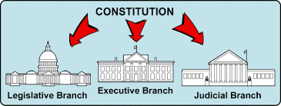
How does our government system keep things in check?
Notes:
Legislative makes the laws(senate and house of rep) , the Executive carries out the laws (President, VP, Cabinet), and the Judicial (evaluates the laws)

Slide 30
Structure of the Courts

Slide 31
Lady Justice
Notes:
How does Lady Justice depict or stand for the impartiality of the courts?
She came from the Roman goddess of Justice, the moral (or correct way to behave) in judicial systems. Scales: the strength (or weight) of evidence and support for each argument,
Blindfold: blind justice for all – justice should be fair, regardless of someone’s money or power, or ethnicity.
Sword: the sword represents punishment. It is always held down to show that evidence in court is always held before punishment.

