Slide 1
Persuasive Opinion Writing
Letter to the Editor

Slide 2
Personal Opinion
I love this cake!
This is your personal
opinion – no one can
disagree with you!

Slide 3
Persuasive Opinion
When you want everyone else to agree with you, you might say, “This is the best cake in the entire world!”
You are trying to get others to
believe it too!
Notes:
Others could say, “No way! That’s not true!”

Slide 4
Persuasive Opinion Writing
* State your thesis with an introduction
including your viewpoint.
* State three main reasons that would
convince someone you are right.
* Provide three reasons supported by facts and details in three separate paragraphs.
* Use linking words (for instance, in order to, in addition)
* Provide a conclusion relating to the reasons
Notes:
For more assistance with persuasive writing. use resources from Lucy Calkins, Boxes and Bullets, Personal and Persuasive Essays, Read Write Think (NCTE online).
Go through each step together to create a persuasive opinion regarding the cake (see TE for ideas). I suggest doing this together using the cake theme (TE on lesson plan), depending upon your students prior experience with persuasive writing at this point.

Slide 5
Don’t forget transitions!
Linking words:
for instance, in order to, in addition, specifically, this is important because, this shows that, this proves that, this has shown me that, this made me realize……
Notes:
Linking words pull together your editorial ~ have we used them? Let’s check!

Slide 6
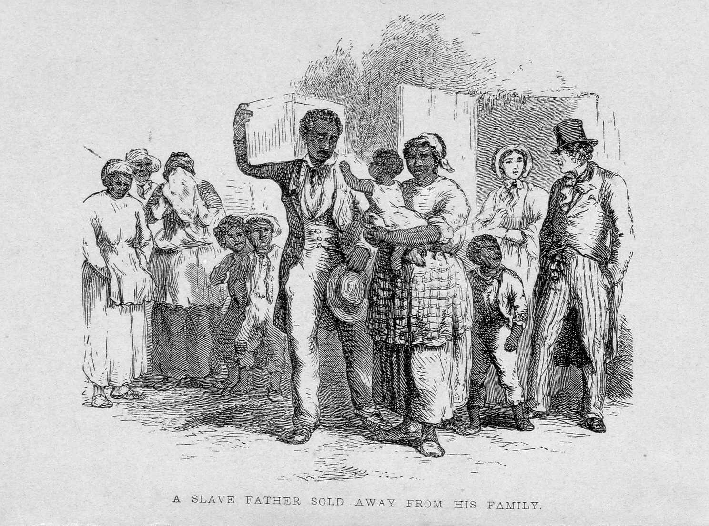
Write a Letter to the Editor
Persuade the community that the Rule of Law must be followed and that an injustice of kidnapping has taken place!
Notes:
This primary source, A Slave Father Sold Away From His Family, is a primary source taken from the Library of Congress. Unfortunately this was often what happened. Families were split apart and individuals were sold to different owners. This was legal in slave states.
In the case of Thomas’ family, and in California, would this be legal? Why not? (The Compromise of 1850 made California a free state, Thomas’ family did not escape from another slave state, so the Fugitive Slave Law does not apply to them) Again, these new federal laws are in the U.S. Constitution, and all states must follow the U.S. Constitution. The Constitution is the Rule of Law that all states and citizens must abide.

Slide 7
Will Cut Eye Higgins Get Away with Kidnapping?
You must provide strong persuasive essays to prove the charge!
Notes:
We cannot have vigilante justice ~ we have the Rule of Law!

Slide 8
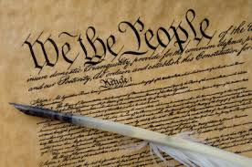
Your opinions are important!
Make them count by “backing them up” with facts and details.

