Slide 1
Beyond the Great Horn Spoon
What Happened Next?
Notes:
Lesson 1
Slide 1:
Cover slide, Beyond the Great Horn Spoon…What Happened Next?
Let students know that in this unit, By the Great Horn Spoon, we will be studying more about what was happening at the time of the Gold Rush in California. They will all need to learn to become different characters in some short dramas. Actors need to understand “character” as an element of theatre, so that they are understood, sometimes even when they don’t even say anything!

Slide 2
We Can Be Real
Characters!
To “become” a character,
you must be believable.
Physical Movements,Gestures, Expressions
What is my????
Occupation, mood, personality,
physical appearance
Notes:
Lesson 1
Slide 2:
Hook: Ask the students what an “occupation” is. Chart responses: doctor, waitress, construction worker, secretary, teacher, etc…
Ask students to think (not wild guesses!) exactly what occupation your occupation is as you role-play the following: Raking Leaves (Gardener)
(With a smiling face, quick movements, “spotting” more leaves and rushing to rake them up as well)
Tell students that you just played a “character” as an actor. After thinking about what they watched, tell them you would like them to think about your occupation (not the job or action you are doing). (gardener) Ask them to think about your mood, a quality of your personality (conscientious, hard working), your physical appearance and/or health….all based on your movements, gestures and expressions.
Chart the responses of the students, and delve for more!
Explain that students will be learning about how to “become” a character, and to do that, they need to understand the character in order to make him or her believable. Actors use physical movements and gestures to develop a character in a specific way. Look at all you learned about the character I just played!
Practice: ( 5 minutes) In pairs, A and B. “A” begins and acts out (through movement only), their occupation. Without it becoming a “guessing game”, the one watching must be able to 1) state the occupation, 2) mood, 3) quality of the personality, and 4) physical appearance and/or health. Now “B takes a turn.

Slide 3
Dialogue
Good dialogue must “belong” to the character:
What character says
How character says it!
Clarity - Speak clearly
Projection - Voice can be heard, no shouting
Interaction - Communication between actors
Notes:
Lesson 1
Slide 3:
5 minutes) Ask if they know what “Dialogue” means (the words the actors speak). Just as movement tells a lot about the character in the story, dialogue does the same and also advances the plot of the story - moves the story along! Good dialogue must “belong” to the character, both in what they say and how they say it. The words of the character tell the story, or the plot. In addition, Character is developed by strong dialogue, with good interaction between actors, and also voices that speak clearly (clarity) and loud enough to be heard without yelling, and changing the tone of the dialogue. In theatre this is referred to as “projecting”.
To be successful, actors must warm up their voices.
Students stand, take a few deep breaths, and then are asked to warm-up their voices by repeating the vowels with you. This is to be exaggerated; facial muscles are stretched and articulation is very clear. “A E I O U “ Ask them to repeat the vowels slowly again but with a softer voice, a whisper voice, and finally a voice loud enough that someone in the back of the room could hear them (not shouting, but “projecting”.
The entire group continues, using the word “terrific” with a happy voice, sad voice, mad voice, sarcastic (smart alecky) voice. Reiterate: the way the character uses the dialogue really gives meaning ~ along with the movements

Slide 4
Character Dialogue
A: “I came to California to find gold.” (excited, young)
B: “I came to California to find gold.” (tired, old)
Notes:
Lesson 1
Slide 4:
Students get in pairs again, A and B. “A” says the first statement in character, and “B” responds to the first character.
Students trade off, each time using the dialogue with the emotion required. If students can add the movements and gestures at the same time, that is terrific!

Slide 5
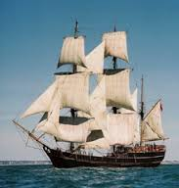
Character Dialogue
A: “On our way here the sea was really rough and lots of people got sick.” (young, had been seasick)
B: Repeat above, as an older boy who thinks it is funny!
Notes:
Lesson 1
Slide 5:
Student interaction in pairs

Slide 6
Character Dialogue
A: “I found one small gold nugget just yesterday.” (any age, discouraged)
B: Same dialogue, (any age, encouraged and excited)
Notes:
Lesson 1
Slide 6:
After finishing the last partner dialogue:
Closure: Call up a couple of the pairs and have them show one of their “dialogues”. Using the rubric as a guide for valuing the work, the class can describe what they observed the pair demonstrate in terms of movement, gestures, expression, speech (clarity), projection and interaction. Students analyze how the pair has made their character believable.

Slide 7
All That Gold…
What Happened?
Notes:
Lesson 2:
Slide 7: Have a discussion with students. You can ask them to start by describing what happened and how it made them feel. You can probe if necessary, with the following questions:
Did you have trouble getting as much gold as you wanted?
Did you feel that others were getting more than you?
How did that make you feel?
Why do you think this happened?
What if someone from another classroom happened to walk by, and then started to grab gold? How would you feel?
Play the podcast (15 minutes)
Do you see any connections to the problems discussed by the children, Praiseworthy and Mrs. Clapp, and what just happened here in our classroom as we scrambled for gold? (people get anxious when they are anxious to get a limited amount of something; some “take over” and don’t give others a chance. When there aren’t any rules, people can act pretty wild!)

Slide 8
Effects of the Gold Rush on Daily Life
Analyze reading: What is the theme or overall issue?
Who, What, When, Where, Why ?????????
Find additional details and facts.
Notes:
Lesson 2
Slide 8:
Teacher: You heard Praiseworthy tell the children that they were going to need to learn more about the details of the issues affecting daily life if any problems were going to be solved. In order to be informed, will need to do some research on your own, (or in pairs).
After the research you will “become” these children: Sarah, Jack, Thomas, and Constance, and in groups, you will face a “challenge” given to you. The challenge begins by reading and collecting research individually about your assigned issue. So individually, (or in pairs) I am asking you to read the handout I have given you. Please take notes on the details on the graphic organizer you will also be given. Do your best thinking, and search through the resources I have given you to find the details and facts!
After you have read by yourself and again, with the group, I will give you your “challenge”!

Slide 9
Group 1: Travel
Group 2: The Life of a ’49er and Mining
Group 3: Women of the West
Group 4: Immigrants, Migrants and Native Americans
Group 5: Law and Order
Notes:
Lesson 2
Slide 9
Please read the article(s) I have given you, ( either separately or in pairs), and complete the graphic organizer to the best of your ability.
Teacher: If you have access to the internet, or additional books that apply to their topic, it would be great for them to add to the information offered in their handout by doing further research.

Slide 10
Theme
Who
What
Where
When
Why
Three less important details in these boxes
Notes:
Lesson 2
Slide 10:
Teacher: This is the graphic organizer to help you organize your thoughts. I suggest you read your article completely, underline key words that may help you, and circle words you do not understand.
Then read the article again and ask yourself, what is the overall idea or theme of the article. It may give more detail than the title on the article. Go through and make notes on Who is involved, What is happening, Where it is happening, When it is happening and Why you think this is an issue.
Then take some notes on three details about the above ~ they will be less important, but give more information.
Finally, give the least important detail to finish your notes.

Slide 11
Cooperative Group Roles
LEADER Makes sure every voice is heard Focuses work around the learning task Sound bites: “Let’s hear from ____next.” “Interesting, but let’s get back to our task.”
RECORDER Compiles ideas from group on graphic organizer Sound bites: “I think I heard you say ____; is that right”? “How would you like me to write this?”
TIMEKEEPER Encourages group to stay on task Announces when time is halfway through and nearly up Sound bite: We only have three minutes left. Let’s see if we can wrap up by then.”
Notes:
Lesson 2:
Slide 11 and 12: Once you have discussed each role on this slide and slide 12, in groups,
students draw from “role cards”or teacher chooses roles for group”,
Leader, Recorder, Time Keeper, Presenter, Errand Monitor
Note: Roles on next slide as well

Slide 12
PRESENTER Presents the group’s finished work to the class Sound bites: “How would you like this introduction to sound?” “How would you like to respond to questions at the end?”
ERRAND MONITOR Briefly leaves the group to get supplies or request help when the group agrees they do not have the resources to solve the problem. Sound bites: “Do you think it’s time to ask the teacher for help?” “I’ll get an extra graphic organizer from the shelf.”
Notes:
Lesson 2:
Slide 12
Slide Once you have discussed each role, in groups,
students draw from “role cards”or teacher chooses roles for group”,
Leader, Recorder, Time Keeper, Presenter, Errand Monitor

Slide 13
In what way do we want to work together?
For example:
1. Be prepared
2. Everyone Participates
3.
4.
5.
6.
Notes:
Lesson 2
Slide 13:
Group Rules (5 minutes) Students take on roles assigned as they create rules to “live by” for their group, for example:
• Be prepared
• Everyone participates
More ideas:
Give everyone a chance to speak before you speak again
• Be respectful of the roles of each member in the group
• Stay on task

Slide 14
Collaborative Practice
Opinion: In my opinion…
Clarifying: Do you mind explaining what you meant when you said________?
Paraphrasing: I understood that you said _______.
Agreeing: I agree with _____because…
Disagreeing: I see it differently than ___because…
Building On: Adding to what ___said…
Summarizing: Overall, what I’m trying to say is…
Notes:
Lesson 2
Slide 14: Collaborative Practice (5 minutes)
Review this slide with sentence starters and handout, explaining that this is the way collaborative groups speak to one another to be most productive. We will practice using these sentence starters with a discussion topic. Each member of the group picks up one of the sentence starters and adds to the discussion.

Slide 15
Practice Having a Collaborative Discussion
What is this California creature called?
What type of animal is this?
Is it dangerous?
Is it a sea or land creature?
Would you want it for your pet? Why or why not?
Notes:
Lesson 2
Slide 15: ( 10 minutes) the slide is presented showing a “California Mystery Animal”. Students use the sentence starters to have a civil discussion about the questions asked on the slide, practicing with collaborative speaking and listening.
When it is their turn, they pick up a face down “Sentence Starter Card” and add to the discussion. Only when everyone has had their turn, may the sentence starter cards be put back in the middle of the group - face up…adding more discussion and more practice with a chosen sentence starter.
Ask the group how this worked for them; what were the challenges using the sentence starters? Can they see how using the sentence starters during the group work may be helpful? Why, why not?
Students will want to know more about this “Mystery Animal”. Information is at the end of the Lesson Plan.

Slide 16
Challenges
In your roles, use sentence starters and discuss the following:
1. What was the overall theme of your article? Begin with, “In my opinion…"
2. Share answers to the other questions presented.
Notes:
Lesson 2
Slide 16: Using your new collaborative skills and roles, in your groups, discuss the article you have read:
What was the overall idea or theme of the article, and
Share your answers to the other questions the article presented. (Ask students to use the new “language” and sentence starters as often as they can).

Slide 17
Group Challenge
Create a Drama…
Beginning: Setting,
Middle: Rising Problem,
End: Story is Completed.
Each group member becomes an “actor” and plays the part of either the beginning, middle, or end.
No scripts, just know your part of the “story” and use dialogue as you play your part.
Notes:
Lesson 2:
Slide 17:(15 minutes) Challenges, continued: Students are given their group challenge. They are to create a beginning, middle and end to their challenge presentation (handout available). Those who play the beginning “freeze” when finished, middle players begin immediately and “freeze”, etc. Students are told that they are not to write out “scripts”, but after taking notes on what happens in each section of the play, decide what their parts will be and “play” the parts even if the words are not exactly the same each time (improvisation). As they work together and agree upon the content of the beginning, middle and end, and then practice, they are asked to remember to have discussions using the sentence starters and the group roles already established. (Reinforce students positively for using sentence starters and proper roles, as they discuss how to “frame” their challenge presentation, without a specific script.
*If the challenge is not clear, or children need more reinforcement regarding breaking their story challenge into three parts you can use Goldilocks and the Three Bears as an example: What happened in the beginning of the story (setting, characters and conflict established) in the middle (rising problem) , at the end (resolution). Ie: Beginning: Goldilocks is hungry and finds an open door, eats the food, breaks a chair and falls asleep on the bed (one of the group members acts this out), Middle: Bears come home and find porridge eaten, chair broken and Goldilocks in Little Bear’s bed and are very upset(three or four group members play the middle part), End: Goldilocks wakes up and runs from the house, sorry to have caused trouble, and very afraid of the bears. (Story is in the handout section of Lesson 2 unit)

Slide 18
Making vocabulary connections
A link to understanding!
Notes:
Lesson 3
Hook:
Lesson 3
Slide l8: Both in reading the book and in our activities, there have been many vocabulary words that we have never heard before! Some are words that were related to mining and the Gold Rush “times”, and others are used by us in our everyday lives. Can anyone think of a word right now that was completely “strange” to you when you first heard of it? (Give think time, students look through notes from unit).
How about the words “pay dirt”? What did this word mean during the Gold Rush?
Finding gold easily through mining, and making money
“Pay dirt” is now used in a casual way ~ “Fixing up my bike and selling it was like “pay dirt”. (I made money easily)
Practice: (20 minutes)
1) I will give each of you a word page. You will look through your notes, and think about what this word means. Keep thinking….how does this word relate to the Gold Rush, ie: the economy, population, or the environment? Write some notes relating to this vocabulary word in your notebook. Keep those thoughts!
2) Students move around and meet up with another person. They share their vocabulary word with their partner and explain what it means. The partner paraphrases or summarizes what they just heard. Then the other partner shares their word, and they switch roles.
Ring the bell, and they switch to another partner and go through the same process again.
Repeat this several times, so lots of vocabulary words are shared.

Slide 19
d
Pay Dirt + Profitable
Notes:
Lesson 3
Slide 19:
The students are directed to find a classmate whose word connects or links to theirs in some way. For example, the words might be synonyms or antonyms, one might be an example of the other, or both might be examples of some higher-order concept. The goal is for the students to identify some way to connect their word with a classmate's word. When students find a link, they stand with their partner around the perimeter of the classroom. Another example: “hardships and miners” go together because miners had many hardships as they worked to find gold.
Example on slide: Pay Dirt + Profitable
After a certain amount of time, have those who have found “links” explain their reasoning. If some are still in the middle of the room, they may find a link with what is shared by students on the perimeter, or be assisted by the group and join a group on the perimeter, or team up with another still in the middle. Each time a link is made, the students should give an explanation. Another example: “hardships and miners” go together because miners had many hardships, like aching backs, finding little gold, poor housing and food.
This can be repeated with additional words, and/or the same words many times, with different links, and a ’49er “conversation using the linked words.

Slide 20
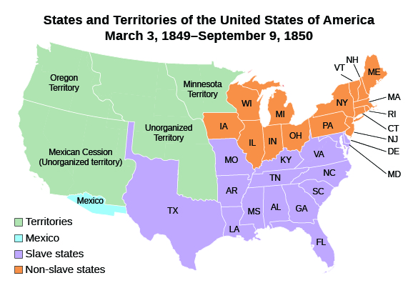
Notes:
Lesson 4: Part of the Union: What Does it Mean?
Slide 20, Review: Let’s go back in time, just before gold was discovered:
In 1847, the United States defeated (beat) Mexico in a two-year conflict known as the Mexican War. When the peace treaty was signed in early 1848, Mexico was forced to a “cession”, or to “cede” an enormous amount of territory, (meaning to give it to California). Neither the United States nor Mexico knew that gold had been discovered just days before they signed the peace treaty!
Why would the U.S. want to gain California as one of its’ states? James Polk, the U.S. President at the time believed in Manifest Destiny ~ what do you think that might mean? America should own all of North America ~ would be good for the U.S. to be larger, gain more wealth, people, and economic (money) influence around the world)
Notice that this map shows territories, states that are “slave states” and states that are “non-slave” states. What does that mean? Could this be a problem? In what way? Keep these thoughts in mind…..

Slide 21
Notes:
Lesson 4
Slide 21:
Have you ever seen this before? What is it and what does it represent? What does the Grizzly bear represent? The Red star? The red line? The white background?
One of the revolts California and Texas had against Mexico before the U.S. was involved was called the Bear Flag Revolt took place between the republics of Texas and California, against Mexico. After the Californians and Texans won the revolt, California made this their state flag.
The star: represents the Lone Star of Texas and “sovereignty” which means the right to govern yourself
Grizzly Bear: represents strength
Red Color: represents courage
White Background: purity, or “goodness”

Slide 22
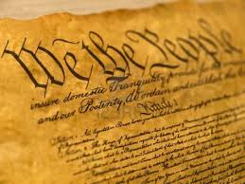
What is the
U.S. Constitution?
The Rule of Law
Notes:
Lesson 4
Slide 22
What is the US Constitution? Why is it important?
The U.S. Constitution is a written document that defines the structure and purpose of the U.S. government., It describes the powers of different states and local governments. The Constitution establishes The Rule of Law, the laws we must all follow equally as a nation and as a state.
The United States had a Constitution at this time ~ and it set the laws for the way the states would work together. Remember, California was not part of the United States at first, but was hoping to become the 31st state!

Slide 23
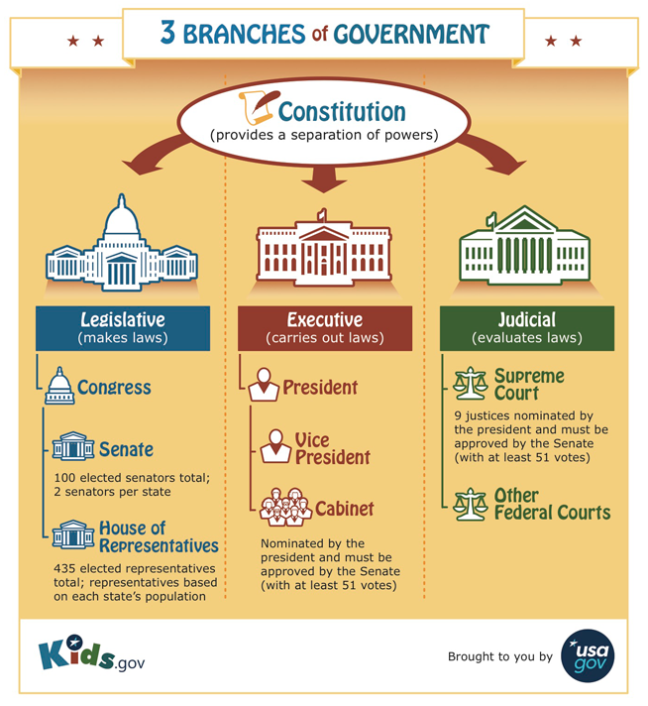
Notes:
Lesson 4
Slide 23
The Constitution for the United States was set up with three branches. The U.S. Constitution must be followed by all of the states in the United States. Review the roles of the three branches using this slide.
Does anyone know why the writers of the Constitution set up three different branches to do all of these jobs? Turn to a partner and talk this through. (They wanted to be sure that one branch could not be too powerful ~ they remembered King George from Great Britain! There was not Rule of Law, only laws that were best for King George! Each branch balances each other, and checks on each other to be sure that the Rule of Law ~ the laws written in the Constitution, are followed.)

Slide 24
California has a Constitution too!
Legislative
Executive
Judicial
State
Assembly
State Senate
Supreme Court
Governor
Court of Appeal
Superior
Courts
Makes Laws
Carries Out Laws
Explains the Meaning of Laws
Notes:
Lesson 4
Slide 24
In September of 1849 Californians were tired of waiting for the federal government or the United States, to make them part of the nation. They wrote their own State Constitution, just like all of the other states in the United States had done. The State Constitution makes laws for the state to follow that are not covered by the U.S. Constitution. State laws in the state Constitution set up the rule of law . However, if they became a state of the United States, in union with the other states of the federal government, California must also follow the U.S. Constitution. Example of a state law: Driving laws (personal injury), criminal law happening in California , family laws. Example of a federal or U.S. law: Civil rights laws: protecting against racial discrimination, for example. The U.S. Constitution also has laws about crimes that take place between one state and another, for example: If someone smuggles drugs from one state to another.
The structure is very similar in the state Constitution and United States Constitution. Legislators: We have representatives from all areas of the state who write our laws ~ many of them, so that people in all areas of the state are represented (teachers: you may want to look up your Assembly representatives for the area by your school). Senator Toni Atkins represents SD County when she goes to Sacramento to work on making laws; when you are 18 years of age, you will vote for whom you want to represent you. Use a kinesthetic movement to represent the Legislators. (Ie: writing laws)
Executive: Who is our Governor? Governor Jerry Brown. Who helps him to carry out the laws? Lieutenant Governor, the Attorney General, State Controller, State Treasurer, Insurance Commissioner, and State Superintendent of Public Instruction. (Most important that they know our Governor has help in carrying out the laws in areas of law enforcement, education, etc.) Use a kinesthetic movement to represent the Executive branch. (Ie: carrying out or enforcing laws)
Judicial: We have three different levels of courts in California who make sure the laws are legal, and decide if a law has been broken: Superior Courts. If a crime has been committed that breaks a California law, you would go to a Superior Court. If you are not happy with the outcome, you have the right to “appeal” the decision, and if so, would go to the Court of Appeal, or Appellate Court. Sometimes cases even go from the Appellate Court to the California Supreme Court. Use a kinesthetic movement to represent the Judicial Branch. (Ie: Explaining or interpreting laws in court)
All of these branches of government were organized in our California Constitution. Do you think that the people in California during the Gold Rush understood, or even knew about the Constitution, the Rule of Law and the structure of our government? Why or why not?
We are going to help them!

Slide 25
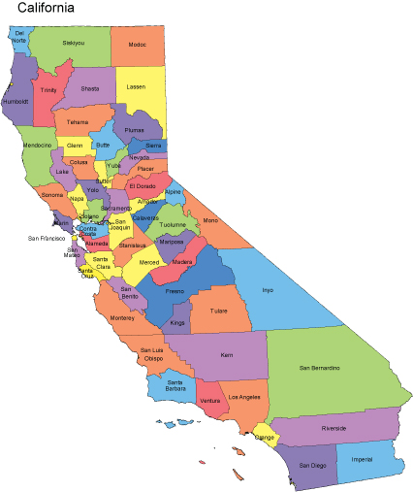
Notes:
Lesson 4
Slide 25:
The United States is made up of states. Turn to a partner for each question I ask you (and then share out).
What is our state?
California is made up of counties: What is our county?
What is another county close by?
We have cities inside our counties: What is our city or town? What is another city in our county?
We have reservations for Native Americans in our county. What is a reservation nearby?
We have school districts for each county. What is our school district?
Counties, Cities, Reservations and School Districts are all part of our governance structure. We have representatives elected from each of these areas to help represent us, “the people” … we VOTE for these people to represent us.

Slide 26
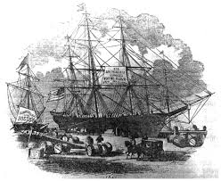
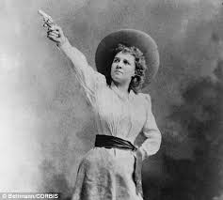
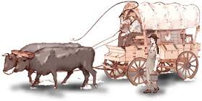
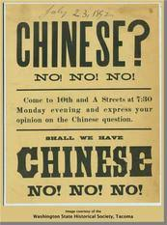
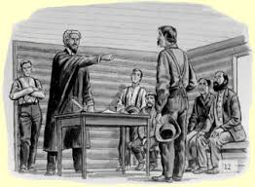
What were some of the social, economic and/or political problems related to…
Travel
Women of the West
Foreign Miners
Life of the Miners
Law and Order
Notes:
Lesson 4 (5 minutes)
Slide 26: Closure: Students are called upon from their groups to share an example of a social, political or economic problem. Ask how they felt the Legislative, Executive and or Judicial Branch might address this problem. For example: discrimination of foreign miners - legislators write laws against discrimination (social problem), executive branch enforce the laws. If there is a conflict or a charge of breaking the law, the Judicial Branch decides. Life of Miners: Create and enforce a law against being drunk in public, and enforce (legislators, executive and judicial). Women: Given the right to vote - which branch starts the action? Not discriminated against - jobs, etc.

Slide 27
We must understand our government!
Notes:
Lesson 4
Additional Class Session: 40-50 minutes
Slide 27: (Handout provided) In order for us to help solve the problems we are having here in Gold Rush Country, people need to understand that there are laws we must follow. We have laws written in the U.S. Constitution, and state laws written in the California Constitution. We have other rules we must follow in our counties and school districts, but we will begin at the Town Hall meeting by educating all of the citizens here about the U.S. or federal government, and the State, or California government.
Either in groups or individually, students will create a poster (or leaflet) for the Town Hall Meeting and to post around town,
• The purpose of the Constitutions must be described for both the U.S. and the State.
• The branches and their roles must be explained for each government.
• Visual graphics must be included to help with the explanations for each branch.
• At least one social, political or economic problem during the gold rush must be given. An explanation of how each branch is organized to address this problem is to be included.
Closure: (5 minutes)
The town hall meeting is coming up soon! Be sure you have your posters or leaflets completed (with the problem and possible solutions), and your tableaux performances perfected!

Slide 28
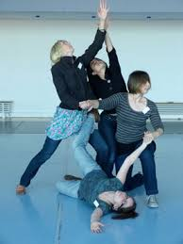
Elements of Tableau
Character: Focus, Expressions and Body Language
Shapes: Curved and Linear
Levels: Low, Medium, High
Share with the group
Develop and practice your three-scene
tableau with your group for the
Town Hall Meeting depicting the three branches of
government.
Notes:
Lesson 5
Slide 28:
Hook: To make your performances about the U.S. and California state governments more interesting at the Town Hall meeting, you will be performing using tableaux (plural) for part of your performance. Specifically, you will use a group tableau to help show the functions (purpose) of the three branches of government. Some of you will be doing a tableau of the California branches, and some will do a tableau of the U.S. branches of government.
Elements of Tableau (15 minutes)
You remember practicing character at the beginning of the unit. Stand and show me with your entire body: Happy, sad, frightened, proud, brave. Now choose a focus ~ looking in a certain direction helps to tell your story as well. Use focus as you show “anger” (some may point to one another, a textbook, the clock, teacher).
Shapes: Notice the girl on the floor - what shape has she made with the let that is “up”? Curved or linear (straight line?). How about the tallest one on the left ~ look at her outside leg, is it linear or curved? Show me a curved shape with your entire body, not a straight shape.
Levels: Different levels with tableau make it more interesting, just as different shapes do. This picture shows low, medium and high shapes. Ask students to get into a low curved shape, a medium linear shape, and a high curved shape. Have students get into groups of four and create a tableau where each person is it a different level, and different shapes are represented. Ask each group or a few to share their tableau, and have others comment: Do they have different shapes, are they showing all three levels and have they chosen a focus as a group?
Assignment (15 minutes)
Tableau can show meaning, or just be an interesting work of art. In our case, you will be showing the three branches of government with tableau. You may use narration of one sentence for each branch you are showing, but the overall tableau should let us know which branch you are demonstrating through your shape. When the class says, “Legislative”, your group makes your first tableau and might say: “Write laws.” Class will then say, Executive, and you do the same until all three branches have been demonstrated with their function. Move from one branch directly to the other without talking. It would be a good idea to look at your posters to remind yourself of the functions of each branch of government and what words you might decide to use.

Slide 29
Town Hall Meeting audience
Assignment Cards:
Hecklers: May “heckle” one time only from example on the card.
Agree’in Folks: May “agree” one time only.
Peacemakers: May shout out support one time only.
Notes:
Lesson 6 Town Hall Meeting
Slide 29: Hook: It’s almost time for the Town Hall Meeting! (5 minutes)
Before students meet to practice with their groups and then perform, let them know that as an audience, they will need to write a thinking question for each presentation. Each student will turn in their questions to the teacher, even if they do not get to ask the question. Let them know you will review “thinking” questions .
Some in the audience will receive “assignment cards”, playing roles in the group. When a presenting group changes, those with “assignment cards” pass to another student who has not already had an audience assignment. Quickly share the roles on the “assignment cards”:
Hecklers: ( one or two students, each may “heckle” one time only) Hecklers might say, “Oh, sure”…”What about…”, “You’re crazy, I ain’t gonna let ……”, etc.
Agree’in Folks: (one or two students, each may “agree” one time only) Agree’in Folks might say, “That’s right, I’m tired of people ..” “You’re darn tootin’, cain’t even drink the water…”, etc.
Peacemakers: (one or two students, each may try to make peace one time only) Peacemakers will might say, “Let um finish”, “Quiet down”, “You ain’t runnin’ this here meetin”

Slide 30
Thinking questions
Analyze!
Evaluate!
Synthesize!
Notes:
Lesson 6
Slide 30 Use High Level Thinking Questions (10 minutes)
Pass out the Thinking Question Stems Handout. In addition, let them know that they will need to write a “thinking question” for each presentation. Each student will turn in their questions to the teacher, even if they do not get to ask the question. Let them know you will review “thinking” questions .
If you have not had students use high level thinking questions before you will need to spend some time giving examples and letting them practice. After asking them to tell you what an example of each of the leveled questions are, it’s time to practice. This is a skill that takes time, and this is a good time to begin! You may use the following examples to practice if necessary:
Collect scissors, stapler, scotch tape, paperclips, stickies and other office supplies.
Tell students you will give an example of an Analysis question, such as:
How does this stapler relate to this entire group of things? It is an office supply, just as the others are.
Example of an Evaluation question, such as:
What is the most important office item? Explain why. Prioritize these items according to the ones you use the most.
Example of a Synthesis question, such as:
What solutions would you suggest for stickies that are always falling off?
Ask students to come up with a question at each of the higher levels to give as another example related to the office supplies. Turn to a partner and establish a question together.
Students are asked to create at least one question at a higher level for each presentation. They must write it down, even if they are not called upon to ask their question. Students should use different levels for the questions they write for the different group presentations. The presenting group will take three to four questions from the group.
Presenters Practice (15 minutes)
Groups gather and decide which poster they will share. They practice their presentation, deciding which part each student in the group will say. They also practice their tableau one more time! They should practice timing their presentation so that with the tableau it is not longer than five minutes. Question and answers from the group will be an additional two to three minutes with students in the group answering three to four questions depending on the time.
Presentation Time at the Town Hall Meeting (Extra Session 40 minutes) Students groups are called upon to present their understanding of the structure of the California Government. They are to share at least one of the social, economic, or political problems of the time and in what ways the branch or branches of government could help to solve the problem. They are to present their tableau of the three branches of the California Government as established by the California Constitution (all within 5 minutes). The audience will play their roles and then give their role card to another person who has not played a role yet. They are all to create questions and three or four will be called upon. All questions will be collected at the end so that the teacher can see to what level everyone has been engaged, understands questioning, etc.
Closure: Podcast C
Podcast C closes this lesson. Synopsis:
On their way home from the Town Hall Meeting, the children learn from Louise Clapp that Cut Eye Higgins has kidnapped their family friends. Praiseworthy seeks out their help to find some legal answers through studying the recent laws of the Executive Branch. The children investigate: in what ways can the Legislative, Executive Branch and Judicial Branch help to solve the problem ~ their friends are free slaves and they have been kidnapped!

Slide 31
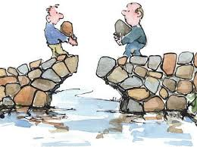
What is compromise?
Notes:
Slide 31
Lesson 7:
Hook: What does it mean to compromise? Talk to your partner. Can you think of an example of a way these individuals on this slide could compromise in a situation where they both have a problem but want this bridge to work?? Look at the picture, imagine what they would be saying. (Example, “You put your rock in first.” “I want credit for this bridge.” (“What about if we both take credit and lodge our rocks together at the same time?”)
How might they compromise, both giving up something they wanted, but figuring out a way to make the issue work for both sides?
Compromise! Find something in common or that you agree upon. Each side has to give up something, but at least there is at least one part that will work for everyone.

Slide 32
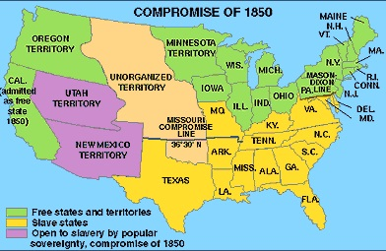
Notes:
Lesson 7 Compromise and Fugitive
Slide 32: We are going to learn about a very important compromise that took place in California that will have an important impact in the case of Thomas’s family being taken away, The Compromise of 1850. Look at this map: Turn to your partner and discuss what the difference is between the bright green states, and the yellow states, and the purple areas. Do you know what this means? (Free, Slave states.) Utah and New Mexico are not states yet, they are territories.
Why do you think the states needed to find a compromise? What was the argument? There was a big argument about whether or not the US should have slavery. The Africans were bought and sold like property. Many people in the North and the South bought slaves and used them to work on their plantations and in their homes. The southern states were very much pro slavery – or for slavery.
Against Slavery: Some people felt slavery was wrong, others, including those in California, did not want California to be a slave state for other reasons, mostly involving money. Partner Talk: Can you think of a reason miners in California would be against slavery? (Probe: Again, it involves money…) If California became a slave state people who had enough money to own slaves could use their slaves to find more gold than the other people.
For Slavery: Partner Talk: They can have free labor to work their plantations and serve them in their homes.
If more states became free states as part of the United States, there would be more free states than slave states. The pro-slavery states were afraid that slavery could be voted against and would eventually become illegal in the United States.
In addition, many people were prejudiced against Africans and did not feel that they were equal to whites or Caucasians. They felt that they had paid for them, and that they were property they had paid for and should not be taken away.
At the same time as California was about to become part of the United States and the war ended, there were about the same number of free and slave states, so this compromise (of having California as a free state and leaving the territories alone) kept the number of slave and free states equal.

Slide 33
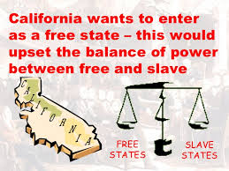
Notes:
Lesson 7
Slide 33: This is why a compromise was needed by the United States ~ the balance of power between free and slave would be upset if California entered as a free state without anything to make the slave states happy.

Slide 34
The Compromise of 1850
Who writes the laws?
The Legislative Branch
California entered the union as the 31st state, a “free state”. No one could be held as a slave!
New Mexico and Utah, which were also gained from Mexico would remain territories, and were not states.
Notes:
Lesson 7
Slide 34: The Compromise of 1850: California finally became part of the United States ~ as a free state, (no slavery), the 31st state in the new nation. The agreement for the compromise was that New Mexico and Utah would remain as territories, not states, and they could decide for themselves whether or not to have slavery. The U.S. had the same amount of free and slave states. The legislators (what is their job? To write the laws) Which legislative branch wrote this law? The U.S. (federal) or California legislature (state)? Federal. Why do you say this? This was a federal law. Which executive branch (federal or state) would have to be sure this was followed? Federal and state!
California’s executive branch would need to be cooperative as they were now part of the U.S. and their Constitution must also follow the U.S. Constitution. (remember slide 23 and 24).
This is the way the legislators “compromised”, or worked it out so that California could be brought into the United States as a free state.
With slavery against the law in California, people could not bring slaves into the state from another state and expect them to continue to be slaves. In California, and all the free states, no one could be held as a slave.

Slide 35
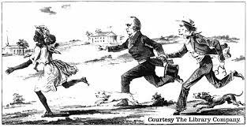
The Fugitive Slave Act
An important part of the Compromise of 1850:
If a slave escapes, he or she is considered a fugitive.
Fugitives may be seized with a warrant from the court, or seized and taken to court, even without a warrant.
African Americans accused of being fugitives could not testify in court, or have a trial by jury.
If any person rescued the fugitive, he would be fined $1,000 and put in prison for up to 6 months.
Notes:
Lesson 7
Slide 35: The Fugitive Slave Act
An important part of the Compromise of 1850 was the Fugitive Slave Act. This act was written to help the slave states from losing their slaves. Slaves were not allowed to escape to a free state ~ if they did, they were considered “fugitives”. They could be hunted down and taken back to their owners. There were people referred to as “Bloodhounds”, “Slave Speculators, or Slavers” who would search for escaped slaves and receive money when they brought them back. This became a problem because in order to make money, some would seize any African American they could find, even if they were free, and sell them at a slave market! Even if a slave was free they were not allowed to testify in court and prove this to a judge. In fact, if anyone tried to help a fugitive, they would be given a fine and put in prison.

Slide 36
Investigation: What About the Jacksons?
Gather the facts!
Analyze the Compromise of 1850 and the Fugitive Slave Act. Consider the facts about what has happened to Thomas’ family.
How can the government help you? Which branch?
What questions need to be asked?
How does the law in this case make the situation difficult/favorable?
Notes:
Lesson 7
Student Investigation (10 minutes)
Slide 36: : Teachers: Give students the handout that basically duplicates the slides about the Compromise of 1850 and the Fugitive Slave Act. Ask them to “think out loud” as they talk to a partner about the Compromise of 1850, the Fugitive Slave Act, and how the law relates to the Jacksons being seized by Cut Eye Higgins. They may use this handout to take notes. Have a whole group discussion (Reminder: The first podcast gave information about the Jackson family, and how Praiseworthy had helped them gain their freedom from slavery).

Slide 37
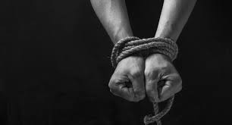
Kidnapping Penal Code
Kidnapping is a violation of the criminal law, as written in the California Constitution.
The “kidnapped” must have been moved a substantial distance, using force or fear, and without their consent.
Notes:
Lesson 7
Slide 37: Slide 37: This is a description of the California Penal Code for kidnapping. You may use it with your other handouts involving the law. The wording of this document must be analyzed and considered in this case, in order to support your arguments

Slide 38
Problem Solvers…
Are Thomas and his family free African Americans?
Which branch of government should they contact, and how would that help solve their problem?
Can the Jackson family testify in court? Why or why not?
What needs to be proven for Cut Eye to be convicted of kidnapping?
Notes:
Lesson 7
Slide 38: Some will be writing persuasive/opinion essays providing facts and evidence that Praiseworthy may be able to use in court as he argues that the Jacksons are free. The prosecution must prove that Cut Eye Higgins is a Bloodhound who kidnapped the family, knowing they were free African Americans. Those of you who write on this side, will be writing to support the Prosecution. Praiseworthy will be the state attorney for the prosecution.
Others in class will be assigned to write essays to represent the Defense of Cut Eye Higgins. You must convince the jury of all the reasons related to the law, that Cut Eye is not guilty of kidnapping. Remember, everyone has a right to a representation at a trial, even Cut Eye Higgins!
Both groups should use all of your handouts, consider the laws first, gathering facts related to the laws and information from the podcasts. Outline your persuasive/opinion essays and back them up!
Teachers: You can hand out the graphic organizer, or “process piece” (for extra assistance) for persuasive/opinion writing. Be sure students use details to back up their claims, and that details relate to the laws – the Rule of Law!

Slide 39
Representing the Defense
How can the defense protect Cut Eye Higgins?
What facts about the law can be used to keep him from being convicted of kidnapping?
Look at key words in your handouts, and see how the law might work in Cut Eye’s favor!
Notes:
Lesson 7
Slide 39: The defense must convince the jury of all the reasons related to the law, that Cut Eye is not guilty of kidnapping. Remember, everyone has a right to a representation at a trial, even Cut Eye Higgins! What might the defense argue?
(Examples: African Americans are fugitives if they escape from a slave state and go to a free state, (California), Cut Eye had a warrant, Cut Eye did not even need a warrant, as they can be taken to court, the Fugitive Slave Act says you may not “rescue” a fugitive)
These arguments by the defense will be used in the trial. How well will you be prepared to help with Praiseworthy’s prosecution?

Slide 40
Get prepared for court!
Attorneys:
1. State your thesis with an introduction and viewpoint.
2. State three main reasons that would convince someone you are right.
3. Provide a paragraph for each of the three reasons and support with facts and details, including the law.
4. Use linking words (for instance, in order to, in addition…)
5. Provide a conclusion relating to the reasons.
Notes:
Lesson 7:
Slide 40: Teachers: You can hand out the graphic organizer that is basically an outline, or the organizer that is the “process piece” (for extra assistance) for persuasive/opinion writing. Be sure students use details to back up their claims, and that details relate to the laws – the Rule of Law!
If your class needs reinforcement with writing persuasive/opinions, an extra power point is available to help with this, included a teacher edition of a written essay.. This will be helpful for differentiation and meeting individual needs. If this is the beginning of your teaching of persuasive/opinion writing, you may want to do at least part of the essay as a whole group. Or work with half the class as the Prosecution while the others get started, and then switch.
Closure for the lesson: Podcast D (which further prepares students for their writing challenge.)
Teachers: If your class needs reinforcement with writing persuasive/opinions, an extra power point is available to help, using a different subject ~ a cake! See Materials and Resources at beginning of the lesson plan, including a teacher edition of a written persuasive essay about the cake. In addition, there is a “process piece” with beginning words to help support the writing of this essay if necessary. This will be helpful for differentiation and meeting individual needs.
If this is the beginning of your teaching of persuasive/opinion writing, you may want to do at least part of the essay as a whole group. Or work with half the class as the Prosecution while the others get started, and then switch.
Writing: Extra sessions, homework, time for editing, and the writing process.

Slide 41
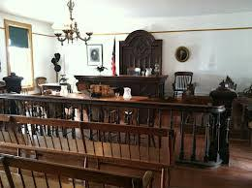
Courtroom
Notes:
Lesson 8
Slide 41:
This is a photo of an actual courtroom from the days of the days of the early development of California. Other rooms in the building were the general store which sold hardware, tools and firearms!
Imagine yourselves in this courtroom as you present your mock trial!

Slide 42
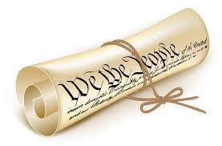
What Laws in this case must be considered?
How do the laws within the Compromise of 1850 apply in this case?
What influence does the Fugitive Slave Act have on this case?
What is the kidnapping law in the Constitution?
Notes:
Lesson 8
Slide 42: Have students share out and review: Compromise of 1850 – California is a free state, Fugitive Slave Act ~ if a fugitive slave escapes, even to a free state, he/she can be captured with a warrant, or without a warrant (if taken to the court), African Americans cannot testify in court, or have a court trial by jury; this case is about kidnapping by Cut Eye. Remember that kidnapping is taking someone forcefully, aware that they were not fugitives.

Slide 43
More to Consider regarding the rule of law
Burden of proof: What does it mean?
What is the role of the prosecution?
What is the role of the defense?
What is the role of the jury?
What is the role of the judge?
Notes:
Under the Rule of Law, even Cut Eye Higgins, whom we have known to be a scoundrel in the past, is deserving of a fair trial. The prosecution has the Burden of Proof. Cut Eye is innocent until proven guilty. He is not “guilty” until proven so, beyond a reasonable doubt by the jury. Discuss (this means each juror may have a small amount of doubt, but are almost positive that he committed the kidnapping)
What is the role of the jury? The jury is to be made up of regular citizens, and not those who would be on one side or the other without listening to facts (Impartial)
(In most court cases, the jury decides on the verdict, and the judge decides on the sentence)
Discussion: What if citizens did not show up, or refused to serve jury duty? Do citizens have a responsibility to get involved? What if it is not convenient for them?
Our government depends on its’ citizens to work together for it to be successful, just as you have worked together to make this unit successful.
Remember our civil discourse practice? Sentence starters? Roles in groups? Use all of these tools to be effective in helping to finish writing this mock trial….and later, as jurors!

Slide 44
Opening statements
In the case of the State of California v. Cut Eye Higgins, (introduce the issue)________________________________________________________
Cut- Eye should be found __________________of the crime of kidnapping the Jackson family.
First of all________________________________________________.
The second reason why Cut-Eye should be found _______________ is because______________________________________________________
An additional reason Cut-Eye is _______________is the most important. Specifically, ________________________________________.
Notes:
Lesson 8: Slide 44: The opening statements in this trial will give a summary of the facts of the case and what your position will be as one of the attorneys. Each student should write their own opening statement, with half the group assigned to prosecution, and half to the defense. This will give the teacher the opportunity to check the writing of individual students. They may then meet in the two attorney groups, prosecution and defense, and make decisions on their final opening statement as an attorney group.
The final summary may be one of your teammates, and/or a combination of some of your group’s summaries. Discuss together and have your decision made for an opening statement. Write-in your group’s very best opening statement.

Slide 45
Read Through
Small groups begin the read-through of the trial, using their own Opening Statements….
Please STOP, when you get to the part where the Judge calls a recess!
Notes:
Lesson 8: Slide 45
For this first read-through, your opening statement will be used and your group will be reading up until the judge calls a recess. A read-through means that everyone takes a turn reading and is important in becoming familiar with the drama storyline. You are not on stage yet, acting it out, you are reading through the dialogue together in partners. In this case, the read-through is important to learn and become familiar with new vocabulary. We will discuss vocabulary after the read-through.
Your scripts will show additional missing dialogue, specifically the attorney’s, opening (and closing arguments we will address later). You have written your own opening, giving a summary of the case to the jurors from the attorneys. Stop the Read-Through at the recess called by the judge as shown on the script.

Slide 46
RECESS
Exhibit A: The Warrant
Exhibit B: The Free Papers
Notes:
Lesson 8: Slide 46
Pull group back to your attention:
After learning of new information at the trial, you must spend some time analyzing Exhibit A, the Warrant, and Exhibit B, the Free Papers. Examine them both very carefully. What do you notice that may have an affect on the arguments you make, or that the defense attorney might make?
Teachers: Delving questions as needed:
Which came first, the warrant, or the Free Papers? Would this make a difference? How? Do the exhibits look official? What do you know about the exhibits? In what way would this help the defense or the prosecution? Will Exhibit A and/or B influence your closing arguments?

Slide 47
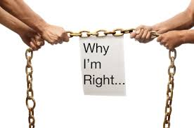
Closing arguments
Notes:
Lesson 8: Slide 47
The closing arguments in a courtroom are very much like the three details and facts you used to persuade in your essay. After reading the remainder of the trial, and filling in what you think should be in the missing dialogue sections, decide upon the best closing arguments. Use the arguments from your essays, or change what you had written for the trial ~ you have new evidence! And turn your final script to me.
Our next read-through will be using the most detailed scripts, so work carefully to consider the facts, the law, and solid persuasion based on both the evidence and law!
Teacher Note: Groups of 8 will play roles in the next read through which will include the closing statements and the trial that follows the Recess where you left off before (and include the new exhibits). Choose as many well-written versions of the trial (with student’s arguments as the number of groups you will have. Make copies for students in each group (there are 8 parts). If you already know which roles each student will play, they may bring props from home for the read-through in character, and/or you can bring small items such as neck ties (Praiseworthy or defense attorney), or jackets for woman attorney, plaid shirts, funky hats (which Judge should ask them to remove in court), etc.

Slide 48
Let’s become the characters!
What is character in theatre?
Demonstrate:
Cut Eye Higgins ~ stealing money from a person’s back pocket
Thomas’ walk as he goes off to bed following the kidnapping
Mrs. Clapp, who watches as the Jacksons are driven away in the wagon.
Praiseworthy, as he enters the courtroom.
Read through: in character, where you left off before recess.
Notes:
Slide 48: Hook: Character Exercise
I need a volunteer to come to the front and decide on a way to demonstrate the character of Cut Eye Higgins as he steals money from a person’s back pocket.
(Class discusses “character”: motivation, objective, physical movements, emotional, facial expression, dialogue (if applicable) For example, Cut Eye might laugh in an evil way after slipping the money from the pocket –or say something such as, “Ha, they will never know what happened.”
Have everyone stand – walk about the room as Thomas, who has just discovered his family is gone! (no dialogue)
Pose or freeze as Mrs. Clapp, who is watching the Jacksons being driven away in the back of the wagon.
Walk as if you are Praiseworthy, entering court as the prosecuting attorney.
Everyone sits: Have a “review” discussion about staying in character, analyzing the individual’s motivation, objective, looks, feelings, speaks, and moves. (In order to be believable)
Read Through in Character: (15 minutes)
In groups of 8, have students complete the mock trial in character where they left off before recess.

Slide 49
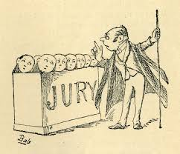
jury
What is the job of the jury?
Why is the jury important?
Why is it important to have a jury of your “peers”?
Did the Jackson’s get a jury of their peers?
“Become the jury” and make a final decision about the guilt or innocence of Cut-Eye Higgins and the charge of kidnapping.
Notes:
Lesson 8, Slide 49 Jury: Using a civil discussion, either use whole group discussion or small group on the guilt or innocence of Cut-Eye. Each point made, must be related to the Kidnapping Law, Fugitive Slave Act, Compromise of 1850, and how the details and actions of the case relate to the same.
It is assumed that Cut-Eye will be found guilty by the class! Follow the following podcast to bring closure to the unit.
Closing: (Podcast)
Pass out the podcast script for students to read along ~ and this time, Sing-a-long! After the song and laughter, the podcast closes the unit closes with a final letter from Louise Clapp. This is an important closure and reflection for the unit.
A positive outcome for African Americans was rare – this case with Praiseworthy and the children taking civic action for the Jackson family would not have likely happened at the time. Without the ability to use the judicial system, laws were broken, minorities were not represented, and justice was NOT equal for all.

Slide 50
Reflection
Let’s think about it:
Do rules protect freedoms? If so, In what ways?
Is the Rule of Law necessary for peaceful coexistence? Explain
Does democracy require the participation of the people? Explain.
Are some of the same type of problems faced at the time of the Gold Rush, still in existence today? Explain.
Notes:
Lesson 8: Slide 50
Handout available. This written reflection, when given the time, can be valuable as an assessment tool ~ and also cements learning! You may wish to have students write individually and then share with a partner.

