Slide 1
Sociology / Criminology & Justice Studies Internships

Slide 2
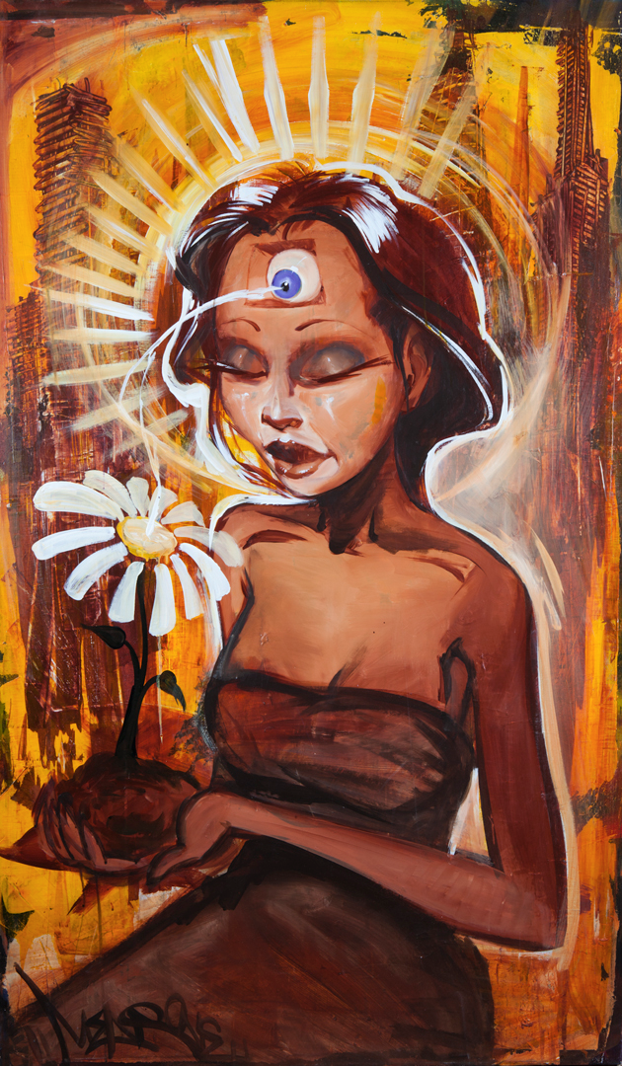
Sociology 494**
Internship that allows for a consideration of crime, law, social control and/or social justice. Requires 100 hours of supervised service in a government agency, community, or grassroots organization, and attendance in a weekly seminar. Focuses upon the analysis of internship experiences in light of criminological and justice studies theories and concepts, issues of professionalization, and methods of social change. Restricted to Criminology and Justice Studies majors of senior status. Enrollment restricted to students who have obtained consent of instructor.
Sociology 495**
Selective placement of students in work-study situations in organizations, which provide service to the local community. Includes participation in a coordinating seminar and producing a written analysis of the organization that demonstrates mastery of learning objectives for the major [requires 100 hours].
**Source: 2016-2018 Course Catalog, California State University San Marcos.

Slide 3
Students who take the internship/community service course are expected to meet the following objectives:
Students will be able to apply sociological frameworks/theory to the internship.
Students will be able to understand the profession and make important career decisions. It may help students affirm their decision to pursue this career or help students change their mind.
Students will be able to receive work experience that will help facilitate employment opportunities.

Slide 4
Soc. 325
Soc. 311, or Soc. 313, or Soc. 315
Enroll in Sociology 494 Successfully
Sociology 494: Internships in Criminology and Justice Studies
IMPORTANT: Students who wish to Enroll in Sociology 494 MUST complete the following courses before they are allowed to enroll in the course:
Sociology 325 (Criminology)
And
Sociology 311 (Inequality) or Sociology 313 (Critical Race and Ethnic Studies) or Sociology 315 (Gender in Society)

Slide 5
Soc. 320 or Soc. 325
Soc. 311, or Soc. 313, or Soc. 315
Enroll in Sociology 495 Successfully
Sociology 495: Capstone Seminar in Community Service
IMPORTANT: Students who wish to Enroll in Sociology 495 MUST complete the following courses before they are allowed to enroll in the course:
Sociology 320 (Sociological Theory) or Sociology 325 (Criminology)
And
Sociology 311 (Inequality) or Sociology 313 (Critical Race and Ethnic Studies) or Sociology 315 (Gender in Society)

Slide 6
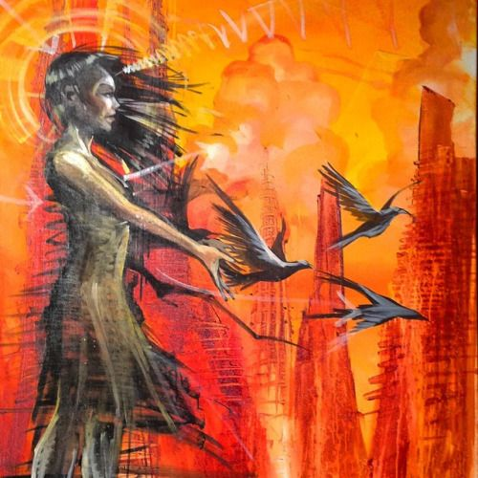
Selecting an Internship
In order to secure an internship it is mandatory that students register through the Office of Internships at CSUSM. Their website is:
https://www.csusm.edu/community/internships/students/index.html
You must select the “internship database” feature in order to search for your community service organization.
Please be advised that students are NOT supposed to do internships that involve clerical work or manual labor. We expect students to work with people within the profession, clients, and spaces within the human services tradition.
Students are encouraged to select an internship with official CSUSM partners, these spaces are listed the internship database. However, you may work with non-partners but you must fill out an exemption form to do this. Feel free to check in with the sociology internship coordinator to see if your internship site works with our major.

Slide 7
Popular Internships
Students have expressed great joy working at some of these internship/community service spaces:
Alta Vista High School
Amity Foundation
Casa de Amparo
YMCA San Marcos/Escondido/Vista
Boys and Girls Club
Campus Safety (CSUSM)
National Latina/o Research Center (NLRC)
Migrant Education
Mental Health Services
Vista Community Clinic
Brother Bennos
Office of the Public Defender-County of San Diego
MiraCosta College
Twin Oaks High School
Humane Society
Please visit the Office of Internship website to find other internship opportunities.

