Slide 1
Introductions

Slide 2
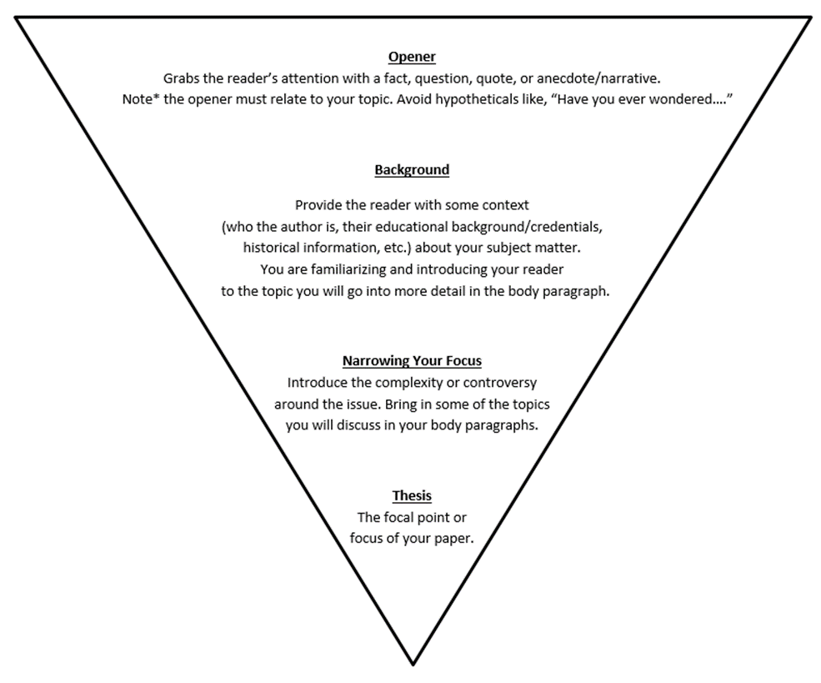
Introduction Triangle

Slide 3
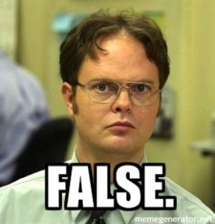
True or False
Introductions can only be one paragraph
You should write an introduction that is proportionate to the complexity of your essay. A short paper (3-5 pages) might contain an introduction from half to three-quarters of a page or about four to five sentences. A long paper (such as a 15-20+ page paper) might need several paragraphs or pages to adequately introduce the topic.
Notes:
http://blog.fractureme.com/wp-content/uploads/2014/12/dwight-schrute-false-288x300.jpg

Slide 4
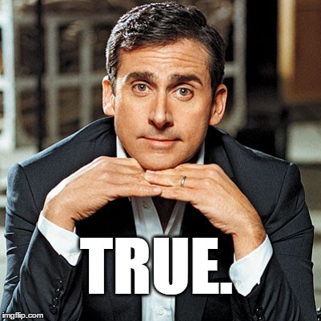
True or False
Good Introductions Need a “Hook”
Getting your reader’s attention in a variety of ways is an effective introductory tool. However, informing your readers of the direction of your paper is more important than trying to be funny or shocking. Consider approaches beyond quoting someone or asking a question to hook your audience. Use your essay’s content to interest the reader.
Notes:
http://3.bp.blogspot.com/_Y1NyJCcQ4Po/TClXNasO21I/AAAAAAAABrs/NXiDfgri4jU/s400/Steve+Carrell.jpg

Slide 5
True or False
You Should Write Your Introduction First to Steer Your Paper
You can write your introduction whenever you want! You may have to experiment to find out what works best for you; some people like writing their introductions first, while some wait until their papers are completely finished to write an intro. Try a few different approaches until you learn how you write best.

Slide 6
True or False
The Introduction Should Provide Background to Your Audience
You should consider your audience in your introduction and provide enough information for them to develop a viewpoint from which to understand your topic. Is your reader familiar with the subject of your paper? What do they already know? Are you writing for an audience outside of the field?

Slide 7
True or False
The Thesis Should Always be the Introduction’s Last Sentence
Typically, a thesis statement can be the concluding statement of the introductory paragraph—many instructors and readers will look there first. However, once you know how a thesis works, you can become more creative with how you position your main point. Some essays might not have a single thesis statement, but a controlling argument still governs the direction of the paper.

Slide 8
Introductions Usually Answer the Following Questions…
What is your topic/focus?
Why is your topic interesting, important, or necessary to discuss?
What sort of background information do your readers need to know?
Is this a controversial topic, and if so, what has already been said about it?
What is your purpose in writing this piece? Are you going to take a position? Are you going to explore a question?

Slide 9
What Should You Avoid in Introductions?
Topics or main points that you will not cover in your paper
Too many ideas that make your thesis indistinct
Excessive background that may be obvious, or general information that is irrelevant to your point
Specific points that need more explanation and should be covered in a body paragraph
Overly general statements such as:
“Since the beginning of time…”
“Media is everywhere…”
“Webster’s Dictionary defines socialism as…

Slide 10
Introduction Exercise
Instructions: Place the following chunks of sentences in the most logical order to create in introduction paragraph.
Dinosaur extinction is a historical falsehood. Dinosaurs were never actually extinct and were only said to be extinct so that the government could abuse them for their own purposes and keep the truth from the public.
Dinosaurs walked the earth before humans and were supposedly extinct at some point in history. Paleontologists have found dinosaur remains in many corners of the Earth and promoted the idea that dinosaurs are extinct. However, recent discoveries show otherwise. For the past few years, the evidence that dinosaurs are not extinct has been growing as laypeople discover live creatures that could have dinosauric origins in the Indian ocean.
Many humans believe that dinosaurs have been extinct for thousands of years, but that is a heinous lie.
These discoveries have not been widely publicized because they are highly controversial. Little known to the public, dinosaur blood is coveted for its special properties. Experts have shown that dinosaur blood has properties that could allow humans to have substantially extended lifespans.

Slide 11
How Did You Arrange Them?

Slide 12
Correct Order
Opener/Attention Getter:
3) Many humans believe that dinosaurs have been extinct for thousands of years, but that is a heinous lie.
Background Context:
2) Dinosaurs walked the earth before humans and were supposedly extinct at some point in history. Paleontologists have found dinosaur remains in many corners of the Earth and promoted the idea that dinosaurs are extinct. However, recent discoveries show otherwise. For the past few years, the evidence that dinosaurs are not extinct has been growing as laypeople discover live creatures that could have dinosauric origins in the Indian ocean.
Narrowing Your Focus:
4) These discoveries have not been widely publicized because they are highly controversial. Little known to the public, dinosaur blood is coveted for its special properties. Experts have shown that dinosaur blood has properties that could allow humans to have substantially extended lifespans.
Thesis:
1) Dinosaur extinction is a historical falsehood. Dinosaurs were never actually extinct and were only said to be extinct so that the government could abuse them for their own purposes and keep the truth from the public.

