Slide 1
Researching Your Topic

Slide 2
Start with a pre-writing strategy to brainstorm topics and get the thoughts flowing.
Notes:
Image: http://shirtoid.com/wp-content/uploads/2010/08/brainstorm.jpg

Slide 3
Broad Strokes
Research Generally
Look at Popular Arguments
Identify Main Themes
Jot Down Notes
Notes:
Research should first look at your topic in a general sense. You can look for popular elements of your topic that are widely discussed or look into the arguments that have already been made or are still in circulation today.
Before you can find specific research, you need to identify the main themes involved with your topic. Once you find those themes, you can begin forming an outline of the specific points you would like to explore in your paper or project.
Remember to take notes about the research you are doing in order to process the information you may end up using in your paper.
image: http://3.bp.blogspot.com/-AmZNmN6A9GM/TsPsf_QOI7I/AAAAAAAAAT4/V1rbyR-NIns/s1600/research.gif

Slide 4
Create a working thesis
the working thesis is based on your initial impressions of your research; however, as you continue researching, you may find your ideas changing, expanding, or becoming more focused. Don’t let your thesis limit you; you can always go back and change it!
Notes:
Image: http://www.egosumdaniel.se/blog/img-post/121117_keep-calm-and-write-your-thesis.png

Slide 5
Types of Sources
Primary: first-hand experiences, autobiographies, historical documents, surveys, interviews, observations | Secondary: commentary on research that has already been completed or an existing document or set of qualitative or quantitative data.
Notes:
Some assignments require you to use certain types of sources, so be sure to review your prompt or ask your professor about source types if the instructions are unclear.

Slide 6
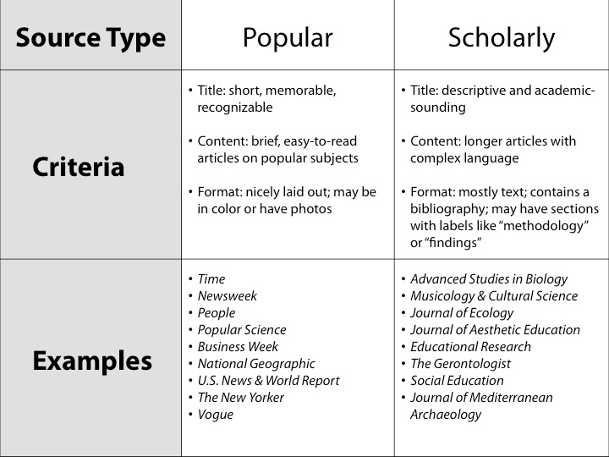
What Makes a Source Scholarly?
Credible authorship
Peer-Review
Research Journals
Notes:
http://www2.potsdam.edu/libdocs/images/RDTutorial-popscholarly.jpg

Slide 7
Using the Library
It will be your new best friend

Slide 8
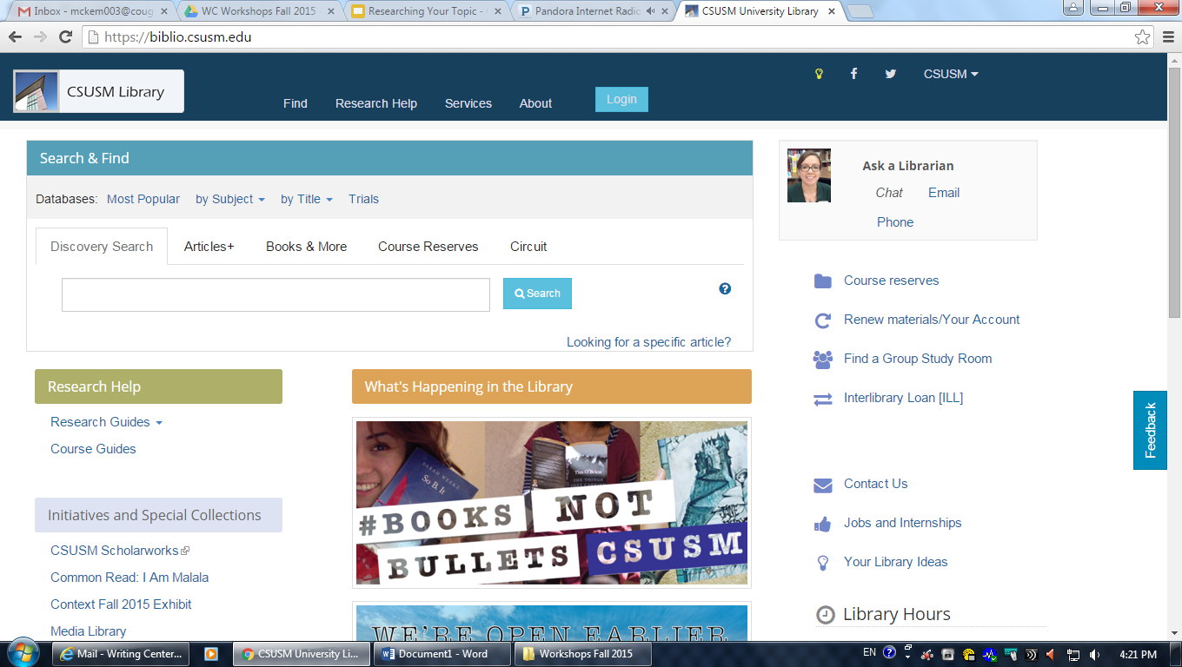
Visit the library website, where you can search the online databases that CSUSM subscribes to by popularity, subject, or title.
Notes:
Visit the library website, where you can search the online databases the CSUSM subscribes to by popularity, subject, or title.

Slide 9
Commonly Used Databases
EBSCOHost
“This scholarly collections offers information in nearly every area of academic study including: computer sciences, engineering, physics, chemistry, language and linguistics, arts & literature, medical sciences, ethnic studies, and many more” (biblio.csusm.edu).
The database contains articles from 1975 to present.
Project Muse
Project Muse contains “full-text coverage for hundreds of scholarly journals in the humanites, social sciences, and mathematics” (biblio.csusm.edu).
Muse is a more modern database with original resource publication dates as early as 1993.

Slide 10
Commonly Used Databases
JSTOR
“Contains (EXCEPT for the latest five years) core scholarly journals in sociology, history, economics, political science, mathematics, African-American & Asian studies, literature, humanities, music, and biological, health & general sciences.,” as stated by biblio.csusm.edu
JSTOR’s resources date back to 1838.
ProQuest
Use ProQuest to search through newspaper articles.
The resources date back to 1971.
Sage Publications
“Sage Journals Online includes over 460 journals in Business, Humanities, Social Sciences, and Science, Technology, and Medicine” (biblio.csusm.edu).

Slide 11
Vary the words you search
Select for only scholarly or peer-reviewed journals
Be specific in your search terms
Read through the abstract to decide if you could use the article
You may also want to take a look at the discussion and conclusion sections
Pick articles that you understand
Notes:
Post-It Note: http://regardingnannies.com/wp-content/uploads/2014/04/tips.jpg
Notebook: http://scottishtransitions.org.uk/wp-content/uploads/Research1.jpg

Slide 12
I’ve Researched--Now What?
Revise your thesis
Use quotes purposefully--use a quote because the author said it better than you ever could
Paraphrase carefully. Using synonyms is not paraphrasing; putting ideas in your own words is paraphrasing.
Include an explanation for every quote you use
When in doubt, ask for help! Your professors, friends, and Writing Center tutors are here for you!
Notes:
Image: http://i.stack.imgur.com/eQ20E.jpg

